Slide 1
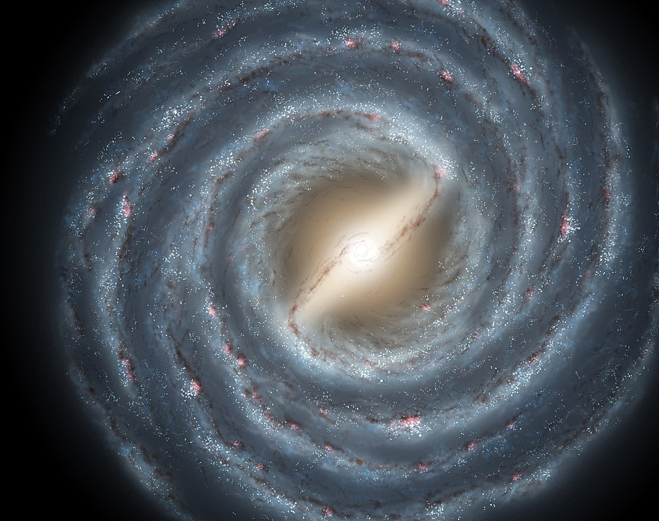

Disentangling the Components of the Milky Way
Raunaq Rai
St Edmund’s College, University of Cambridge
rsr45@cam.ac.uk
Supervised by Dr Anke Ardern-Arentsen
16/07/2025
Artist’s Impression of the Milky Way
Credit: NASA/JPL-Caltech/ESO/R. Hurt
Notes:
Hi my name is Raunaq and welcome to my presentation for the research project on Disentangling the components of the milky way.
Throughout this project I was supervised by Dr Ardern Arentsen

Slide 2
The Milky Way
The Milky Way is our host galaxy
We are situated approximately 150 000 trillion miles from its centre.
The Milky Way is unique
In the sense that we are in the position to observe its properties to high precision.
Observational tools:
Through the use of Gaia, APOGEE, Pristine…
The formation history of the milky way is an active area research
We do not fully understand the processes in which galaxies form.
However, we are able to test scenarios by observing the kinematics and composition of stars in our galaxy.
Notes:
The milky way is our ost galaxy
We are situated within its thin disk a long long way from its centre
Our position within the milky way allows us to observe its properties at high precision with observational tools
We still do not have a firm understanding into the processes which govern galaxy formation
In this project we use the kinematics and chemical composition of stars in the milky way to place constraints on its formation history

Slide 3
Project aims
Reproducibility of Zhang et al. 2024
‘On the existence of a very metal-poor disc in the Milky Way’
Addresses the debate on on whether the Milky Way’s disk extends to low metallicities.
Uses unsupervised learning to identify physical structures of the Milky Way.
Does a genuine in-situ metal-poor disc exist or spun-up debris from early mergers ?
Extend on analysis using Viswanathan et al. 2024
‘A slow spin to win - the gradual evolution of the proto-Galaxy to the old disc’
Include another dimension to analysis to further understand when the Milky Way’s disk formed.
Notes:
The primary goal of this project is to reproduce results from Zhang et al 2024
This addresses the debate on the metal poor disk
By using unsupervised learning it addressed whether a very old disk is present
Or whether rotating features could be debris from early mergers.
I will come onto what I mean by disk and what metal poor means in subsequent slides
We then expand analysis by extending Viswanathan et al. 2024
This builds on zhang et al. 2024 by including another dimension
It builds on Viswanathan by dynamically fitting a number of physical features of the milky way

Slide 4
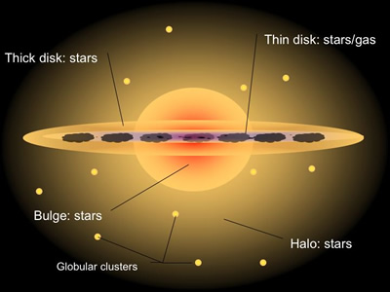
The Milky Way Components
Thin Disk
Contains majority of stars and most of the interstellar gas in the galaxy.
Ongoing star formation
Thick Disk
Like the thin disk but slightly older and thicker
Bulge
Has both old and young stars
Still a star forming environment, but stars have more random motions.
Roughly Spherical Halo
Small fraction of total stars.
Contains the oldest stars.
Contains clear signs of accreted globular clusters and dwarf galaxies.
Credit: Swinburne University of Technology
(Not to scale)
Notes:
The schematic on the right is quite a good description (although not to scale) on the main components of the milky way
The thin disk contains the majority of stars (90% or so) and contains young stars and most of the interstellar gas in the MW.
The thick disk, is a thicker version of the thin disk but is slightly older
The bulge is emphasized int his diagram and contains both old and young stars but stars have more random motions
The halo contains the oldest stars in the galaxy showing signs of accreted material such as dwarf galaxies and globular clusters

Slide 5
Metallicity – age relation
Precise ages for individual old stars are difficult to measure.
Their Chemical Composition can be used as a proxy for this.
The iron-to-hydrogen ratio [Fe/H] is typically used as a surrogate clock.
Low [Fe/H] indicates that stars must have formed before successive generations of Type II and Type Ia supernovae had substantially enriched the interstellar medium with metals. Therefore, they are older
High [Fe/H] indicates that stars have formed in an active star forming environment where supernovae have enriched the stellar medium. Therefore, they are younger.
In general, this relationship holds and is a key assumption for subsequence analysis.
Notes:
Earlier I mentioned metallicity whilst reffering to the age of stars
By using spectral information from gaia xp or apogee, we are able to infer the chemical composition of stars
Low metalliciy stars are analogous to old stars which formed when the gas which the star formed from had little metal in – meaning it had not been enriched as much by previous supernovae
Higher metallicity stars formed when the ism had been enriched by supernovae and are analogous to younger stars
In general, this relationship holds and is a key assumption for subsequent analysis

Slide 6
Milky Way formation scenarios
Early in-situ disc:
Stars formed in a gas-rich disc before z ∼4 and later migrated or were dynamically heated, preserving early chemical signatures.
Massive early mergers:
Very metal poor stars formed in a few massive, gas-rich satellites accreted at high redshift; their debris was deposited into the inner Galaxy as the disc settled.
Late, minor prograde mergers:
Low-mass satellites on aligned orbits were accreted after disc formation, depositing a cool, metal-poor component.
Notes:
[e.g.Sestito et al., 2020].
[Santistevan et al., 2021].
The first scenario involves stars that formed directly in the Milky Way, in a dense, gas-rich disc early in its history — around redshift 4, or over 12 billion years ago. Over time, these stars were either dynamically heated or migrated outward, meaning they now occupy thicker or more extended orbits. But chemically, they still carry the signature of that early star formation — typically low metallicity and high alpha enhancement. These stars are thought to make up part of the thick disc and inner halo today.
The second scenario involves very metal-poor stars that didn’t form in the Milky Way at all. Instead, they were born in a few massive, gas-rich satellite galaxies that were accreted early on — during the violent, high-redshift phase of the Milky Way’s assembly. As the disc settled, the debris from these mergers was deposited into the inner Galaxy. This process helps explain the presence of extremely metal-poor stars with distinct kinematics that don’t align with in-situ formation.
The third scenario takes place later in the Galaxy’s life, after the disc was already in place. In this case, smaller satellites on orbits aligned with the Milky Way’s rotation — what we call prograde orbits — were accreted more gently. These mergers contributed a cooler, lower-dispersion, metal-poor stellar component that blended in with the outer disc or inner halo. It’s a more subtle form of accretion, but it still leaves a detectable signature in the Galaxy’s kinematics and chemistry.

Slide 7
Data
We use the Bright red-giant-branch sample of Andrae et al. [2023].
Characterized by their high luminosity and relatively large size compared to main sequence stars. They are easily observable.
Provides metallicity measurements using an Extreme Gradient Boosting model trained on high-resolution APOGEE DR17 spectra and a supplementary set of very metal-poor stars.
This model is then applied to Gaia XP spectra.
It also includes distance and kinematic measurements allowing us to get 6-dimensional phase space information.
The dataset is supplemented with the Bailer and Jones catalogue.
Parallax measurements go negative, so we use the Bayesian photo-geometric distance values for our analysis.
Notes:
For this analysis, we use the bright red-giant-branch sample from Andrae et al. (2023).
These stars are particularly useful because they’re highly luminous and physically larger than main-sequence stars,
which makes them easier to observe across large distances in the Galaxy.
The metallicity measurements come from an Extreme Gradient Boosting model.
This model was trained on high-resolution APOGEE DR17 spectra, plus an extra set of very metal-poor stars, to ensure good performance across the full metallicity range.
Once trained, the model is applied to Gaia XP spectra to infer metallicities for our sample.
In addition to chemical information, the dataset also includes full distance and kinematic measurements, giving us access to all six dimensions of phase space - positions and velocities.
Bailer and jones is used as it deals with negative parallax using a Bayesian approach.

Slide 8
Data Cuts
Fractional-parallax-uncertainty < 0.1
Accurate velocities scale with distance precision.
Extinction ( E(B – V)_{SFD} ) < 0.5
Gaia XP spectra are susceptible to reddening, heavy extinction dims the sources. This lowers the XP signal-to-noise ratio and biases the machine-learning metallicities.
Galactic Latitude < |10|
Same reason as above
Remove stars lying within 1º of Globular Clusters and Dwarf Galaxies
We are not interested in detailed substructure that could skew results due to the density of these objects.
Notes:
To ensure the reliability of our analysis, we apply a series of quality cuts to the data.
First, we require a fractional parallax uncertainty below 0.1.
This ensures that our distance measurements are precise, which is crucial because stellar velocities are directly tied to distance accuracy.
Next, we cut on extinction, using a threshold of E(B–V) less than 0.5 based on the Schlegel et al. (SFD) dust maps.
Gaia XP spectra are sensitive to dust. In highly reddened regions, the signal-to-noise drops significantly, which can bias the machine learning model’s metallicity estimates.
We also remove stars near the Galactic plane, with a Galactic latitude cut of |b| < 10°.
This serves the same purpose: to avoid high-extinction regions where chemical measurements are less reliable.
Finally, we exclude stars lying within 1° of known globular clusters and dwarf galaxies.
These environments contain dense substructures that we’re not aiming to resolve here.
Including them could distort our view of the broader Galactic population, so we remove them to avoid contamination.

Slide 9
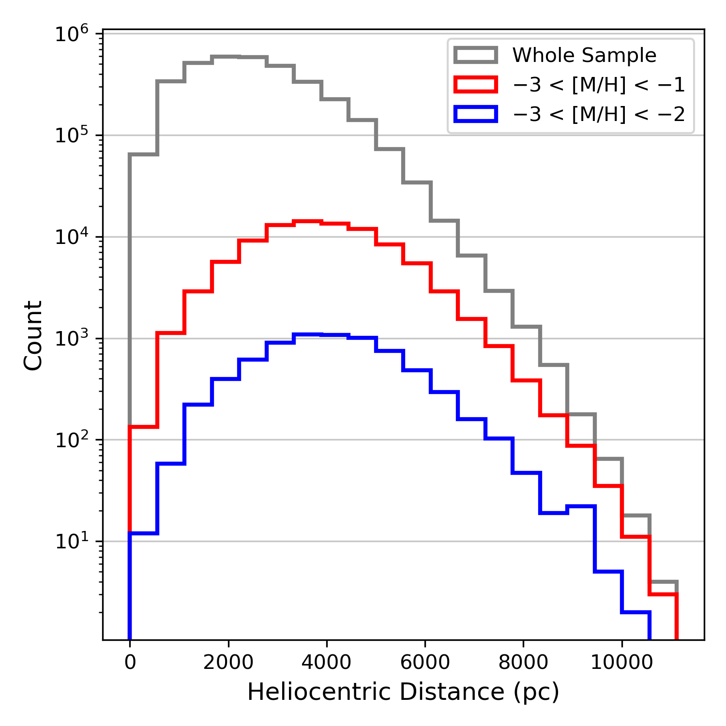
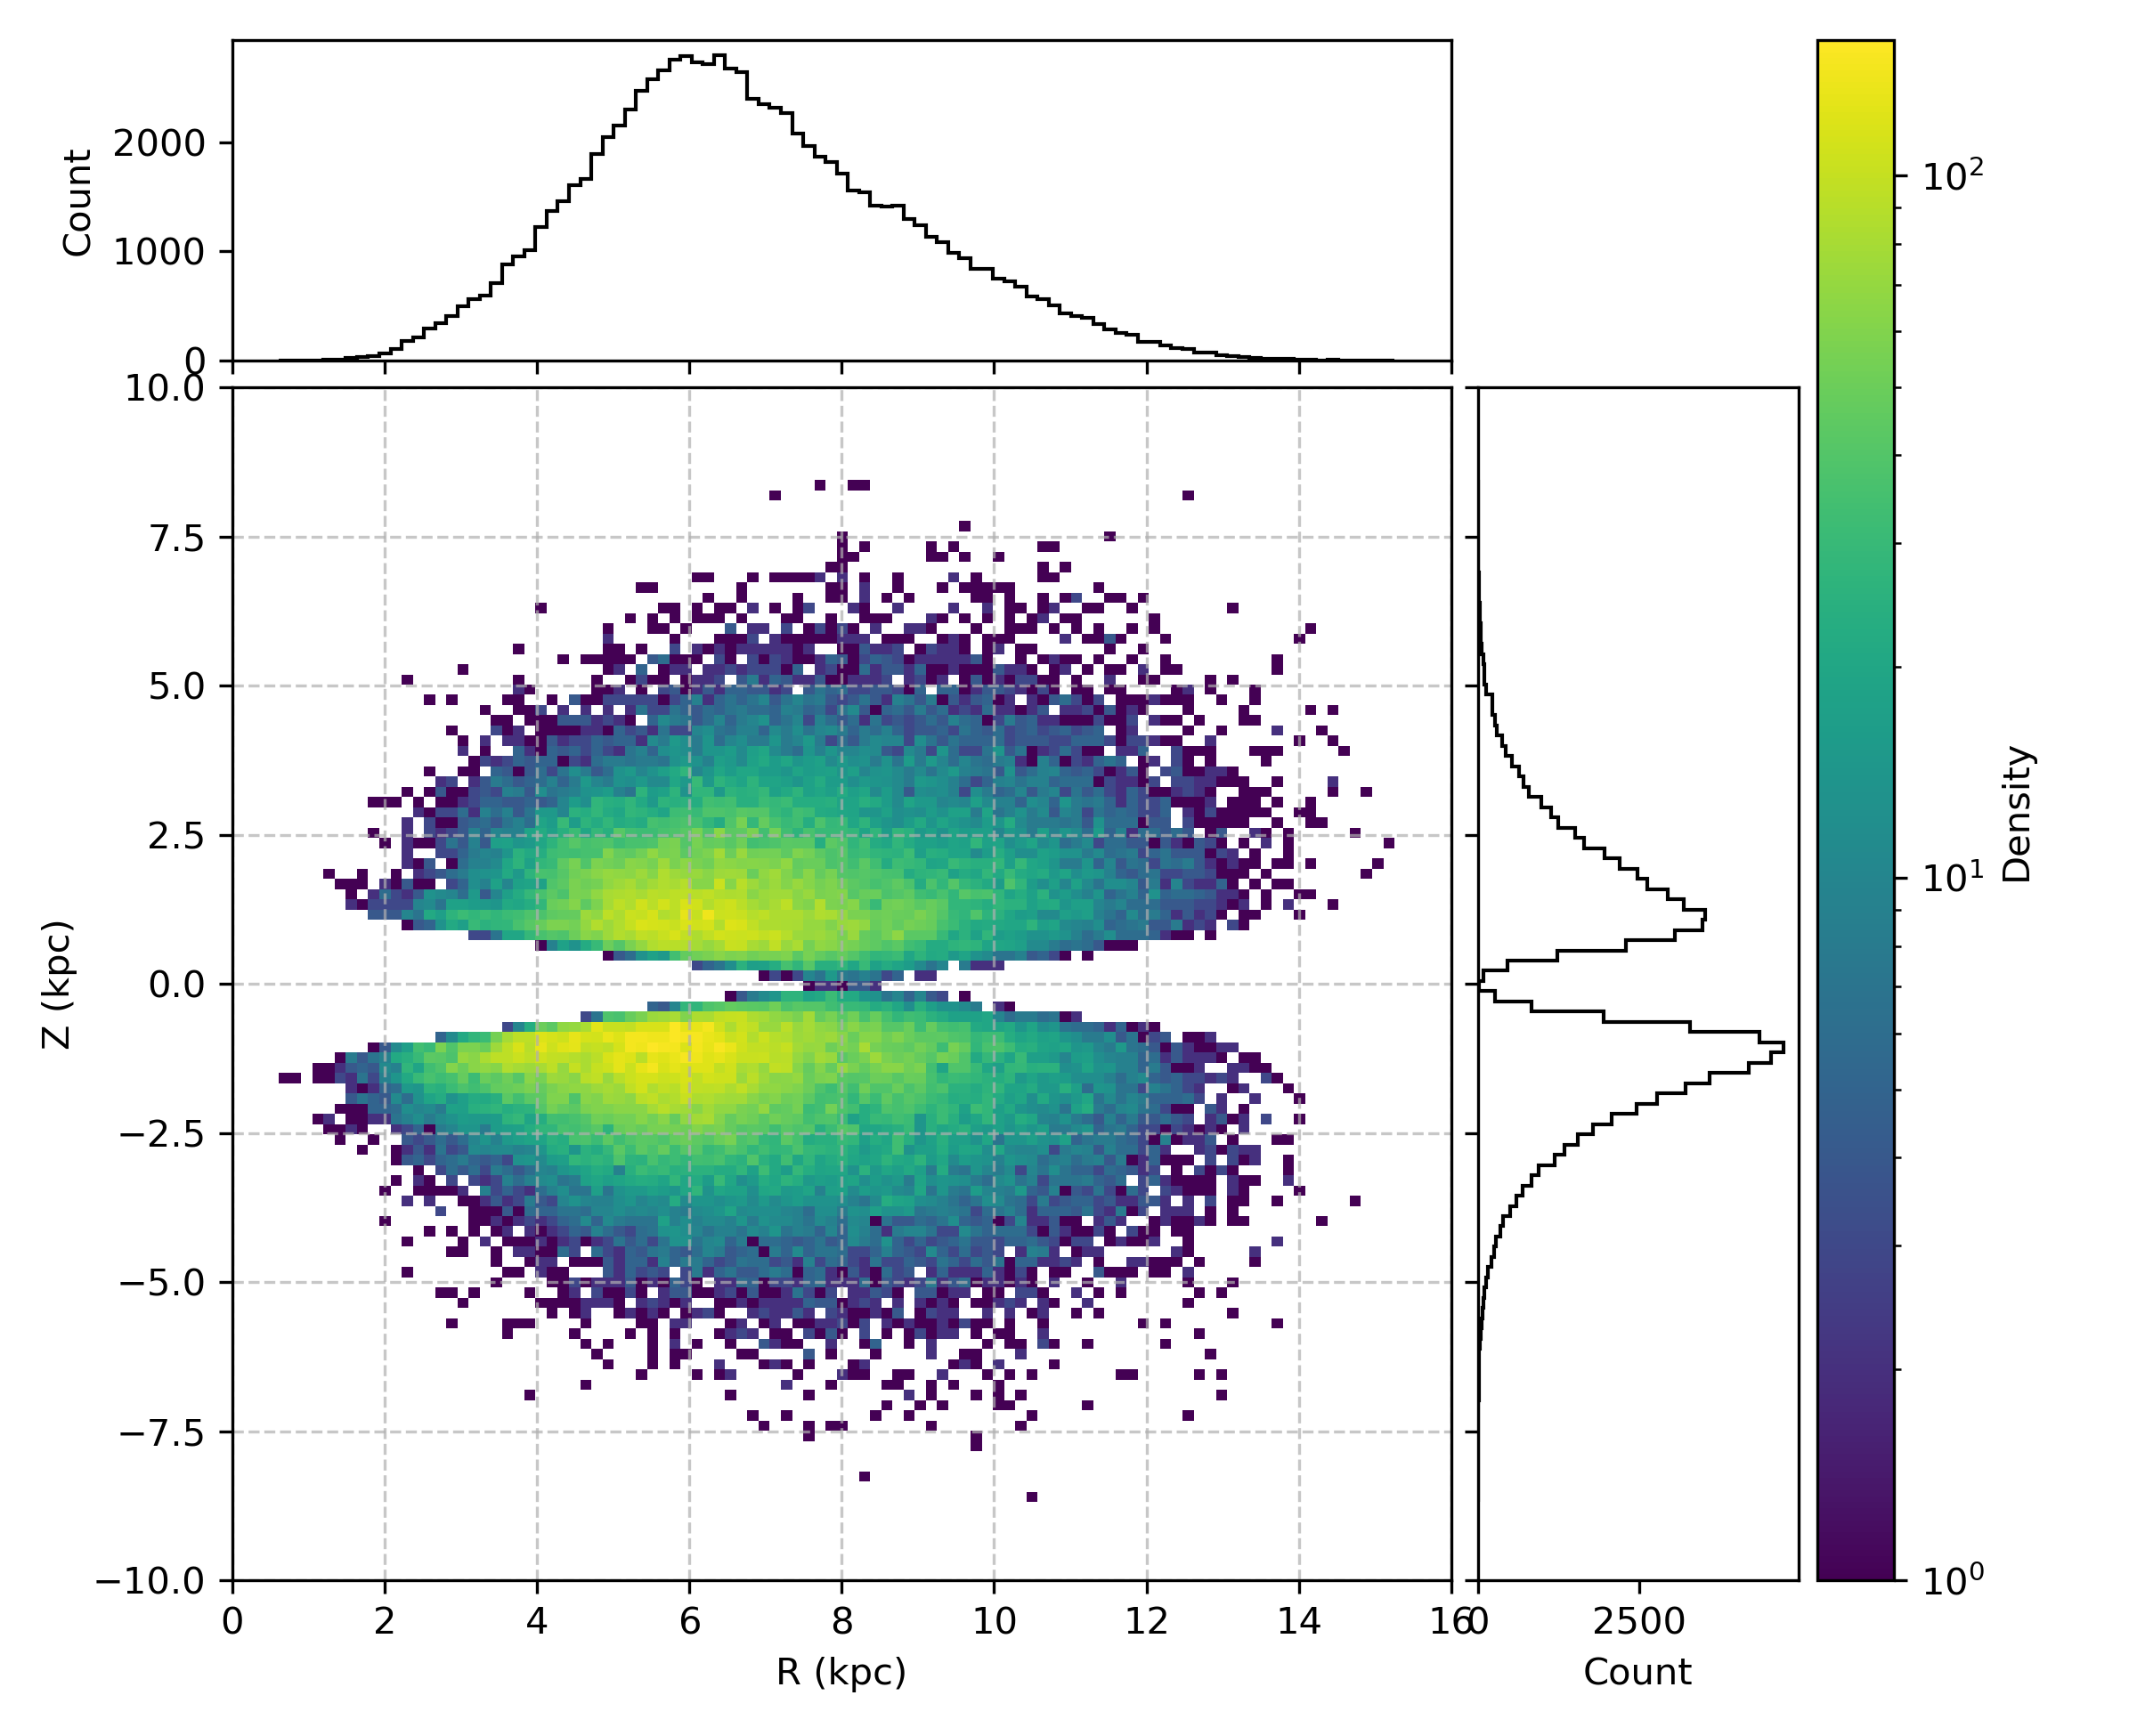
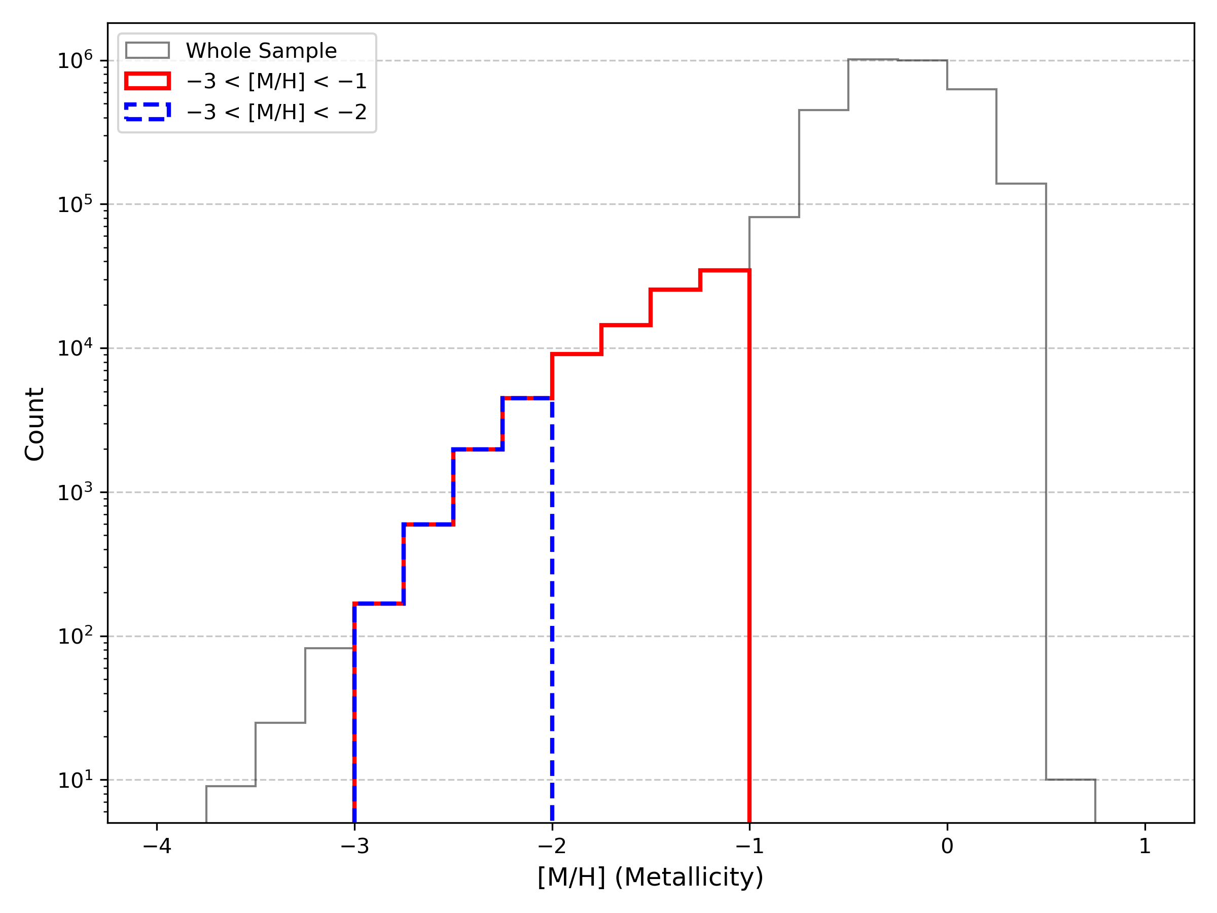
Check that our data is the same as in Zhang et al. 2024
Distance of star from us
Distribution of stars in our sample
Distribution of Metallicities
Notes:
Before proceeding with the analysis, we first verify that our sample is consistent with that used in Zhang et al. (2024).
On the left, we show the distribution of heliocentric distances.
The grey line is the full sample, while the red and blue lines correspond to the metal-poor ([M/H] < –1) and very metal-poor ([M/H] < –2) subsets, respectively.
The central panel shows the spatial distribution of stars in cylindrical Galactic coordinates — Galactocentric radius R versus vertical height Z.
As expected, most stars lie close to the disc plane
(((Overdensity at r=6 observing red giant branch (RGB) stars, which are luminous and overrepresented in older disc populations)))
Finally, on the right we plot the metallicity distribution. The full sample spans a broad range from [M/H] ~ –4.
The red and blue curves isolate the same metallicity bins used in our analysis — and we see that the cutoffs and distributions match well with the reference study.

Slide 10
Phase Space
To get 6-Dimensional phase-space coordinates in the galactocentric cylindrical frame we must make some assumptions:
Position of our sun: R₀ = 8.1 kpc and Z₀ = 25 pc
Velocity of our sun wrt. The galaxy centre: (U, V, W) = (11.1, 245, 7.25) km s−1
U = Radial
V = In the direction of Galactic rotation
W = Vertical
Utilize astropy.coordinates module
Notes:
To study stellar dynamics, we need the full six-dimensional phase space: 3 positions and 3 velocities. But to compute these in a Galactocentric cylindrical frame — that is, centered on the Milky Way — we have to make some standard assumptions
We adopt R₀ = 8.1 kiloparsecs as the Sun’s distance from the centre of the Galaxy, and Z₀ = 25 parsecs above the Galactic midplane
We use (U, V, W) = (11.1, 245, 7.25) km/s, where U is the radial velocity toward the Galactic centre, V is the azimuthal velocity in the direction of Galactic rotation, and W is the vertical motion toward the North Galactic Pole.
With these reference values, we can convert the Gaia measurements — which are in equatorial coordinates — into Galactocentric cylindrical coordinates

Slide 11
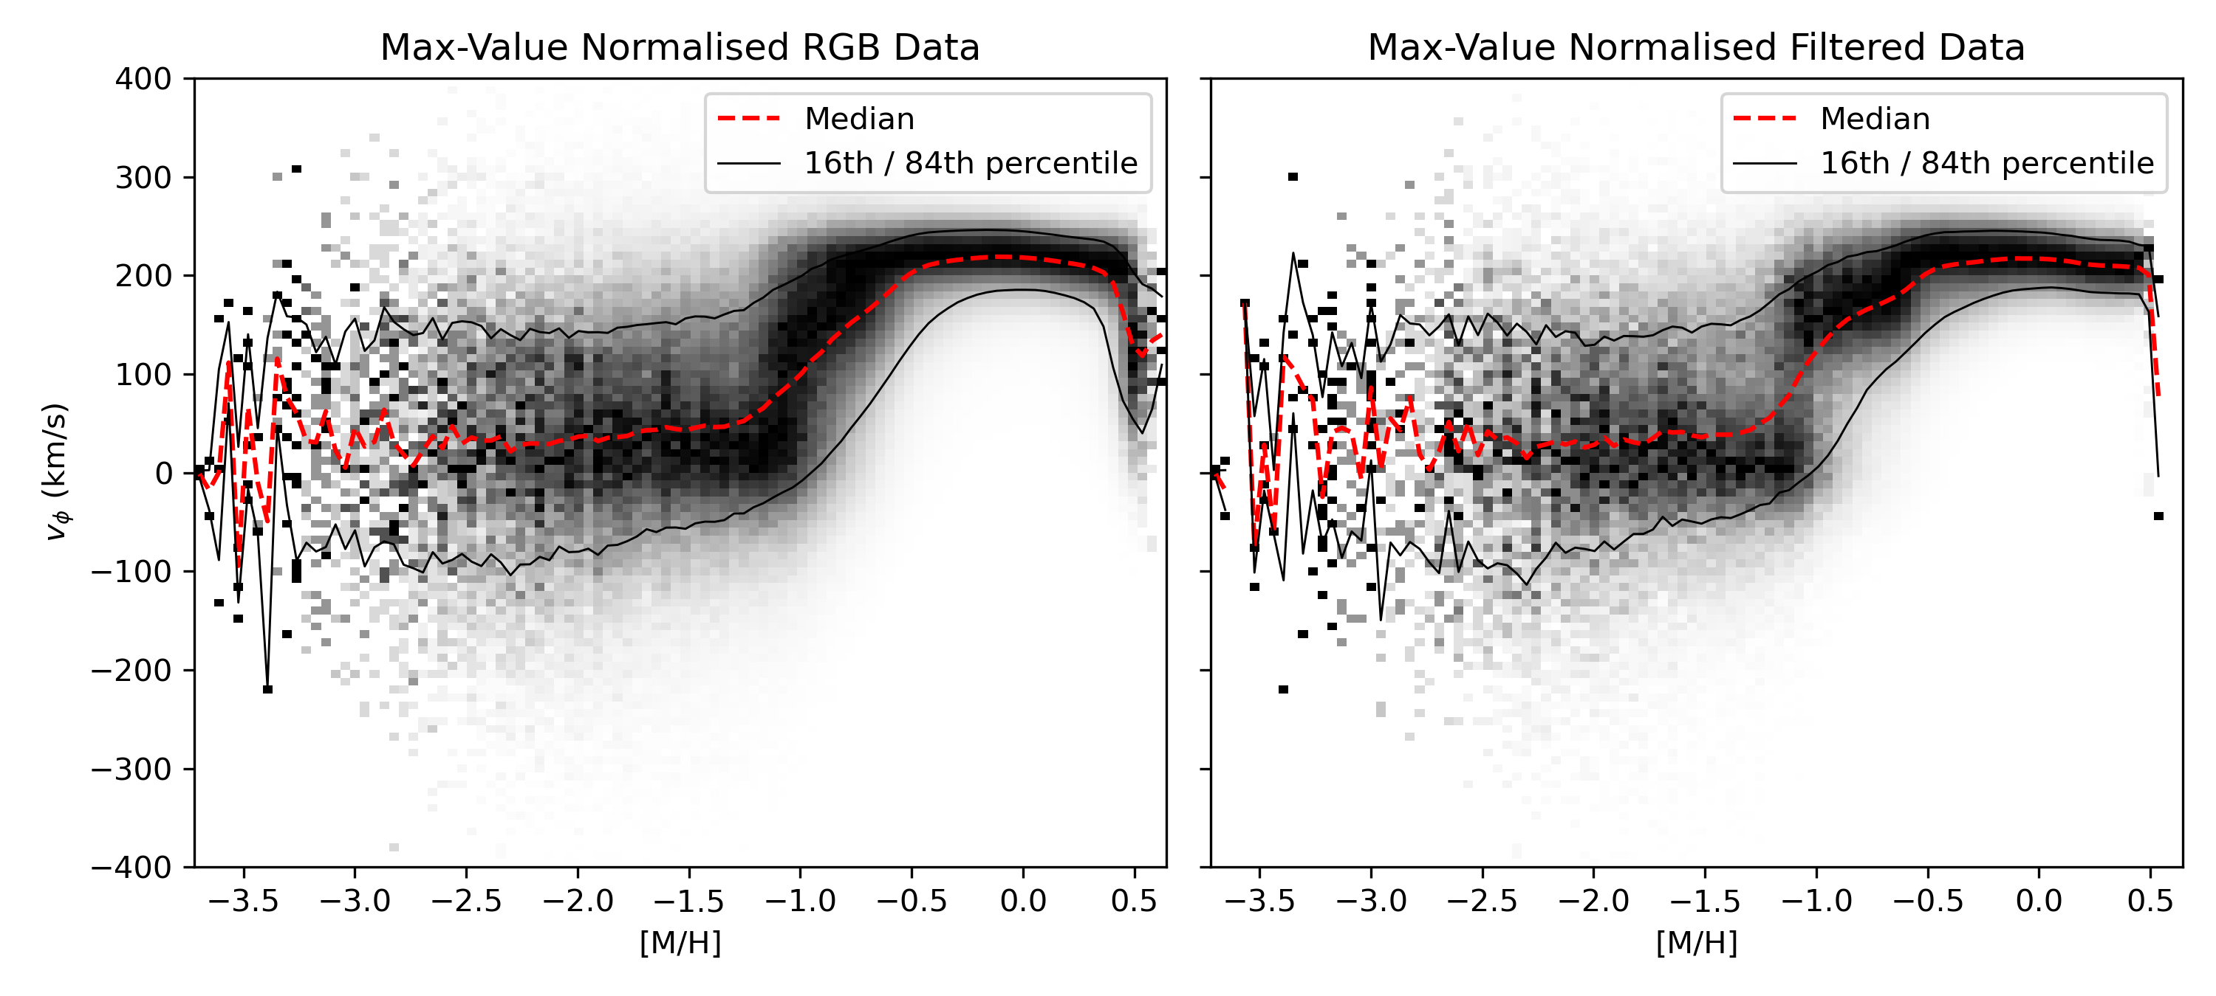
Phase Space
Notes:
Now that we’ve constructed full 6D phase-space coordinates, we can explore how kinematics change across the metallicity range.
We observe similar kinematics comparing the RGB data and the filtered data suggested that our filtered data is representative of our total sample.
The main difference is at the point of spin-up. This is because we remove many stars on the galactic plane through our cuts.

Slide 12
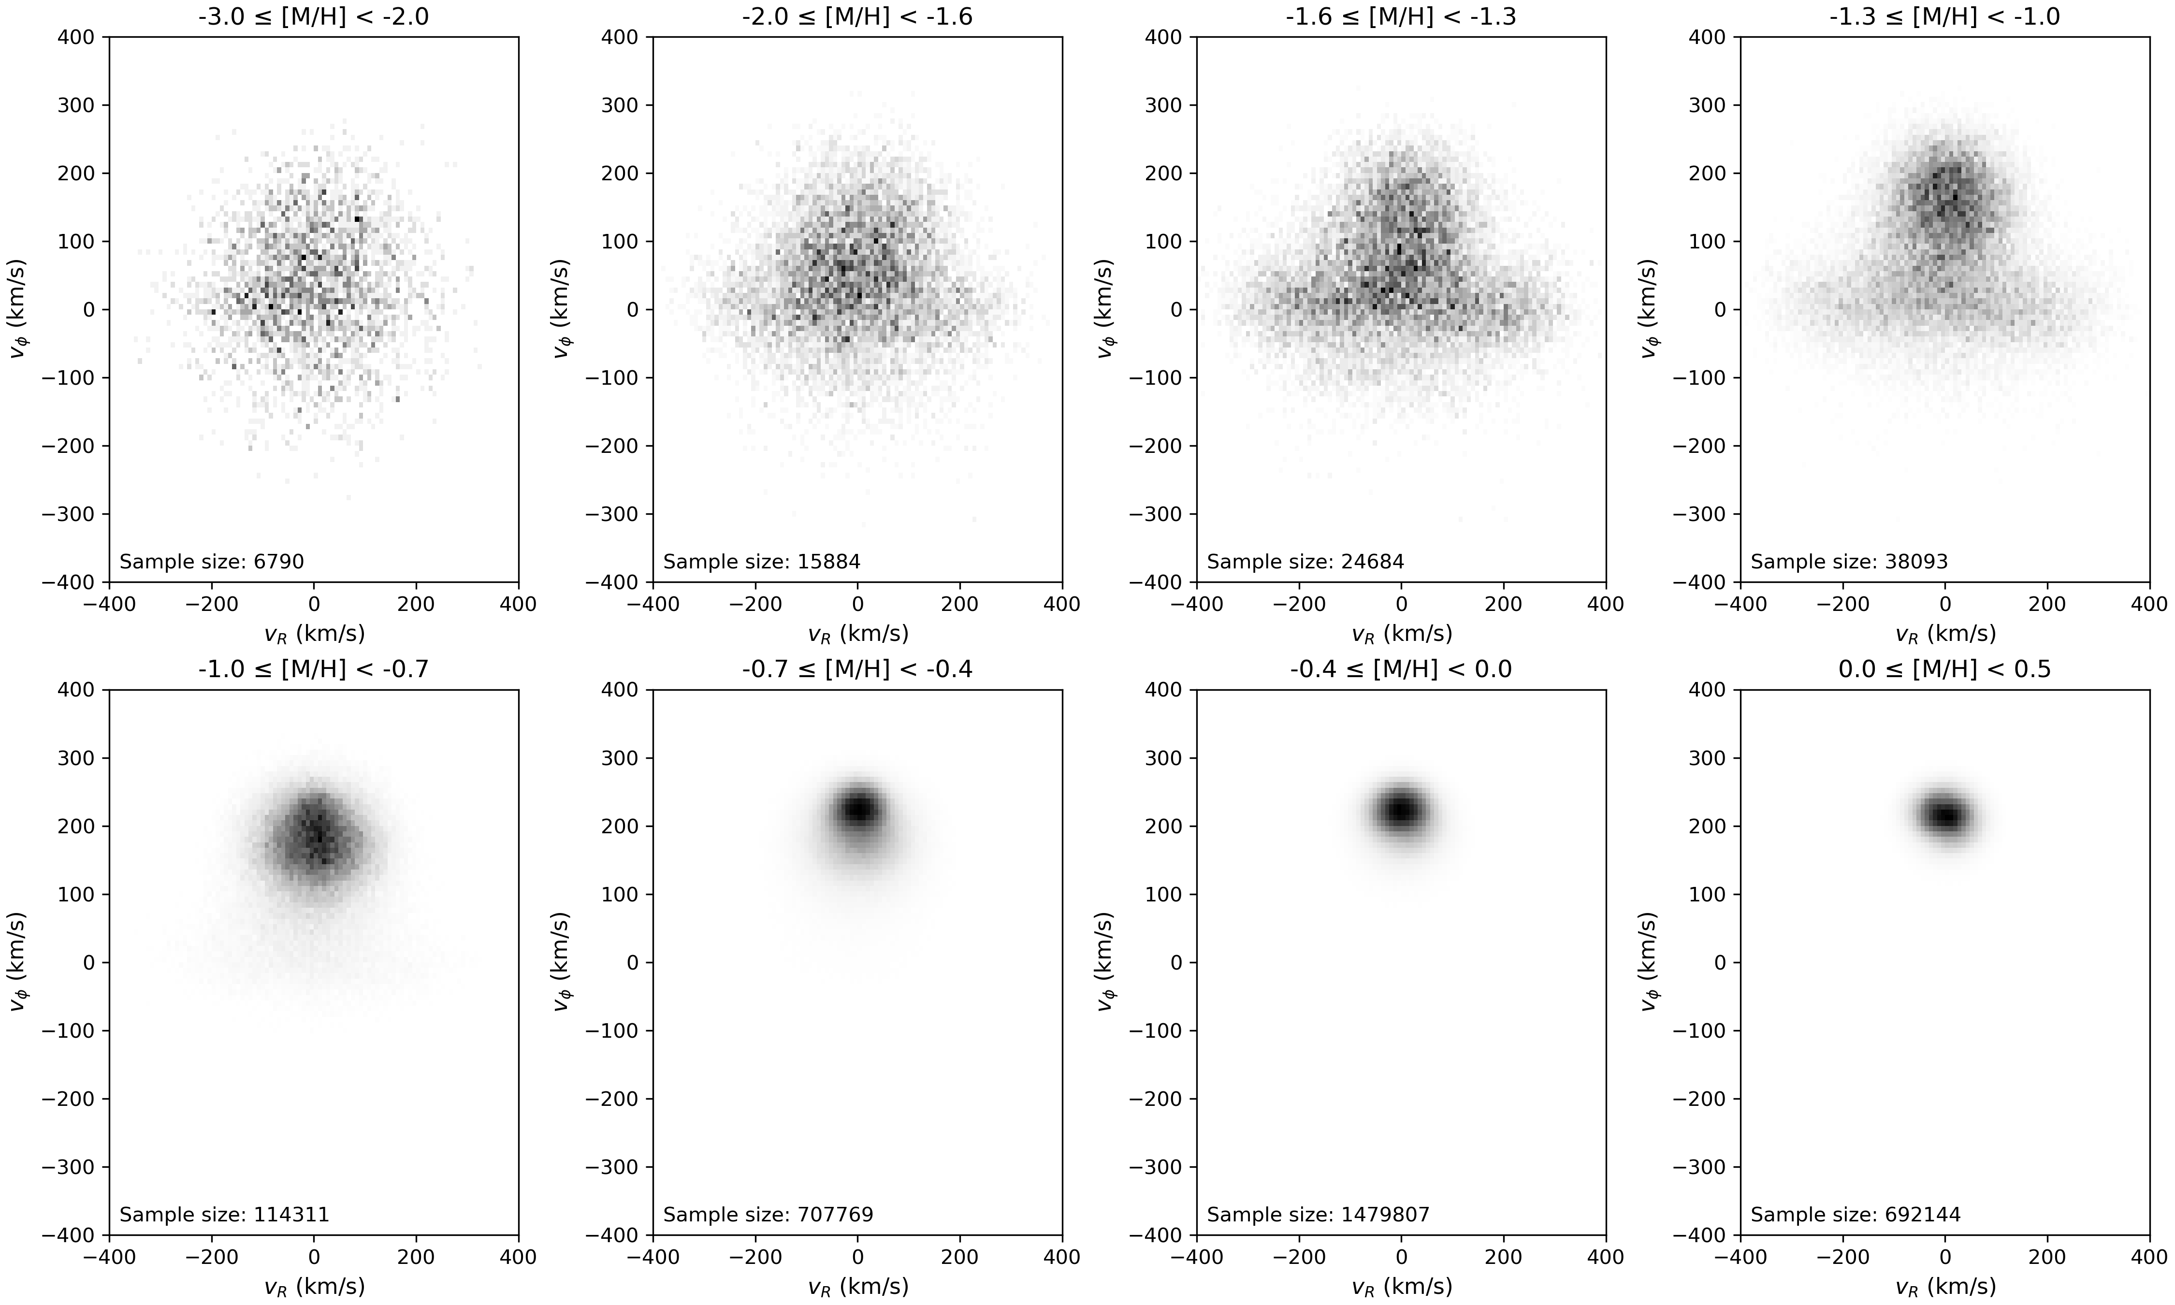
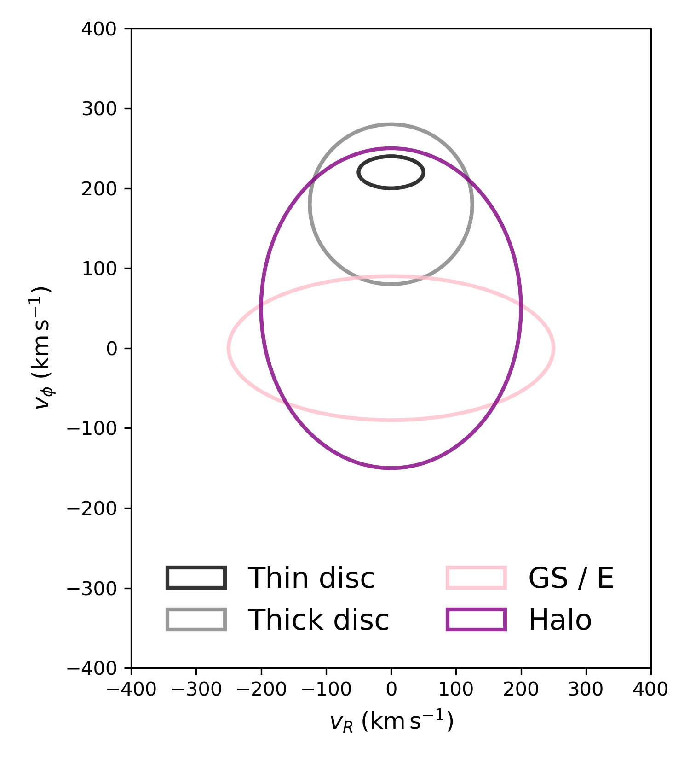
Phase Space
Notes:
Here, we examine how stellar kinematics evolve as a function of metallicity by plotting vᵣ (radial velocity) against vₚₕ (azimuthal or rotational velocity) across eight metallicity bins — from [M/H] = –3.0 up to +0.5.
In the very metal-poor bins at the top left, we see broad, isotropic distributions with little net rotation — characteristic of the stellar halo
Moving rightward in metallicity, a slight asymmetry in vₚₕ appears, reflecting the onset of a prograde halo component, and eventually, the emergence of a rotating disc.
In the more metal-rich bins on the bottom row, the vₚₕ distribution becomes sharply peaked around 200–250 km/s, while vᵣ narrows.
This is the signature of the kinematically cold thin disc.
For reference, the panel on the right shows idealised ellipses representing the approximate velocity dispersion and rotation for each Galactic component
You can see how the shapes of the data distributions in each metallicity bin broadly correspond to these ellipses
We therefore fit Gaussian Mixture Models (GMMs) to these velocity distributions, enabling us to derive quantitative weights, means, and dispersions for each component in the full 3-D Galactocentric cylindrical velocity space.

Slide 13
Algorithm – Extreme Deconvolution Gaussian Mixture Model
Gaussian Mixture Model (GMM
Assumes that each observed data point is generated from a latent variable indicating membership in one of the Gaussian components.
In our case each star has a fractional likelihood of belonging to each component.
Expectation Maximization – initialized and update to maximize likelihood
Extreme Deconvolution
At each iteration trial Gaussian is convolved with the star-specific 3×3 velocity-error matrix.
This accounts for measurement uncertainties and preventing them from creating or erasing kinematic structure.
Notes:
To decompose the kinematics of our stellar sample, we use an Extreme Deconvolution Gaussian Mixture Model — or XD-GMM.
At its core, a Gaussian Mixture Model assumes that each star’s velocity is drawn from one of several underlying Gaussian components
Each star isn't assigned to just one component; instead, it has a fractional likelihood of belonging to each.
We fit the model using the Expectation-Maximization algorithm — which alternates between estimating membership probabilities and updating the Gaussians to maximise the overall likelihood.
What makes this ‘Extreme’ is that we go one step further: we explicitly account for measurement errors in the velocities
At each iteration, the trial Gaussians are convolved with each star’s 3×3 velocity uncertainty matrix. This means we’re not fitting the observed noisy distribution directly, but rather trying to recover the true underlying velocity structure.
This prevents artificial broadening or erasure of kinematic features, and is especially important for stars with large or anisotropic uncertainties — like distant halo stars.

Slide 14
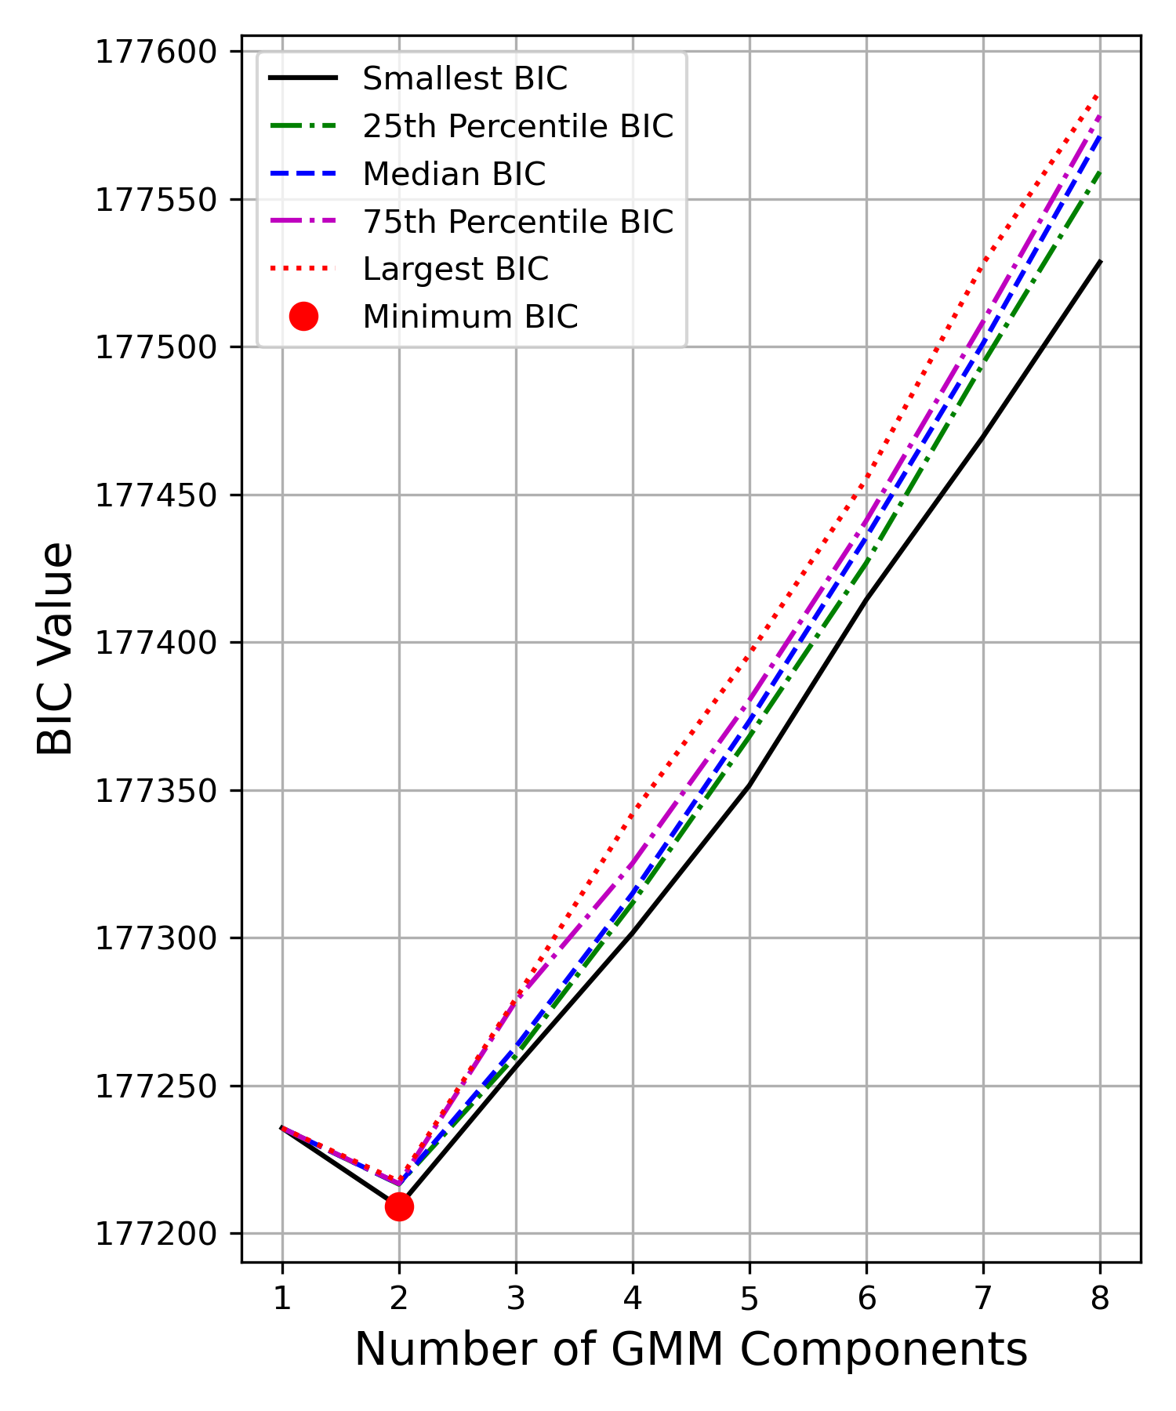
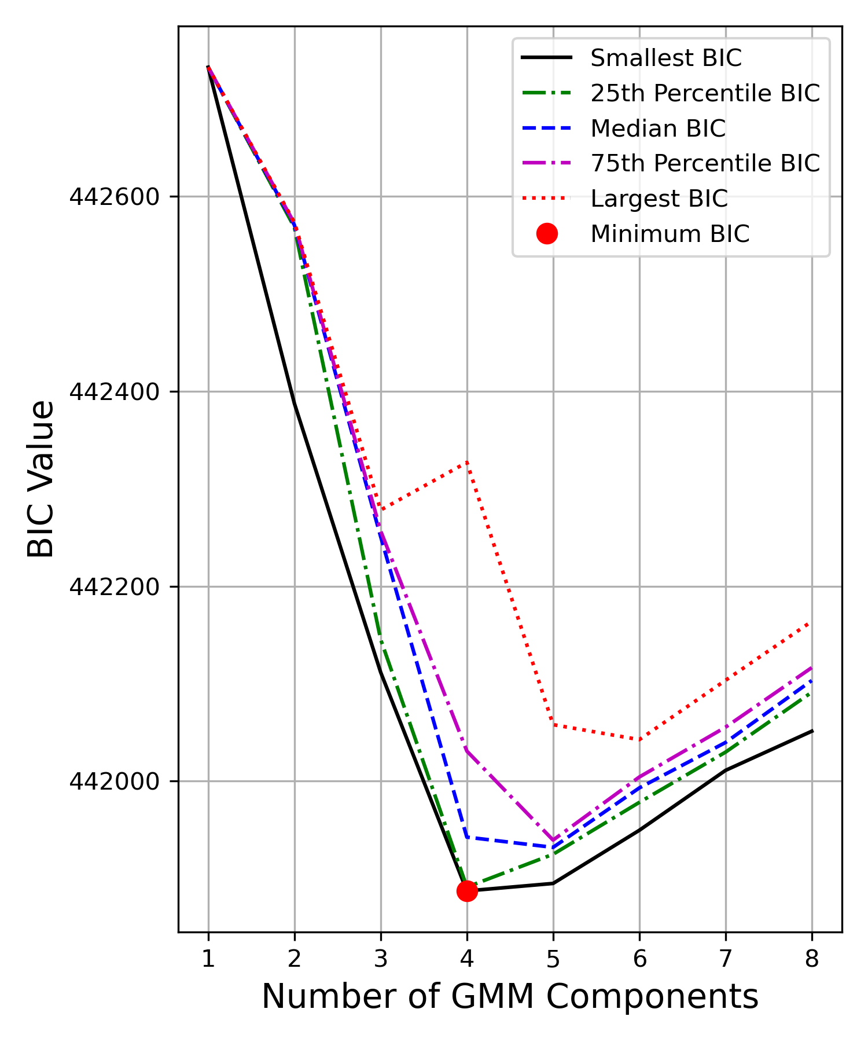
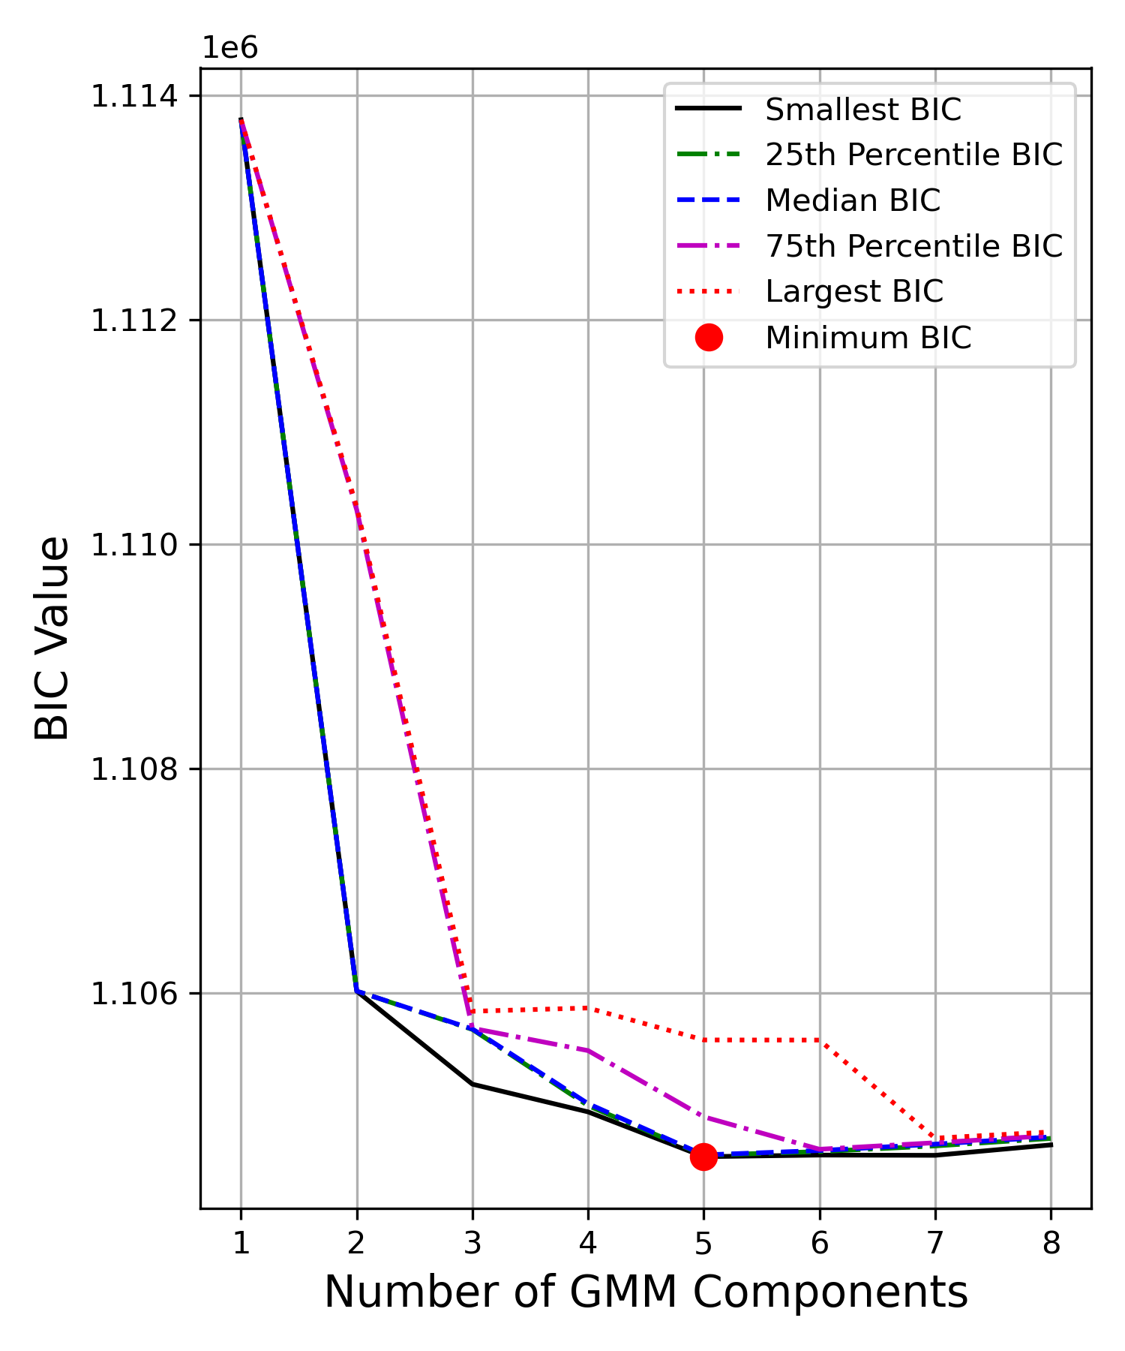
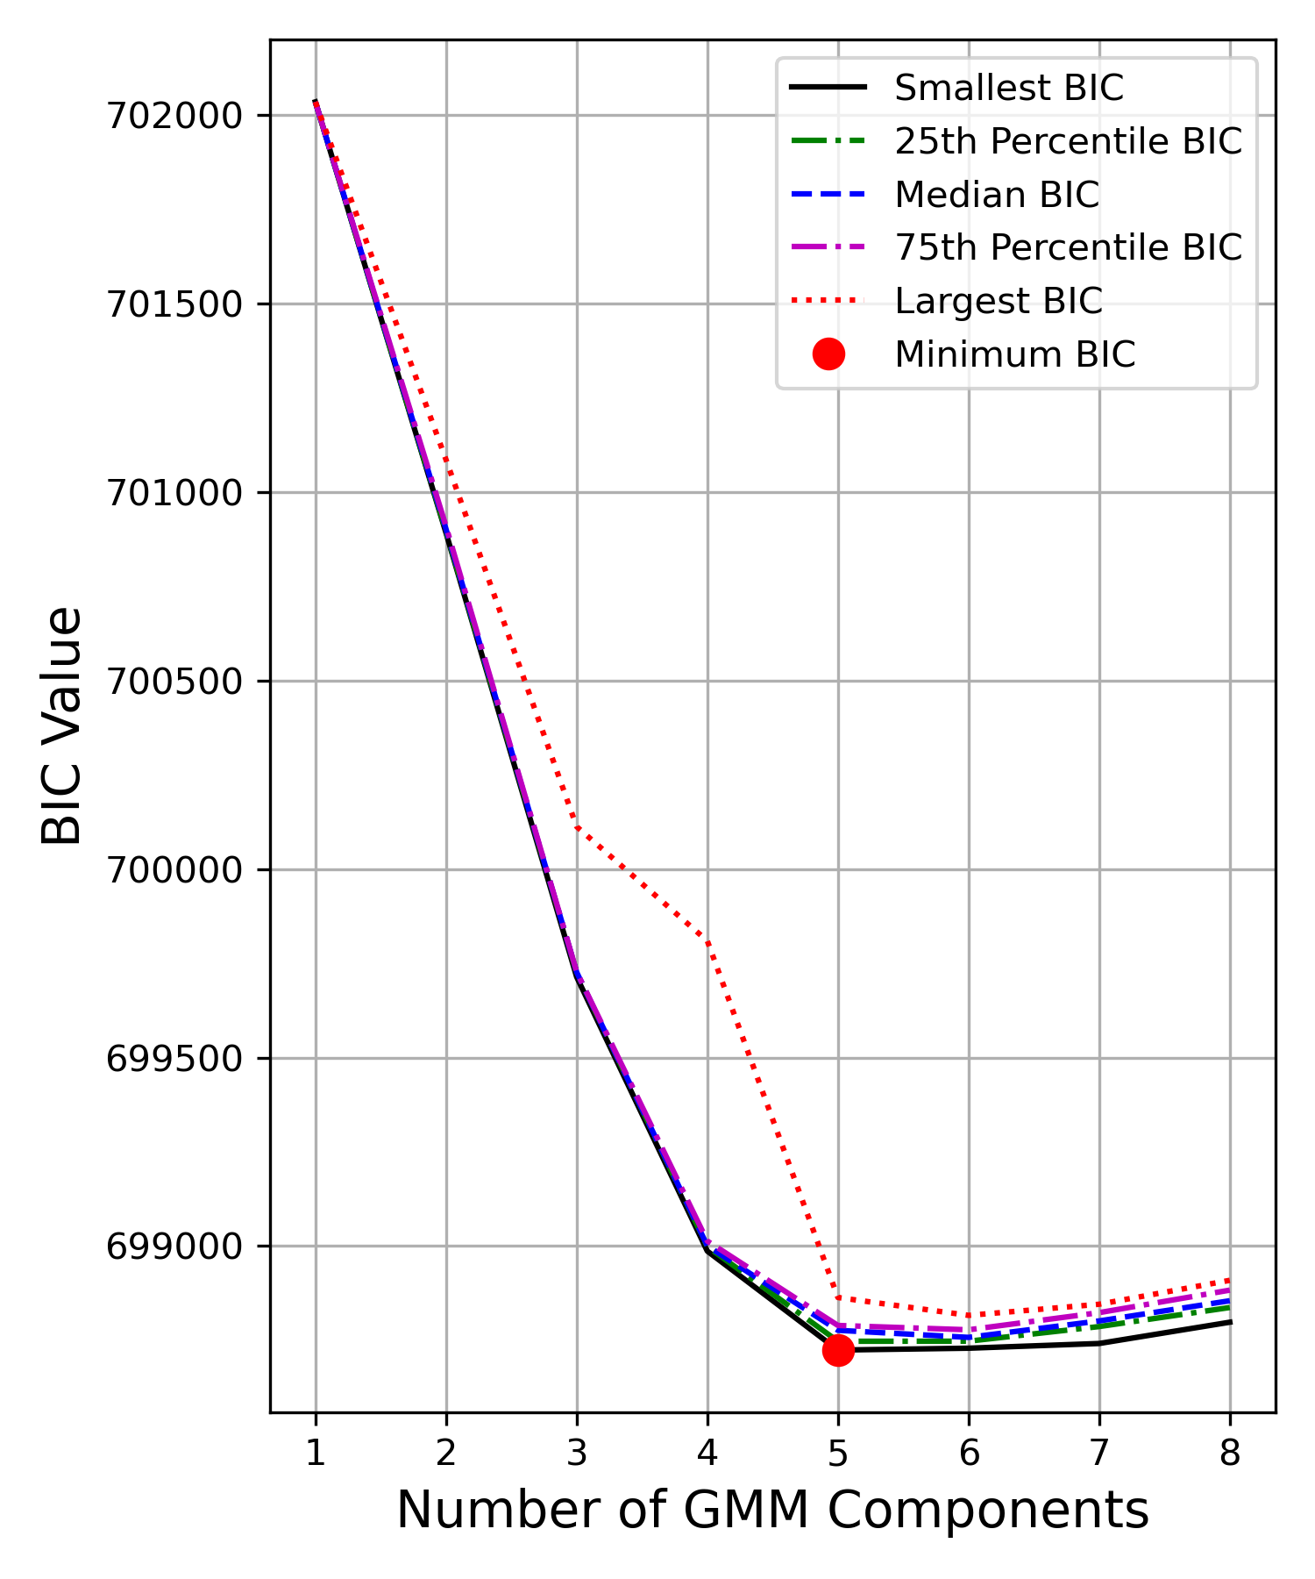
BIC score for number of components
Problem with Gaussian Mixture Models is deciding how many gaussians to fit
Too few would blur distinct populations together and mask a genuine disc.
Too many would yield an astrophysically meaningless result due to overfitting
We calculate the Bayesian information Criteria to deal with this issue
Penalizes model complexity such that extra components without a significant gain in likelihood
Notes:
One of the challenges with Gaussian Mixture Models is deciding how many components to fit.
If we use too few, we risk blurring together physically distinct populations — like the disc and halo — and missing important astrophysical structure.
But if we use too many, we start to overfit — fitting the noise in the data and getting components that don’t correspond to anything real.
To balance this, we use the Bayesian Information Criterion, or BIC. This statistic penalizes models that become more complex unless they also provide a much better fit to the data.
So, we calculate the BIC for a range of component numbers and look for the point where adding more Gaussians no longer improves the score significantly.
You can see that trend across all four metallicity bins here. The red dots mark the minimum BIC values — suggesting the most appropriate number of components for each bin.
So, using BIC helps us stay grounded: it lets us identify a model that's complex enough to capture the structure, but simple enough to remain physically meaningful.
Number of params 1 weight 3 means 6 covariance as it is symmetric, -1 as one weight is independent

Slide 15
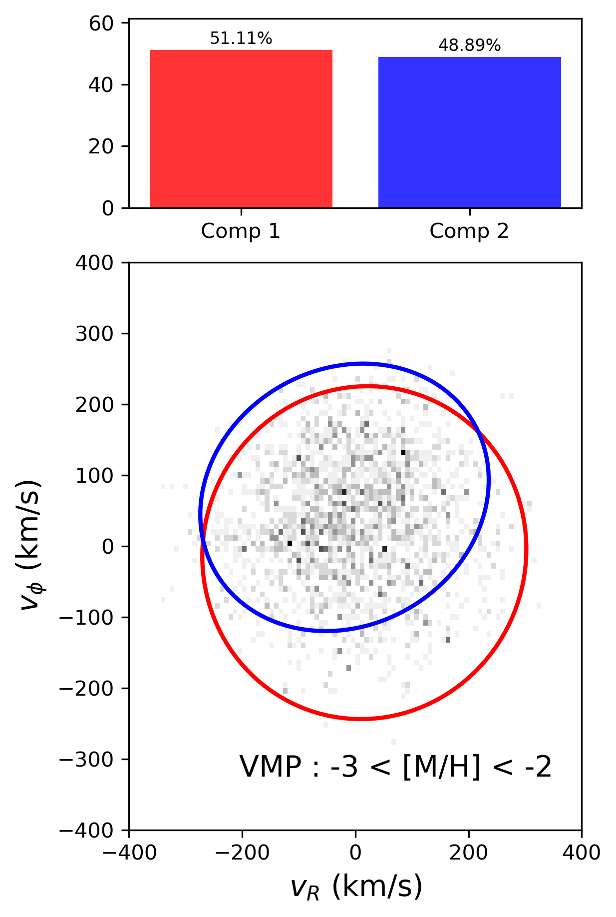
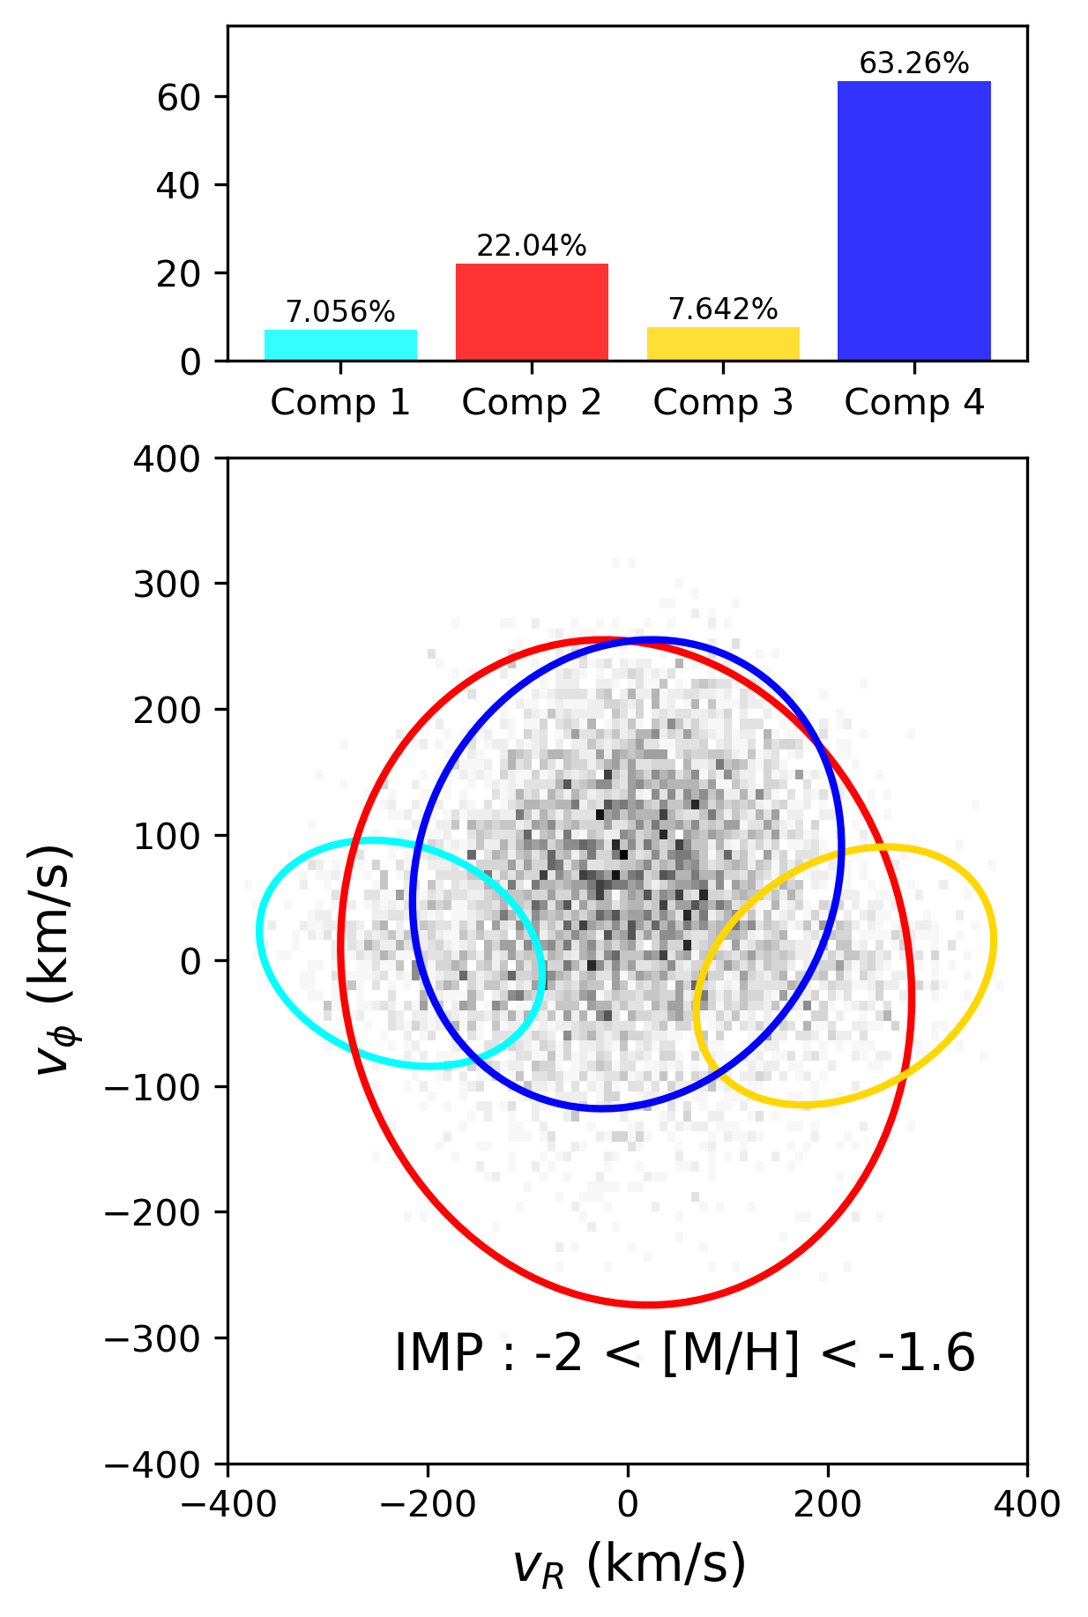
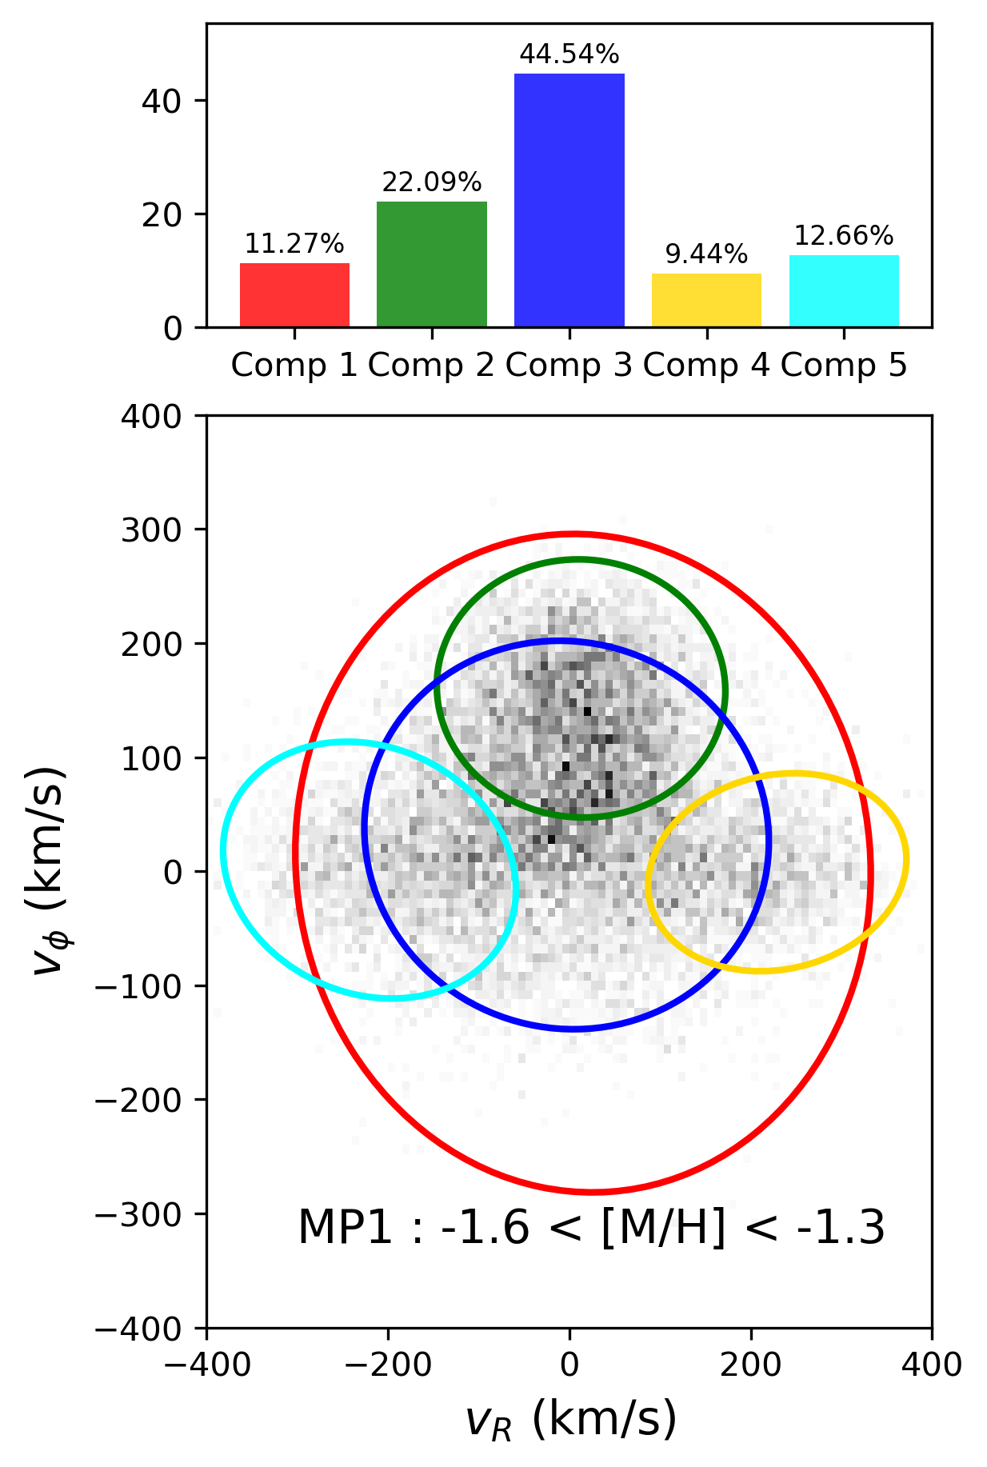
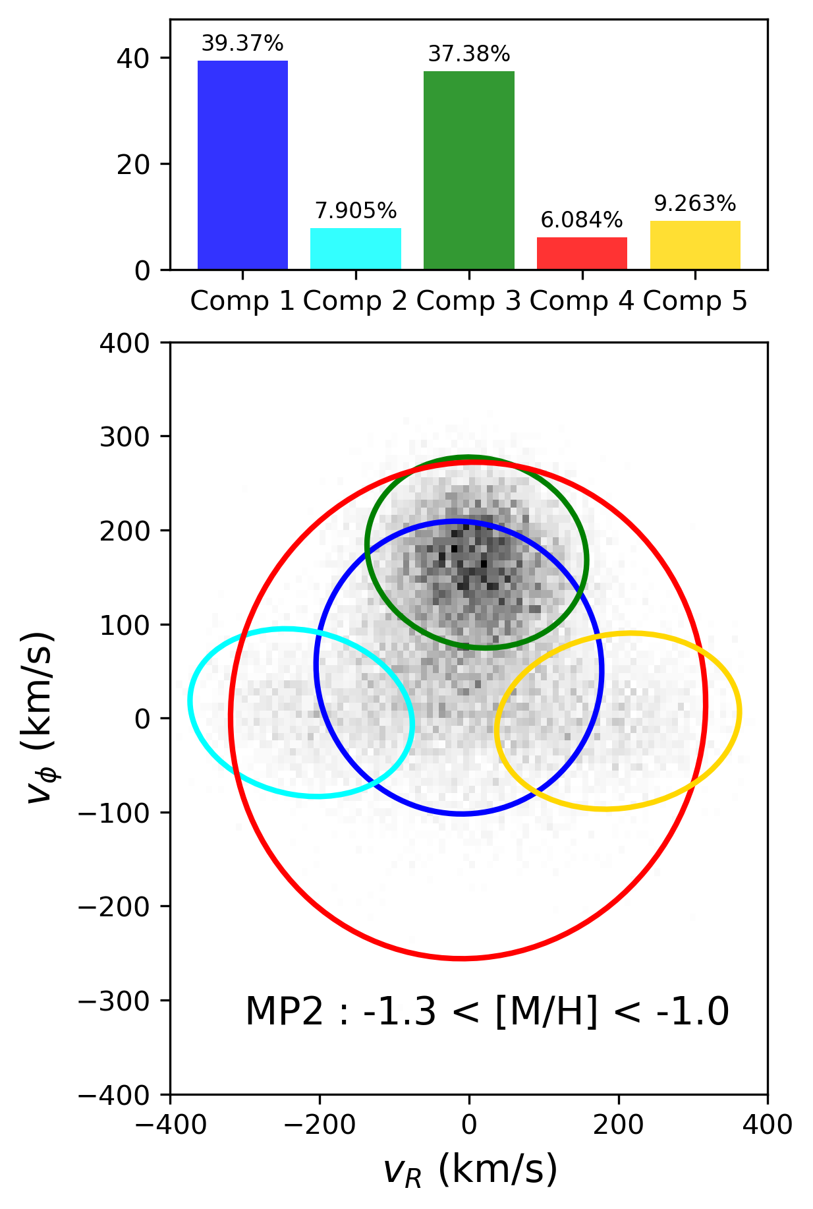
2D GMM fit results
link
link
link
link
Notes:
We fit 3d gaussians in the vr vphi vz spave
By clicking the links we can better see how these gaussians fit over the 3d velocity space
Datapoints are assigned Computes the weighted PDF of each component for every data point
Normalises across components to obtain posterior probabilities
Assigns each data point to the component with the highest posterior probability
By observing the weights we can see that results are as expected: as metallicity (or time) increases, the weight of the thick disk increases whilst that of the stationary halo decreases.
It is interesting, however that the weight of the prograde halo remains broadly similar- this is likely because this component describes the GS/E component as well as overlap between thick disk stars and halo stars.
We do not observe any disc-like contribution at low metallcities, the prograde components is likely attributed to the aurora population that corresponds to an early, slightly
rotating in-situ population. This is consistent with heated or spun-up debris rather than an in-situ disc

Slide 16
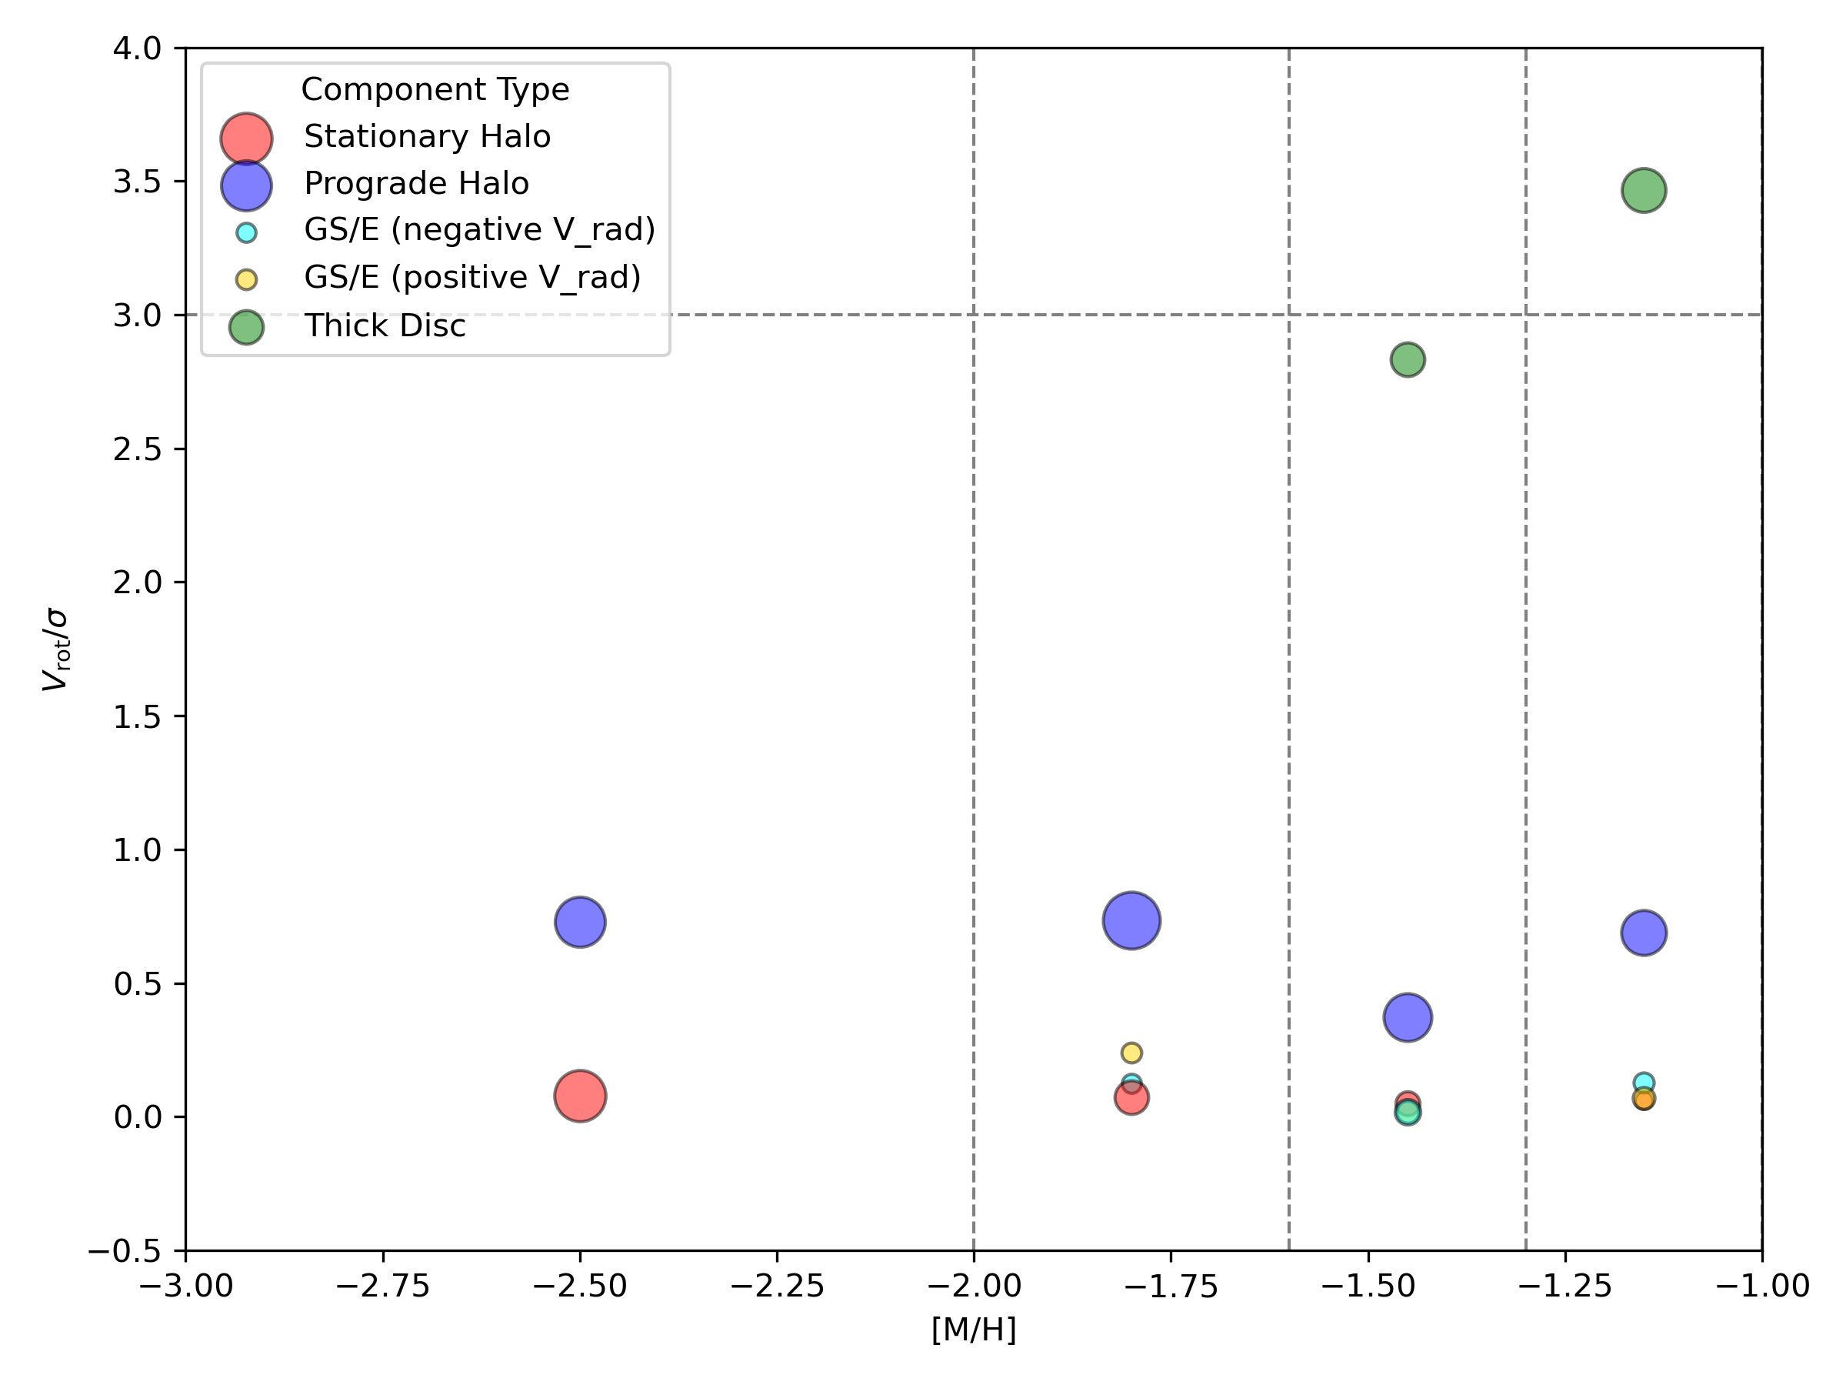
Rotational Support
Rotational support can be assessed by computing V_{phi}/σ_{Vphi}
This is used as a diagnostic for disk-like kinematics
Values approximately greater than 3 indicate rotation-supported populations.
We first observe disk-like kinematics in the MP1 consistent with the thick disk.
Notes:
So here, we assess rotational support, which helps us distinguish between halo-like and disc-like kinematics. - To do that, we look at the ratio of the mean rotational velocity to its dispersion — that’s Vϕ over σVϕ​​
If this ratio is greater than about 3, it suggests the population is rotation-supported, like a disc. Lower values — closer to 0 — are what we expect from pressure-supported systems, like the stellar halo.
You can see that as we move to higher metallicities, this green component starts to appear, and its valuerises above 3.
This tells us that disc-like kinematics first emerge in the MP1 bin, around [M/H] = –1.5, which we interpret as the onset of the thick disc.

Slide 17
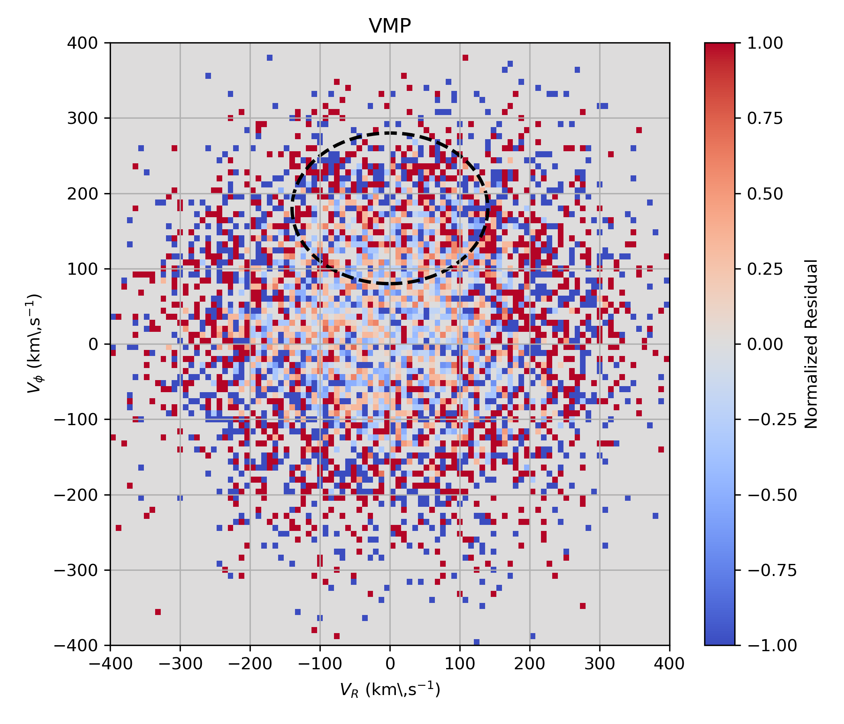
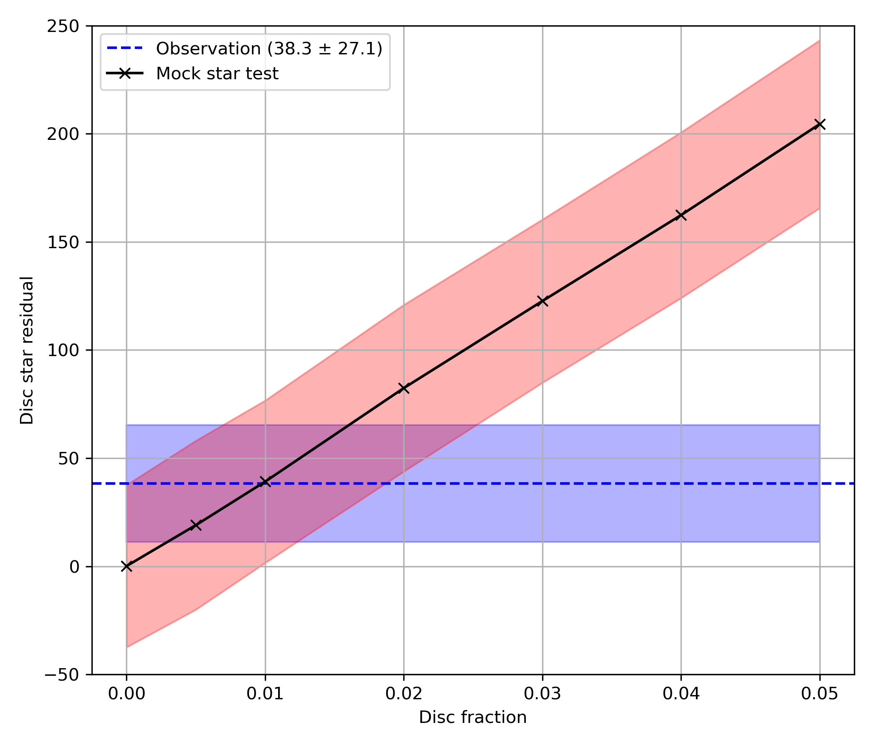
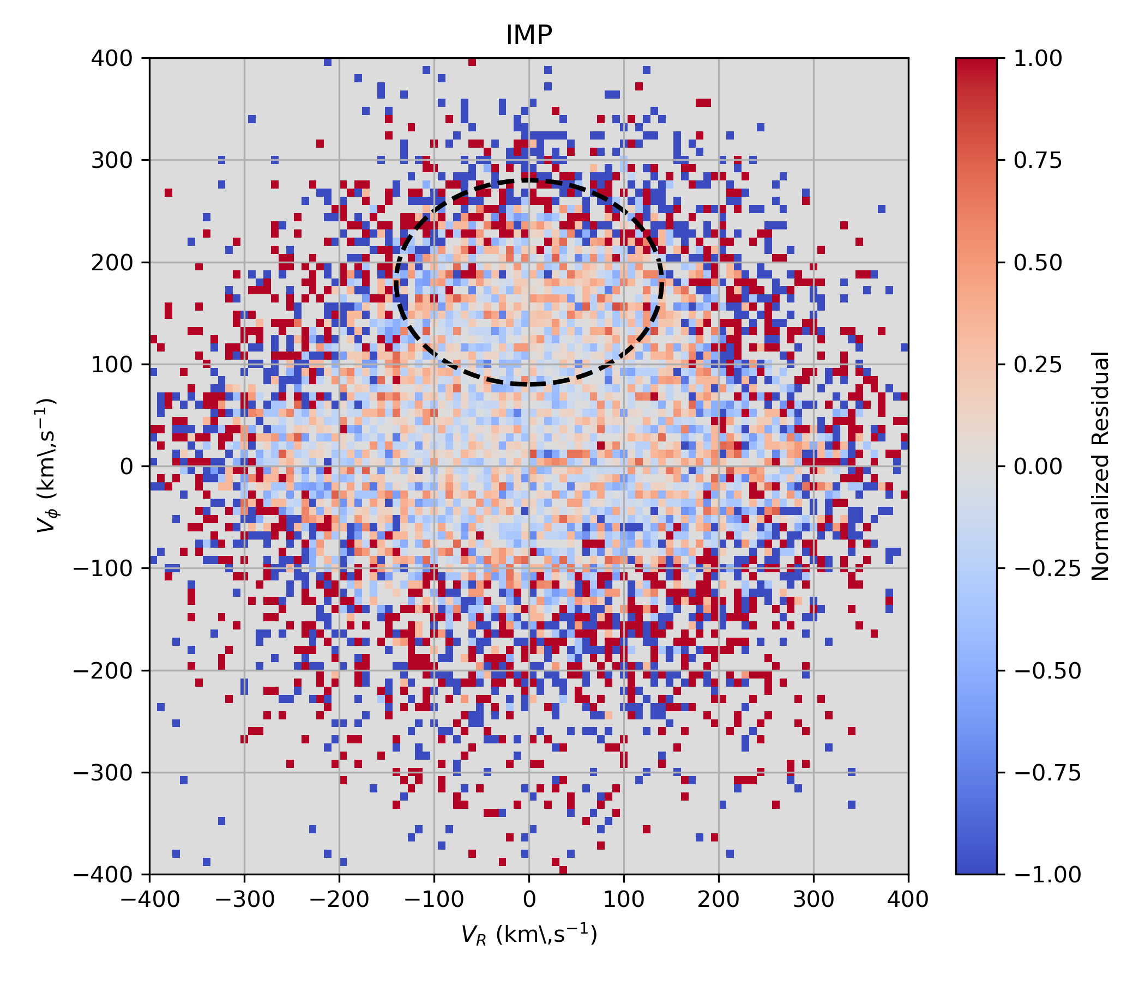
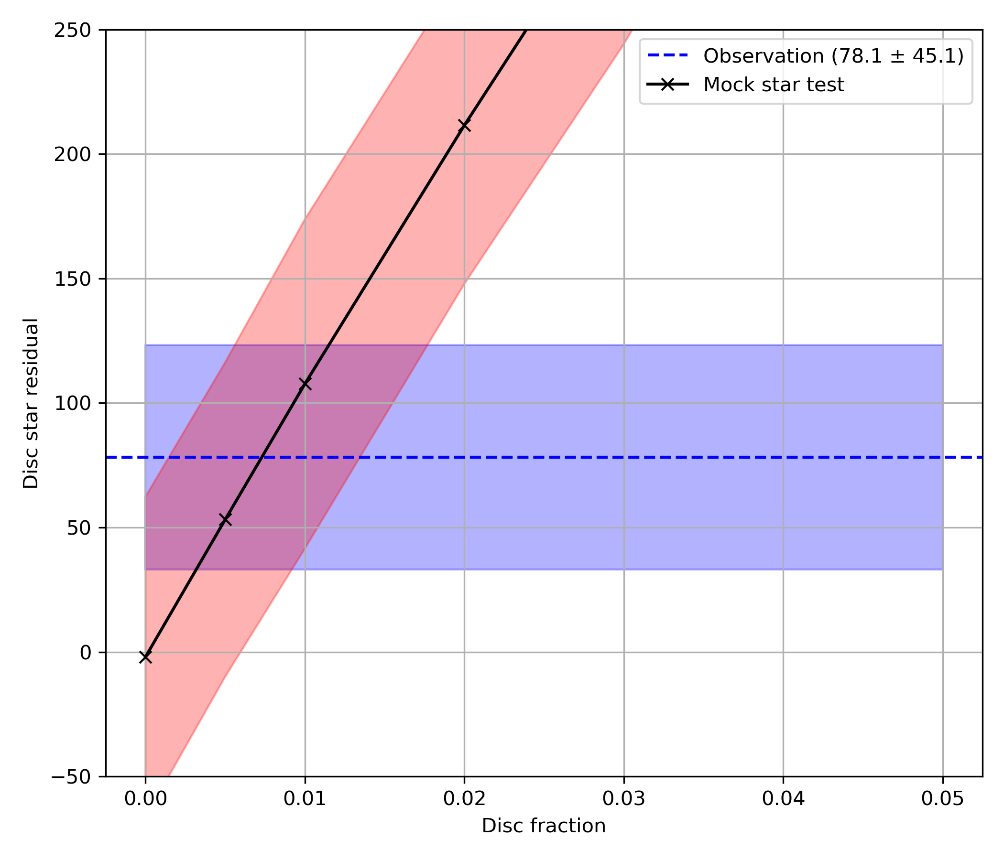
Residual Analysis
Standard GMMs may miss weak substructures; test for a faint disc‐like component hidden in very-/intermediate-metal-poor.
Draw mock stars from the best-fit XD-GMM; assign each mock star the velocity errors of its nearest observed neighbor, then add Gaussian noise.
Evaluate excess counts inside a 2 σ ellipse centred around thick disk
Inject mock discs (0–5 %) into the model; intersection with observed residuals suggests approx. 1 % hidden thick-disc contribution in both VMP & IMP bins.
Any undetected disc component is minimal
Notes:
To make sure we're not missing any faint, hidden disc components — especially in the very metal-poor (VMP) and intermediate metal-poor (IMP) bins — we perform a residual analysis
The concern here is that standard GMMs, even with Extreme Deconvolution, might miss small or subtle disc-like substructures
First, we generate mock stars from our best-fit XD-GMM model
Each mock star is given the same observational uncertainties as a real star — we do this by assigning it the error of its nearest neighbour and adding Gaussian noise
Then, we compare the mock and real data by looking for excess counts inside a 2-sigma ellipse centred on the thick disc in velocity space.
Now, to estimate how much disc might be hidden, we inject artificial discs into the model at different levels — from 0 to 5% — and see how the excess we observe compares to what we’d expect from these mock injections.
What we find is that the observed residuals — shown in the blue shaded region — are consistent with a disc contribution of about 1% in both the VMP and IMP bins.
So the takeaway here is that even if a faint disc component is hiding in those metal-poor bins, it’s minimal — at most, around 1%

Slide 18
Reproducibility of Zhang et al. 2024
We successfully complete the primary aim of this research project: to reproduce the analysis of Zhang et al. 2024. using the methodology outlined.
The only difference in methodology came when initializing the XD-GMM: the paper mentions random initializations – however, k-means initializations are required such that the algorithm does not get trapped in local minima.
Key Differences:
At the very metal-poor end, our model recovers a nearly even split between stationary and prograde halo components, in contrast to the more dominant non-rotating halo found by Zhang et al. [2024].
the kinematics of the prograde component in our fit are consistent with those reported for Aurora
Notes:
The only methodological deviation came in the way we initialised the XD-GMM.
While Zhang et al. mention using random initialisations, we found that this approach often caused the algorithm to get stuck in local minima.
To avoid that, we opted for k-means initialisation, which consistently led to more stable and convergent fits.
Now, regarding key differences in the outcomes
At the very metal-poor end, our model identifies an almost even split between a stationary and a prograde halo component
the prograde component we recover has kinematics that match well with those reported for the Aurora structure, reinforcing confidence in our results despite the methodological nuance.

Slide 19
Extension analysis - Alpha
Add another dimension into analysis – alpha abundance
By following methodology outlined by Viswanathan et al. 2024 we create a high- and low- alpha split which in theory should show different structures upon the application of the XD-GMM algorithm.
High alpha:
Rapid, intense star formation enriches the gas with α-elements before Type Ia supernovae contribute significant iron, leading to elevated [α/Fe].
Low alpha:
A more extended star-formation history allows iron from Type Ia supernovae to accumulate, diluting the α enrichment
Notes:
Type 2 – adds irons and alpha
Type 1 – adds mainly iron
we now add a second chemical dimension: alpha abundance.
We follow the methodology of Viswanathan et al. 2024, which suggests splitting the data into high- and low-alpha populations before applying the XD-GMM algorithm.
The idea is that these two groups should exhibit different structures in phase space, reflecting different formation pathways.
High-alpha stars formed in environments with rapid and intense star formation. These enrich the interstellar medium quickly with alpha-elements — things like oxygen and magnesium — before Type Ia supernovae have had time to explode and contribute iron. That gives us high [α/Fe] ratios.
In contrast, low-alpha stars come from systems with slower, more extended star-formation histories. In these, there’s time for Type Ia supernovae to inject iron into the gas, which dilutes the alpha enhancement and lowers [α/Fe].

Slide 20
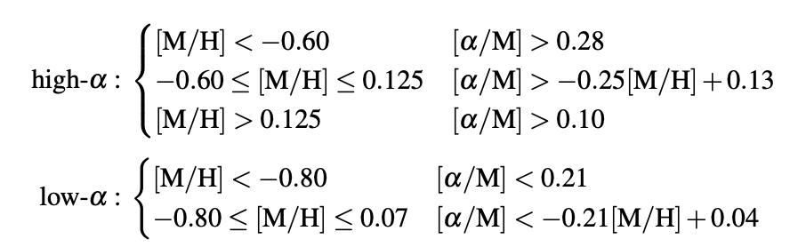
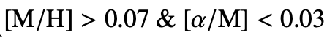
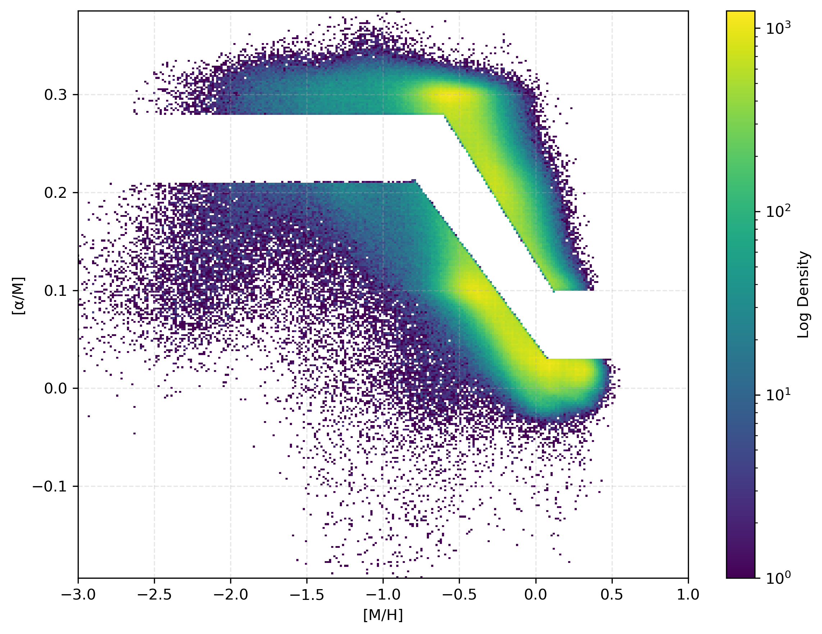
Alpha thresholds
We following boundary conditions as in Viswanathan et al. 2024.
This cut excludes the middle band so that we minimize the overlap between different populations.
We are skeptical of the population of low alpha at low metallicities
Alpha abundance values are not as trusted at low metallicities
Notes:
In order to separate high- and low-alpha stars, we apply boundary conditions defined in Viswanathan et al. 2024. These thresholds are designed to minimise overlap between populations
We remain sceptical of the low-alpha population at very low metallicities. That’s because alpha-abundance values are less reliable in this regime — so any trends or structures we observe in that corner of parameter space should be interpreted with caution.
Furthermore we make the same cuts as before, but instead use fpu<2 to retain a practical number of stars
Must admit that in my report I have mistakenly excluded the bottom equation but am including it here for completeness.
In the real world I would immediately fix this having noticed it.

Slide 21
Predictions
High-α:
Thick disc dominance
Disc forms earlier
Higher velocity dispersion (kinematically hotter)
Low-α:
Thin disc observable and higher metallicities
Disc forms later
Lower velocity dispersion (kinematically colder)
More metal-rich
Notes:
- For the high-alpha population, we anticipate:
A dominance of the thick disc,
An earlier formation history,
And higher velocity dispersion — in other words, stars that are kinematically hotter.
- On the other hand, the low-alpha stars are expected to:
Be more metal-rich,
Trace the thin disc at higher metallicities,
Form later,
And exhibit lower velocity dispersion — so they’re kinematically colder.

Slide 22
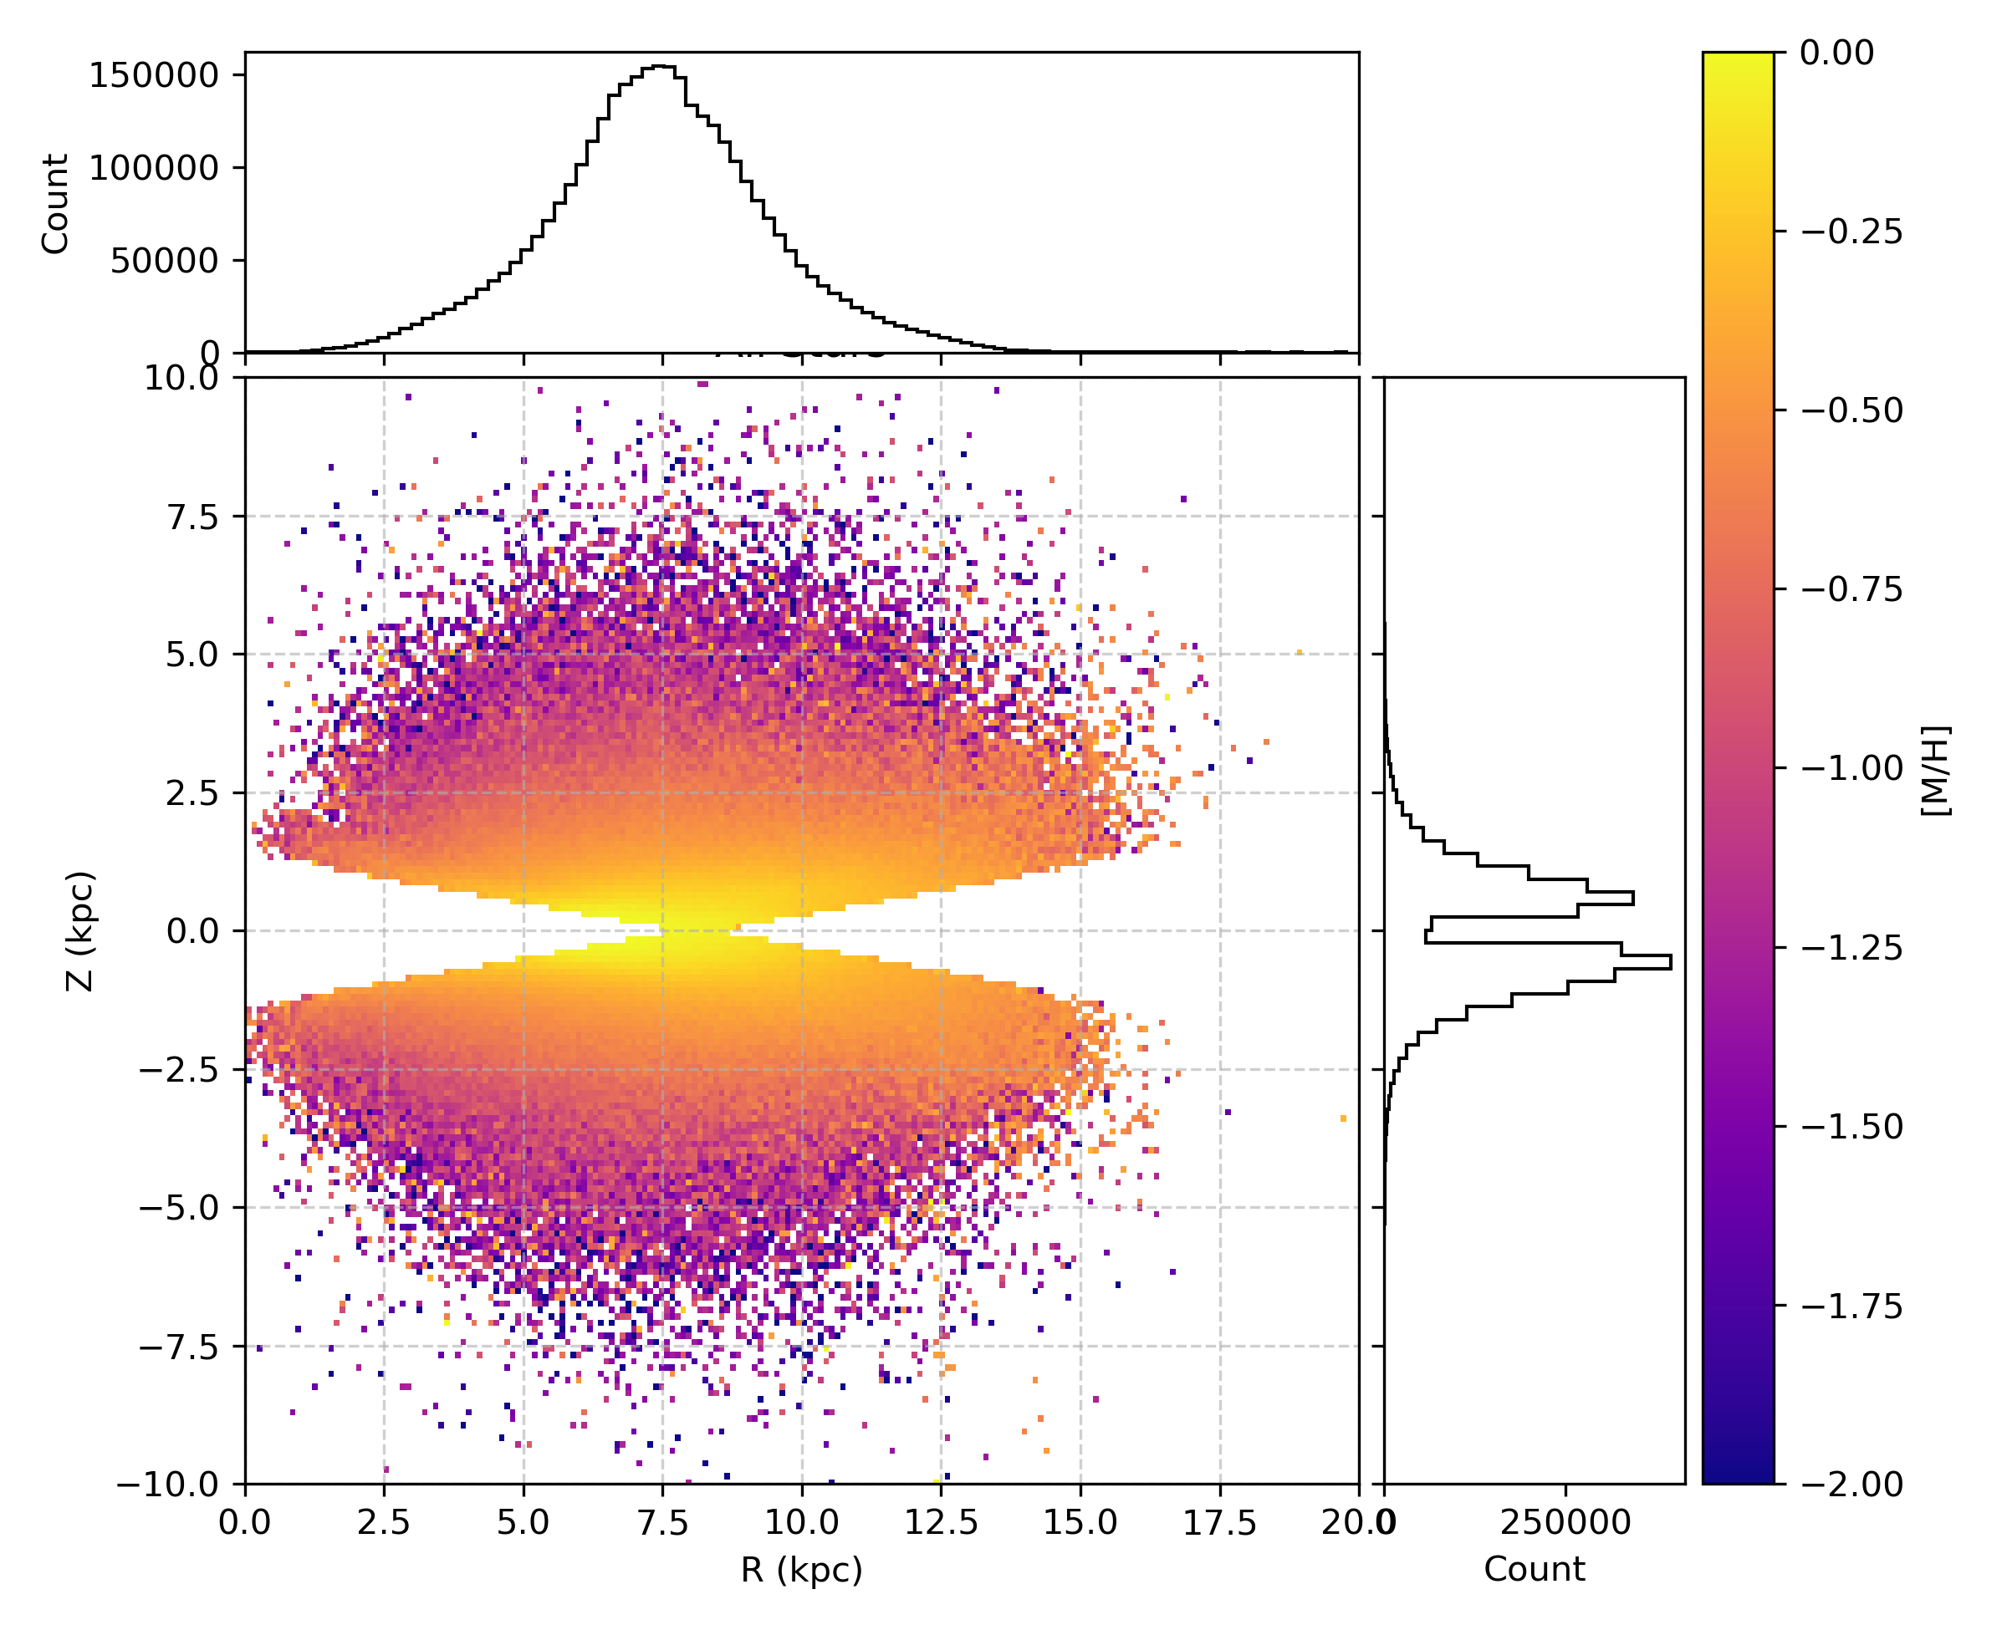
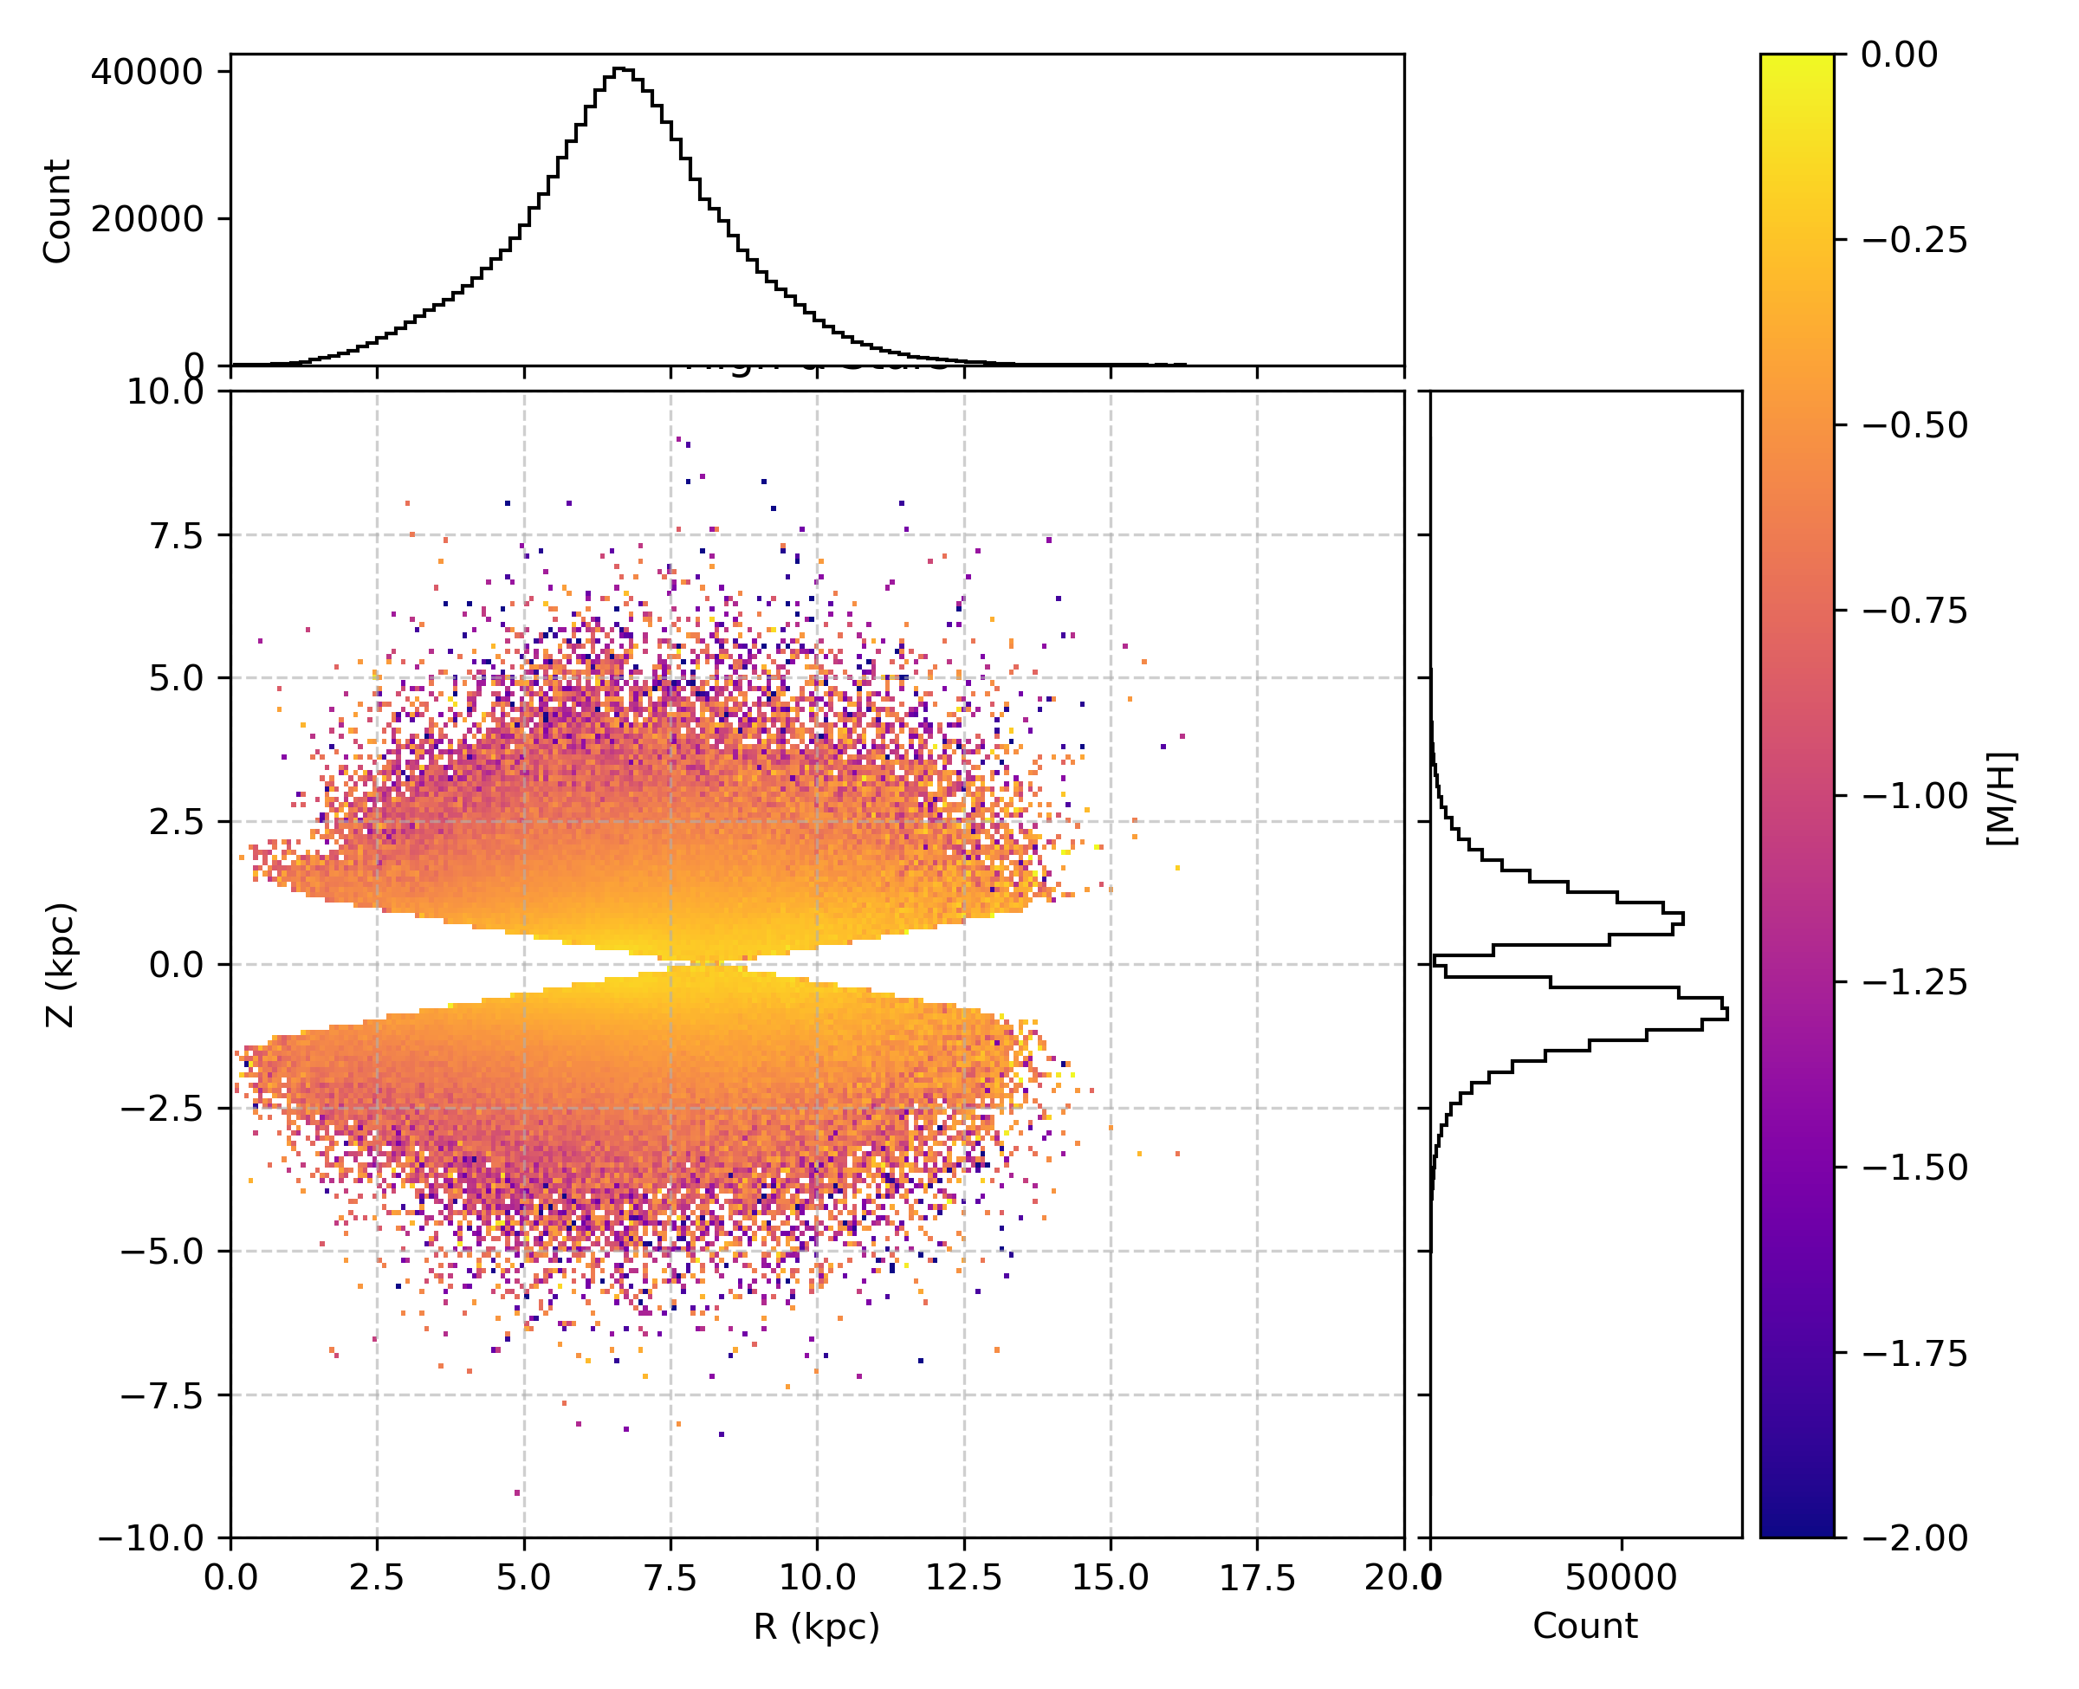
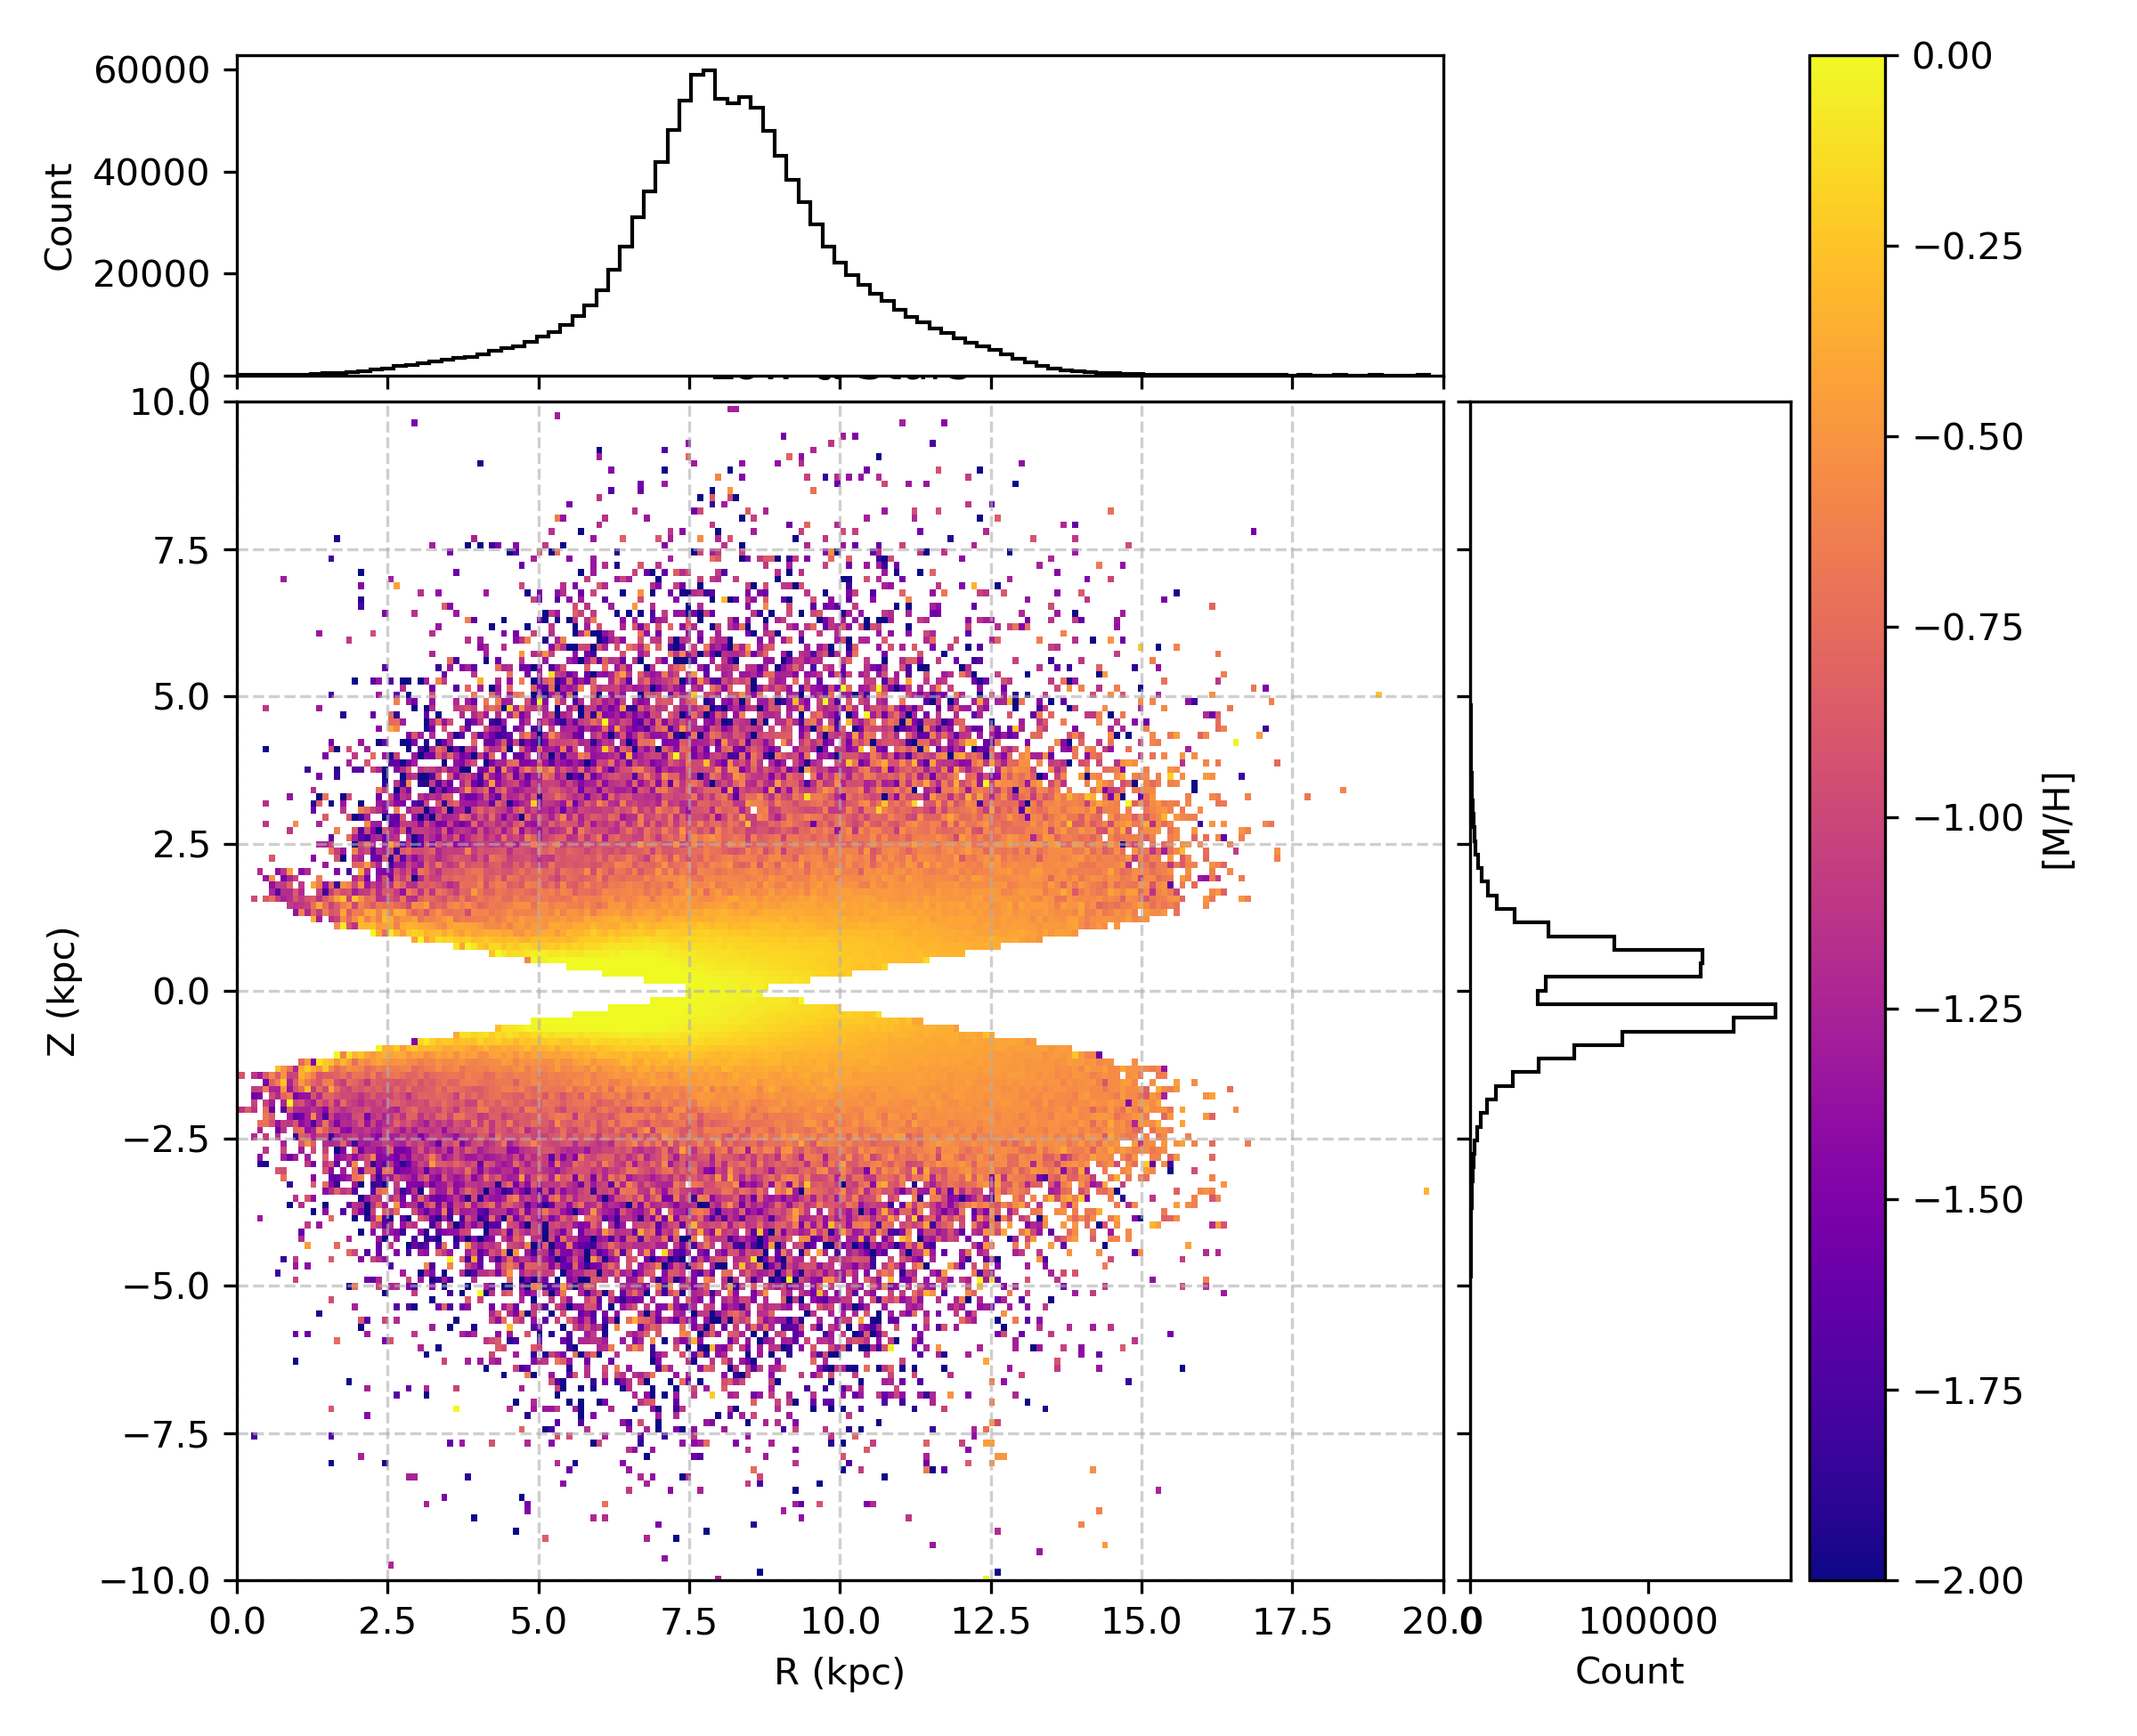
Metallicity distribution
Full sample
High Alpha
Low Alpha
Notes:
Before diving into the kinematics, it’s useful to take a step back and examine the metallicity distribution across our sample
The low-alpha population, on the right, shows a steep negative metallicity gradient with increasing vertical height z.
We also observe a metallicity gradient with increasing radius R in the low-alpha sample. This suggests radial migration — the idea that stars formed in the inner Galaxy have migrated outwards over time
In contrast, the high-alpha stars, on the left, display a shallower vertical gradient and a visibly thicker disc structure, consistent with their older, dynamically hotter nature.

Slide 23
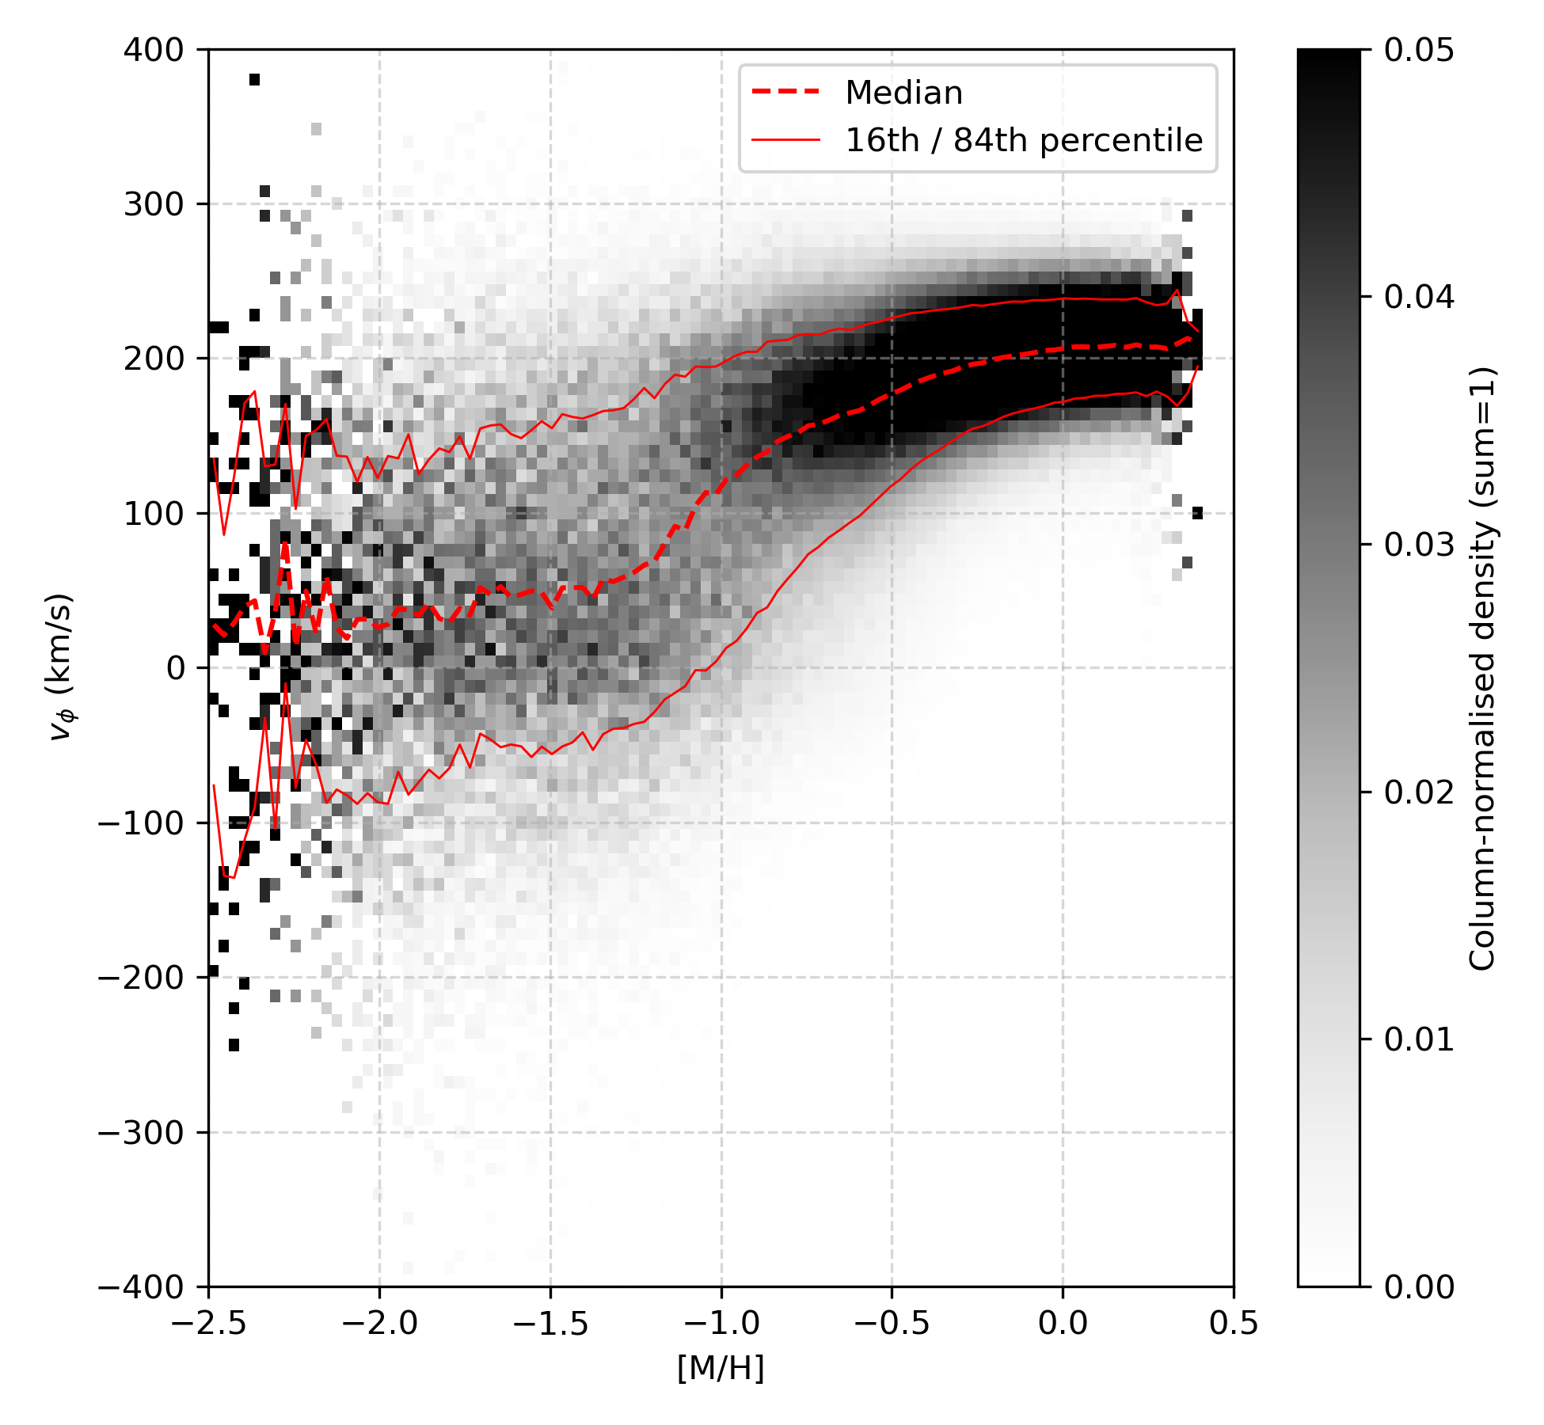
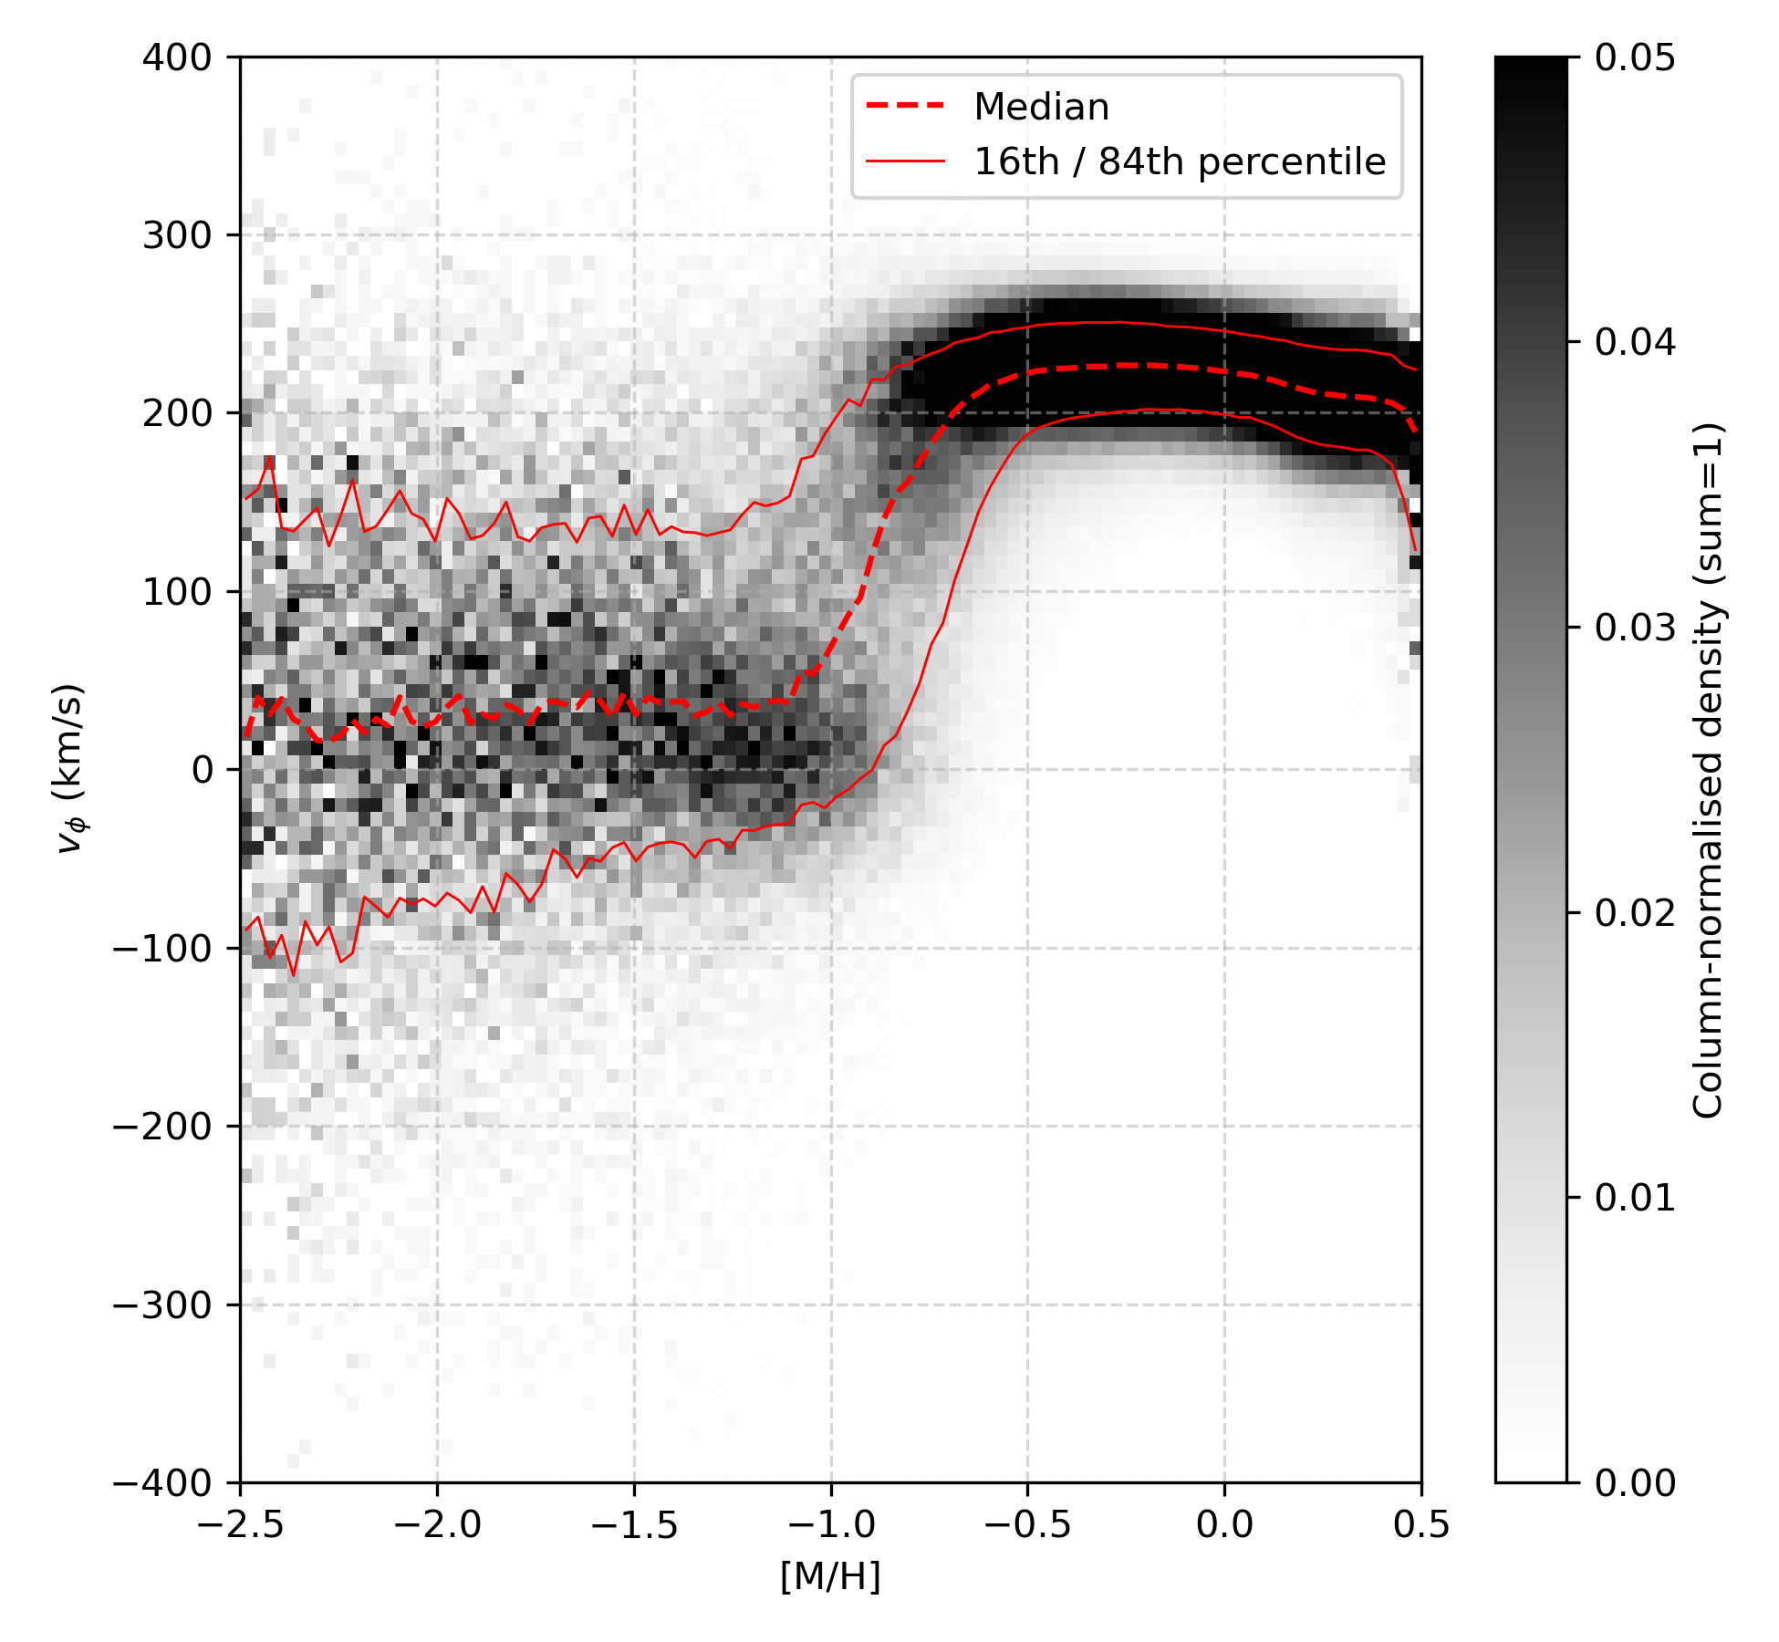
Azimuthal Velocity Distribution
High-alpha
Low-alpha
Notes:
On the left, we see the high-alpha stars. These stars show a gradual spin-up with increasing metallicity.
From around [M/H] ≳ -1.3, we begin to see a steady increase in rotation velocity and a decrease in dispersion, marking a clear transition toward the thick disc.
By [M/H] ≳ -0.5, most high-alpha stars lie in a kinematic regime with elevated vφ and moderate dispersion, consistent with a rotationally supported but still kinematically hot thick disc.
This continuous trend in the high-alpha stars supports a formation scenario where the Galaxy’s in-situ population gradually acquired angular momentum as star formation progressed.
Now on the right, we have the low-alpha stars. At [M/H] ≲ -1.2, their kinematics are similar to the high-alpha sequence
But above [M/H] ≳ -1.2, we observe a much sharper transition to a population with strong net prograde rotation and lower velocity dispersion.
This sharp spin-up suggests that the low-alpha population formed after the gas settled into a stable disc, enabling the rapid build-up of a fast-rotating, dynamically cold thin disc.

Slide 24
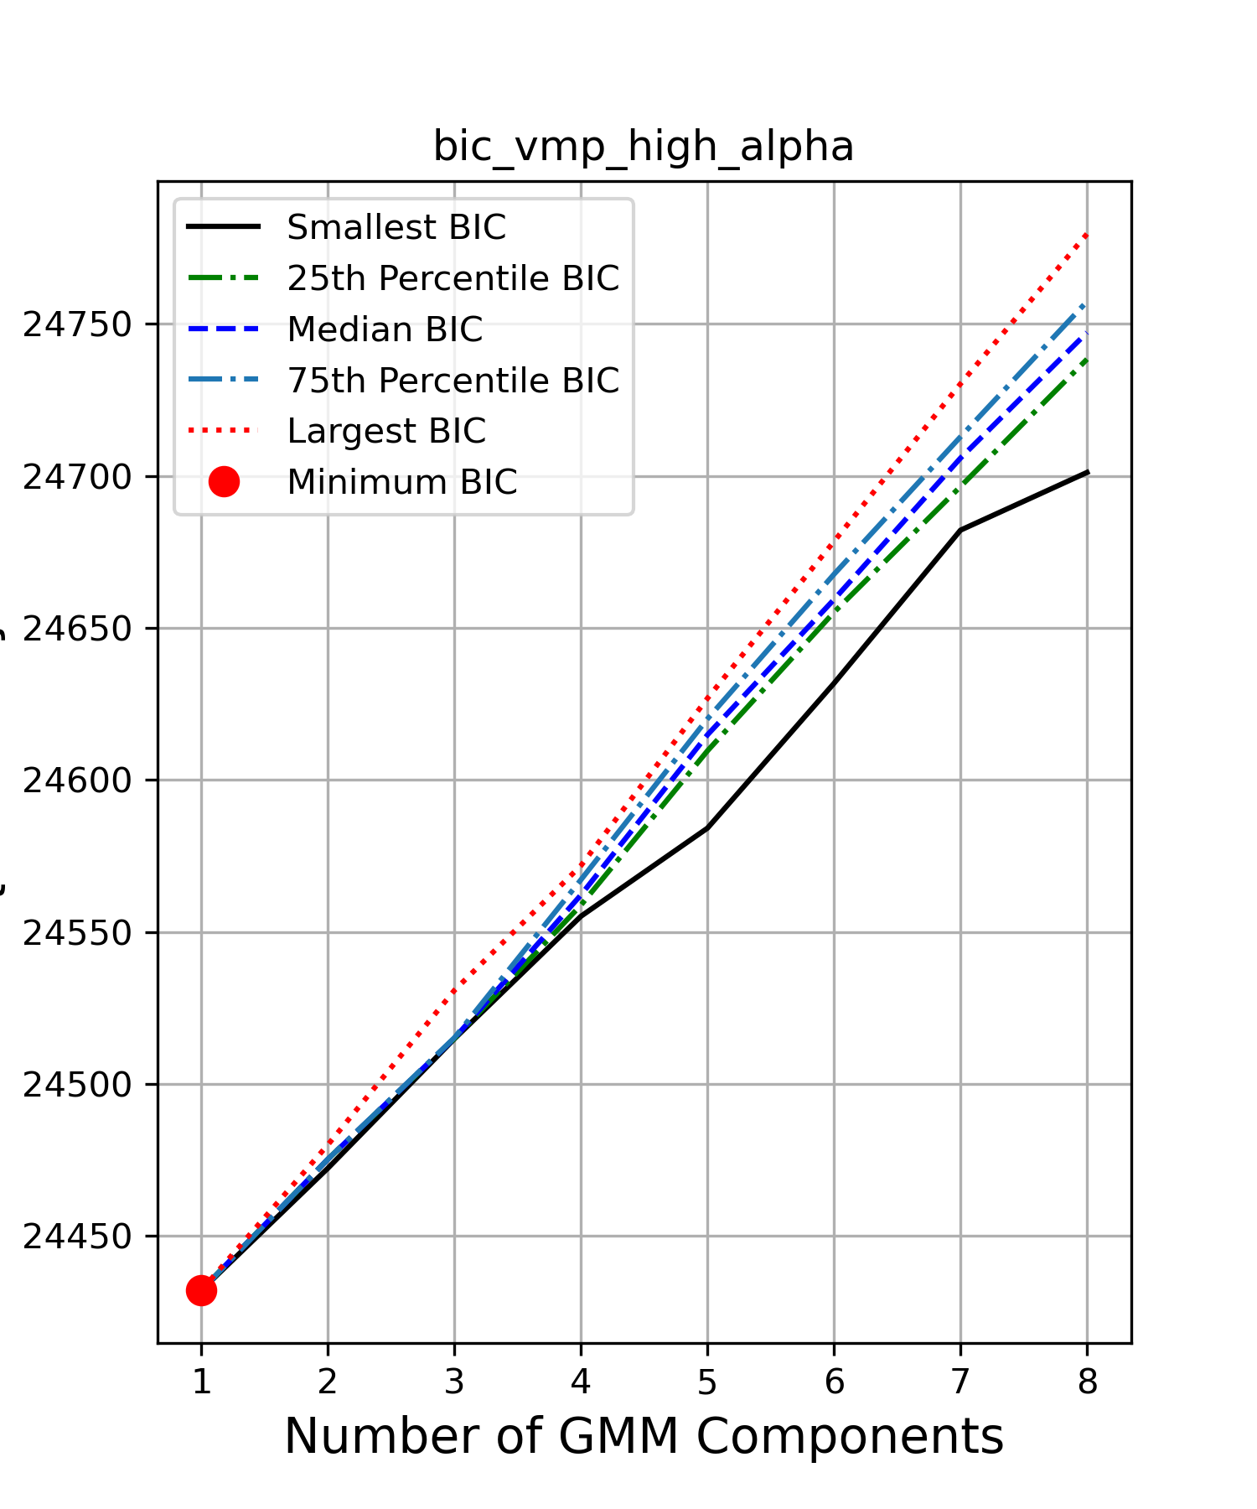
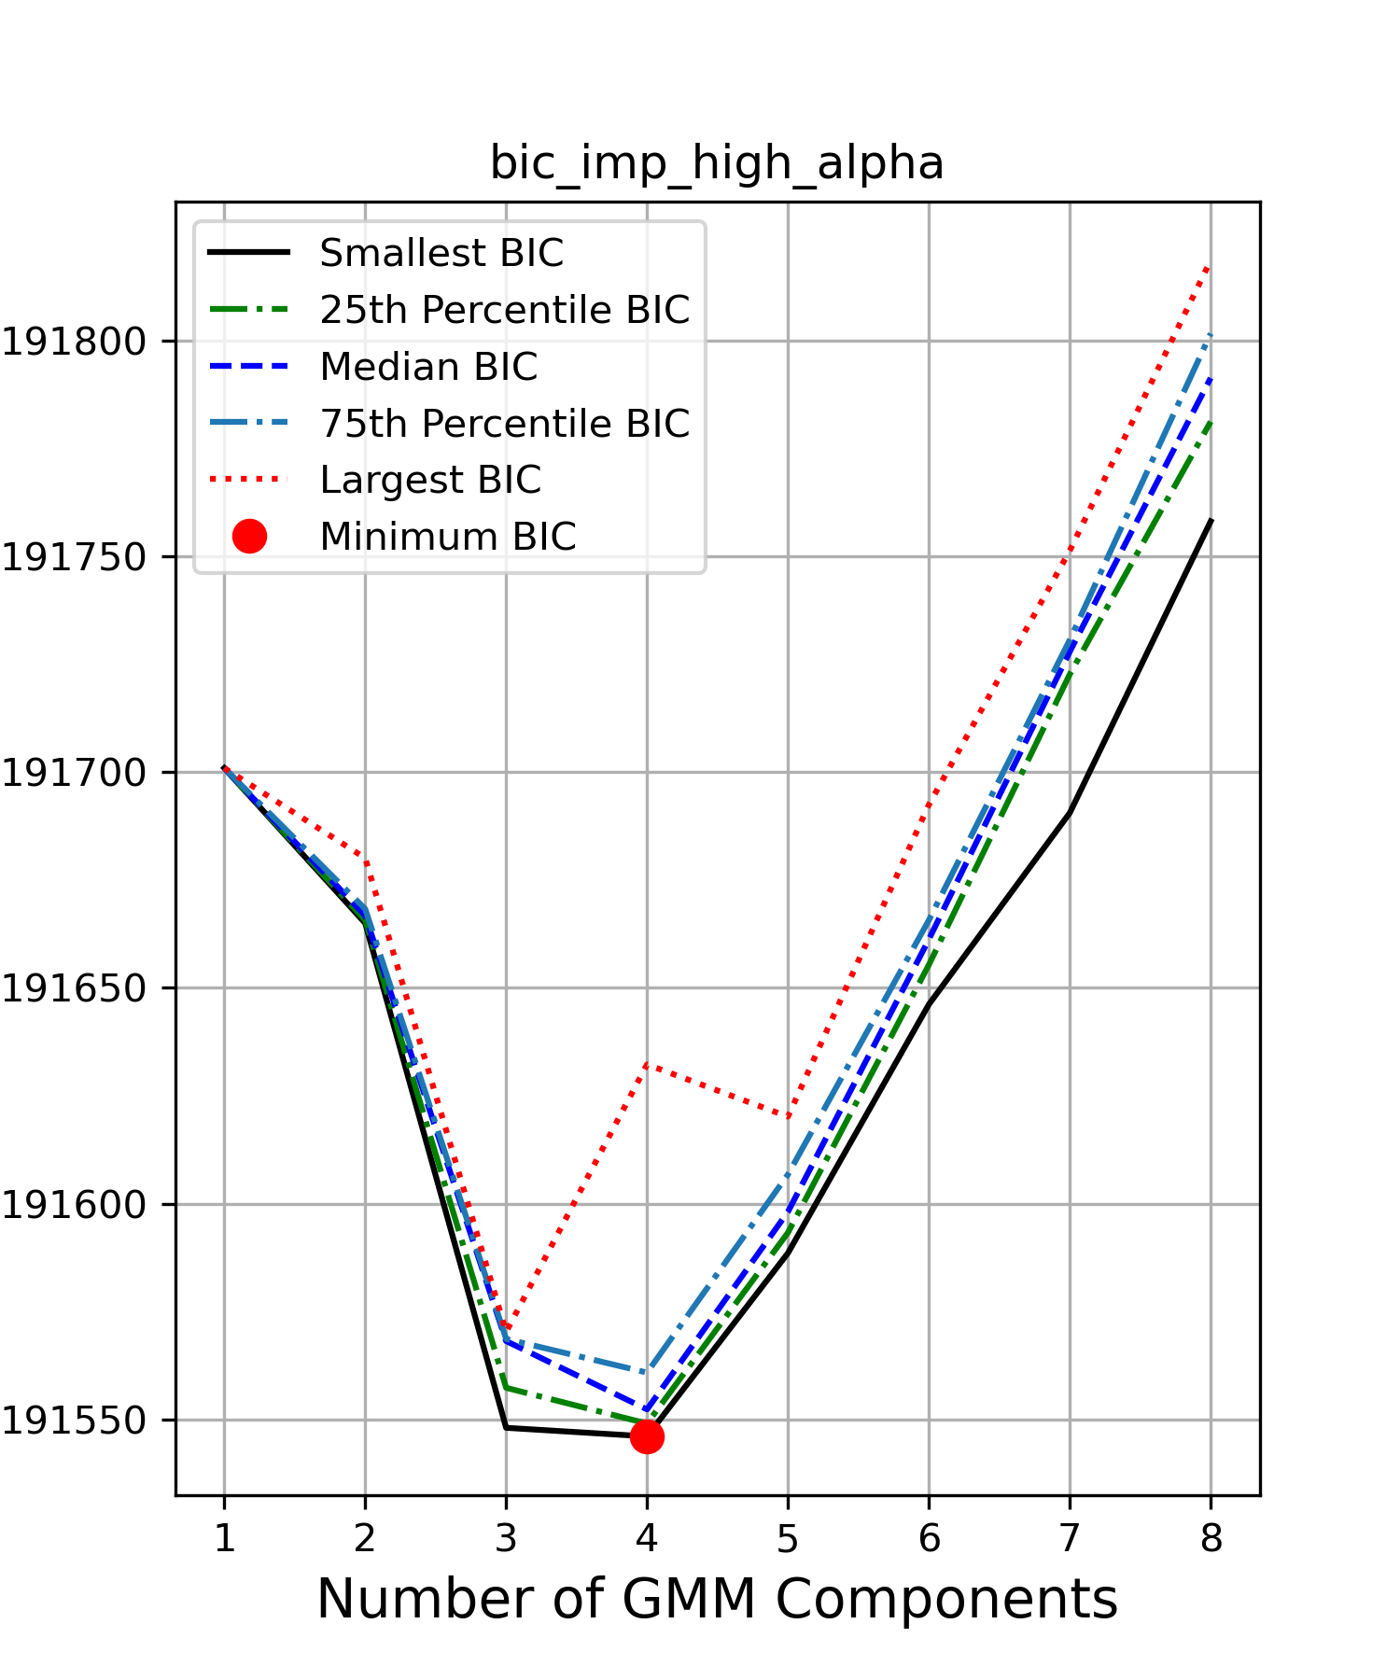
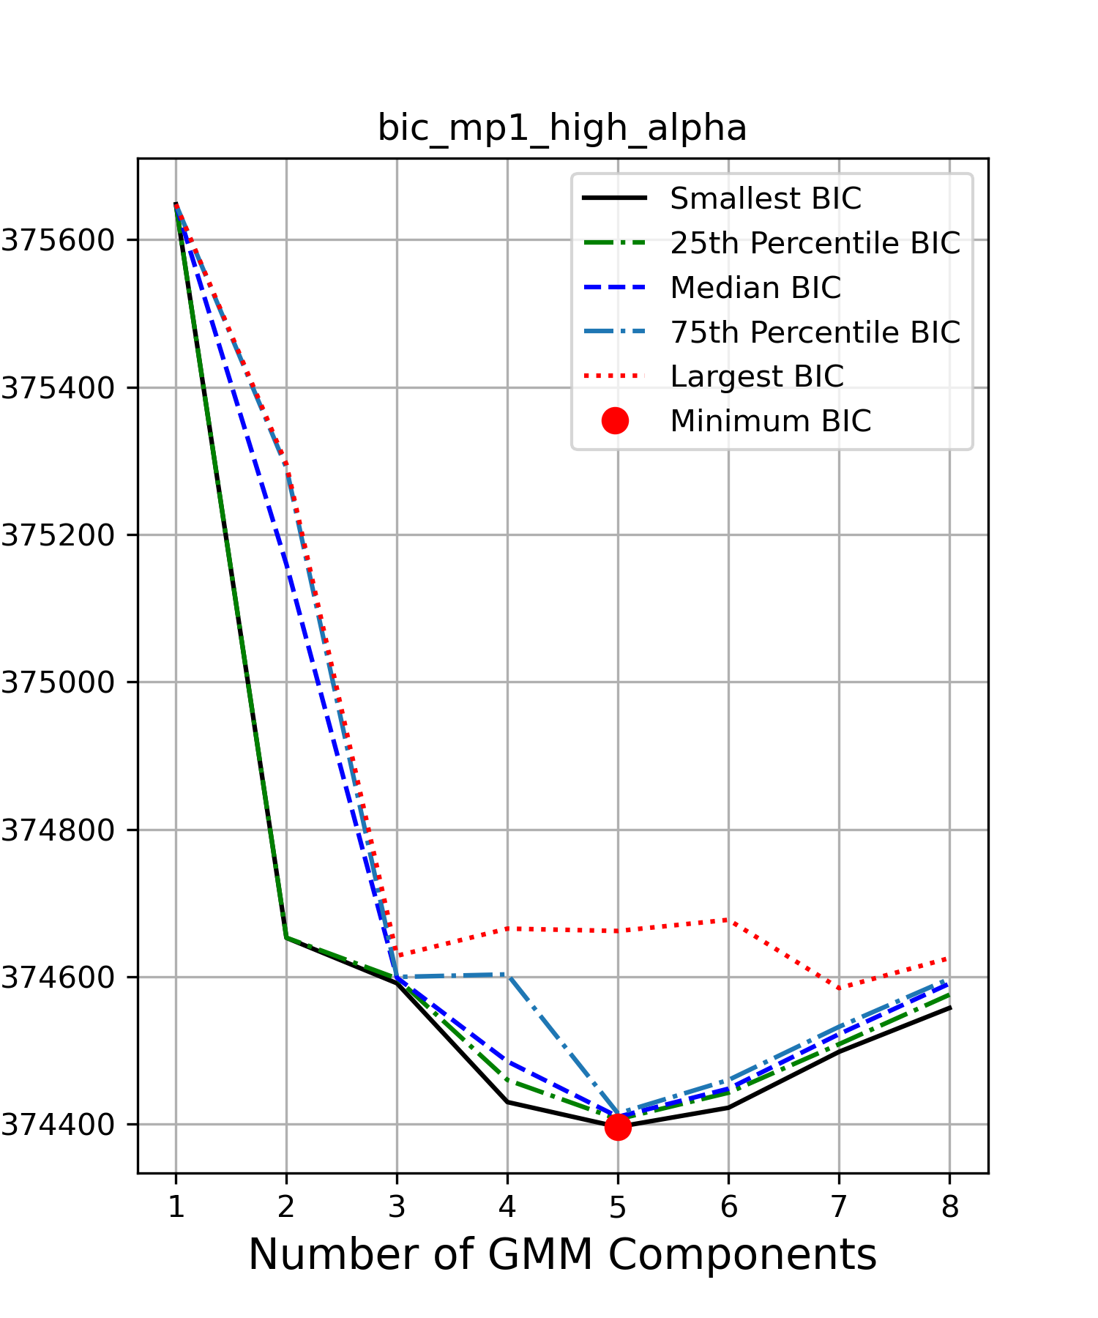
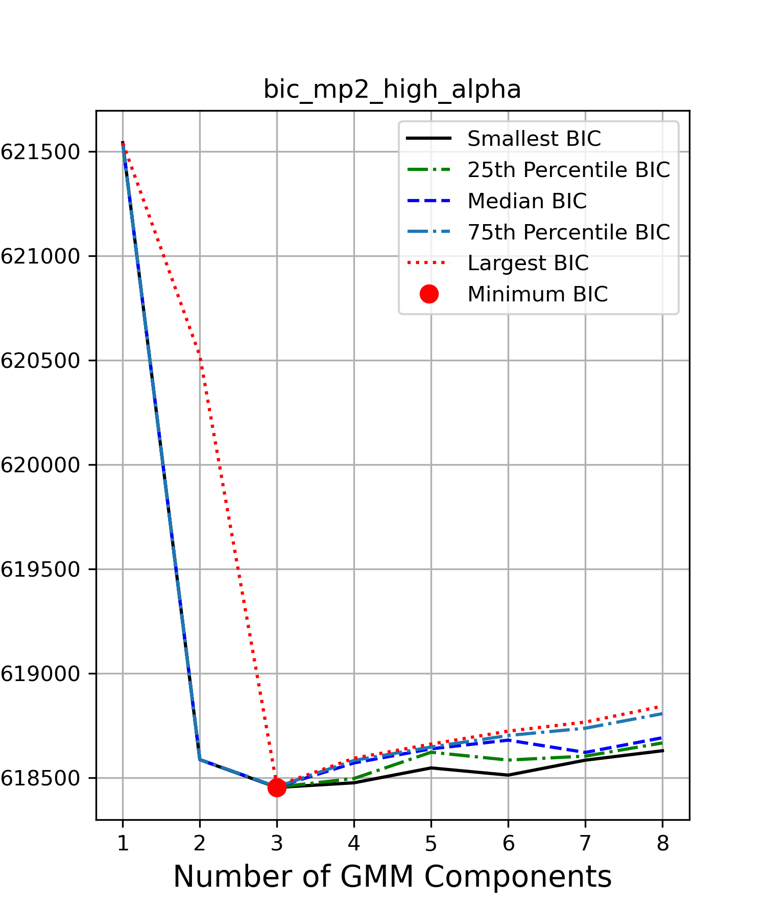
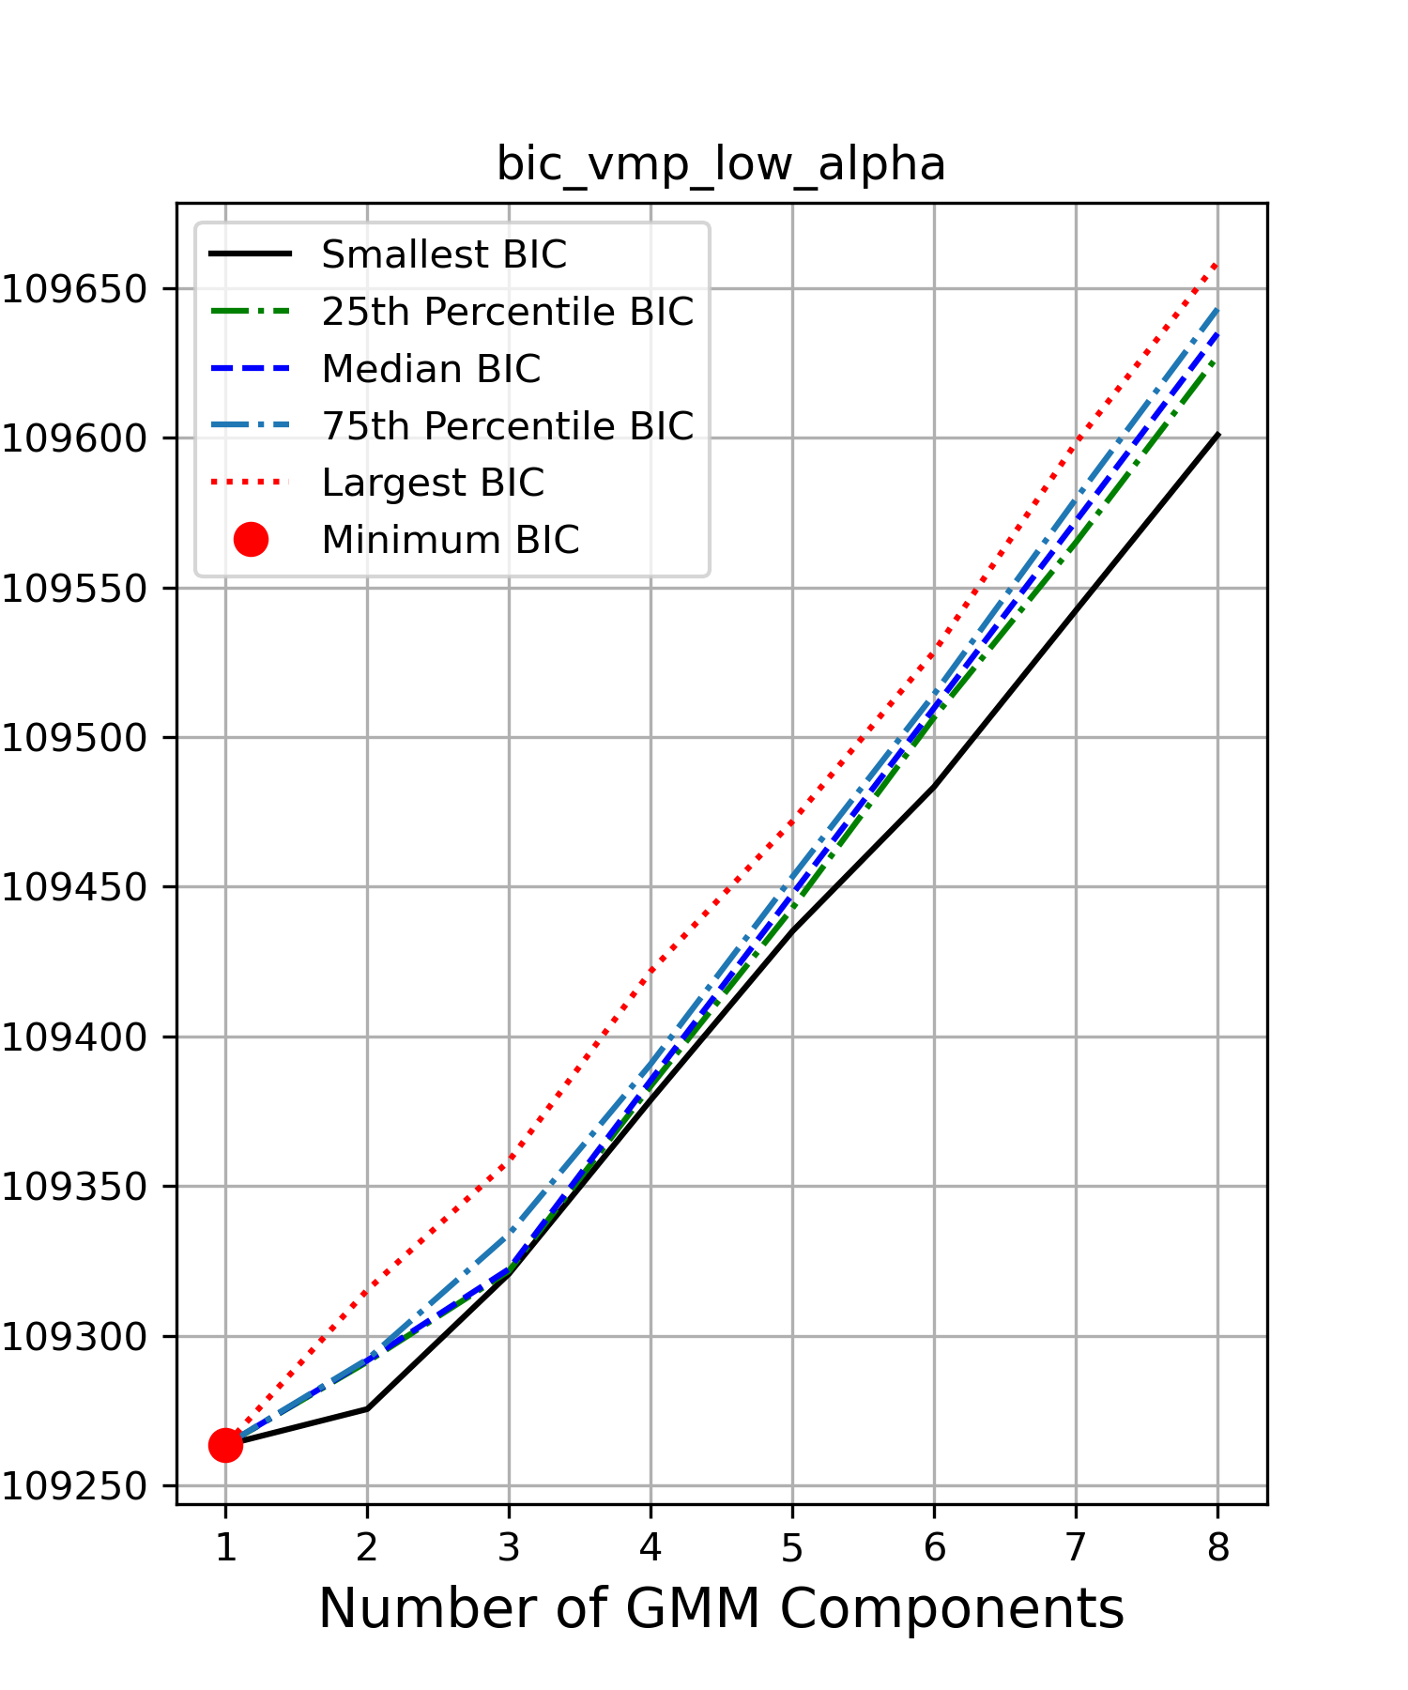
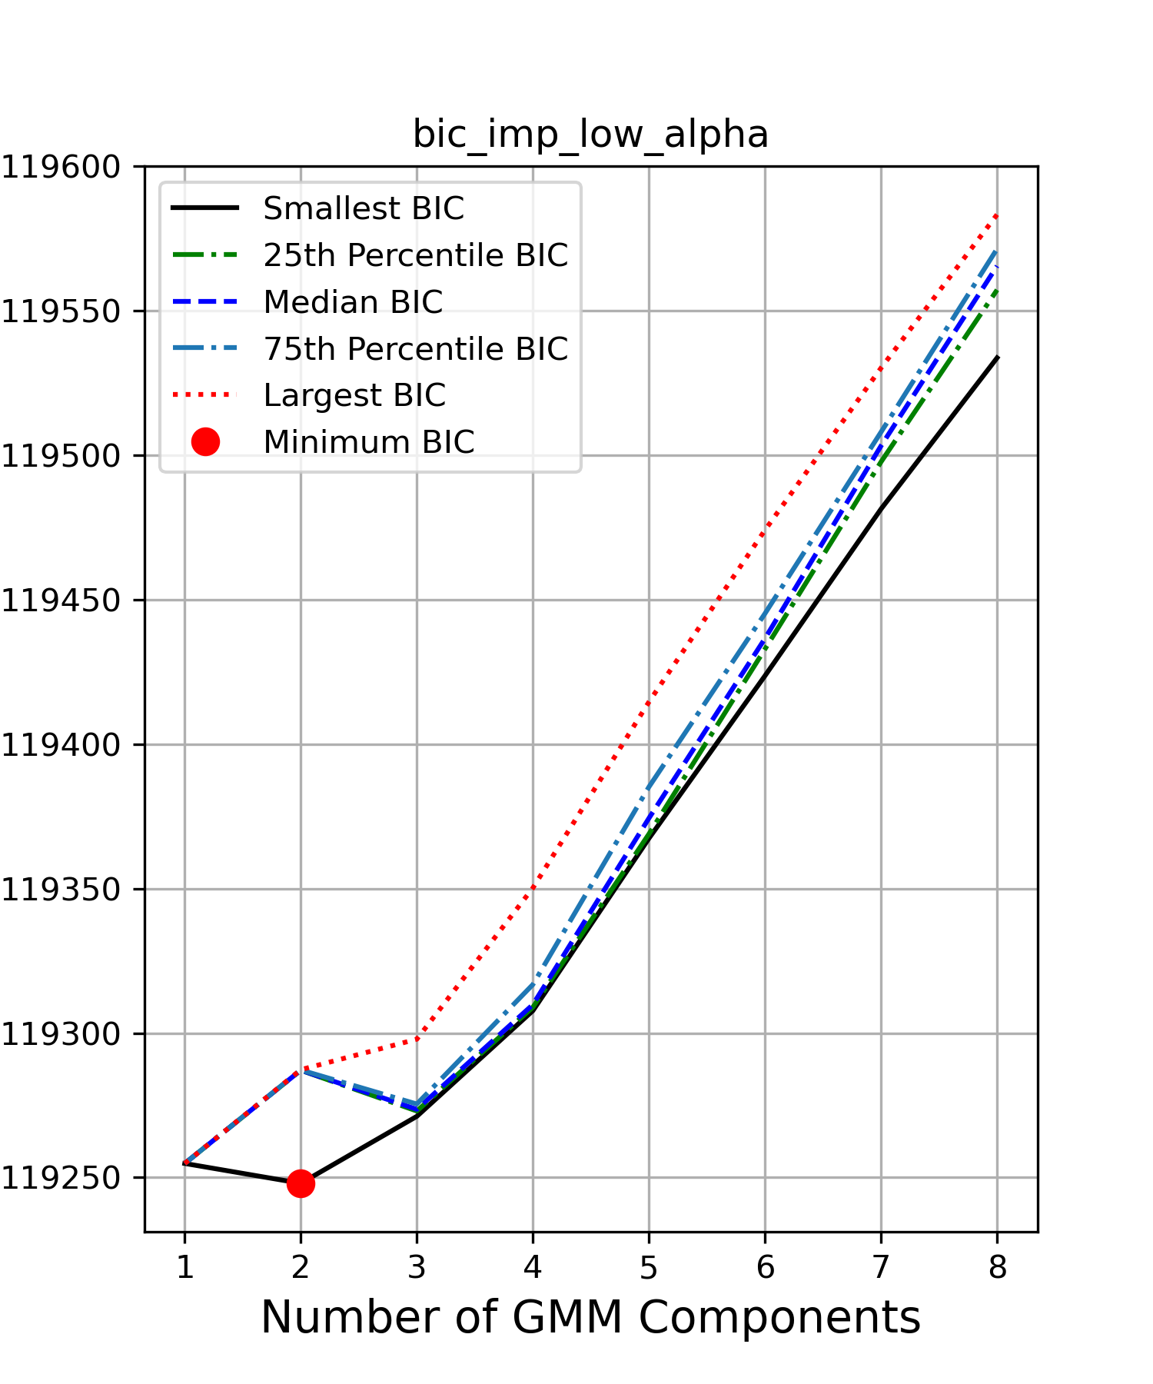
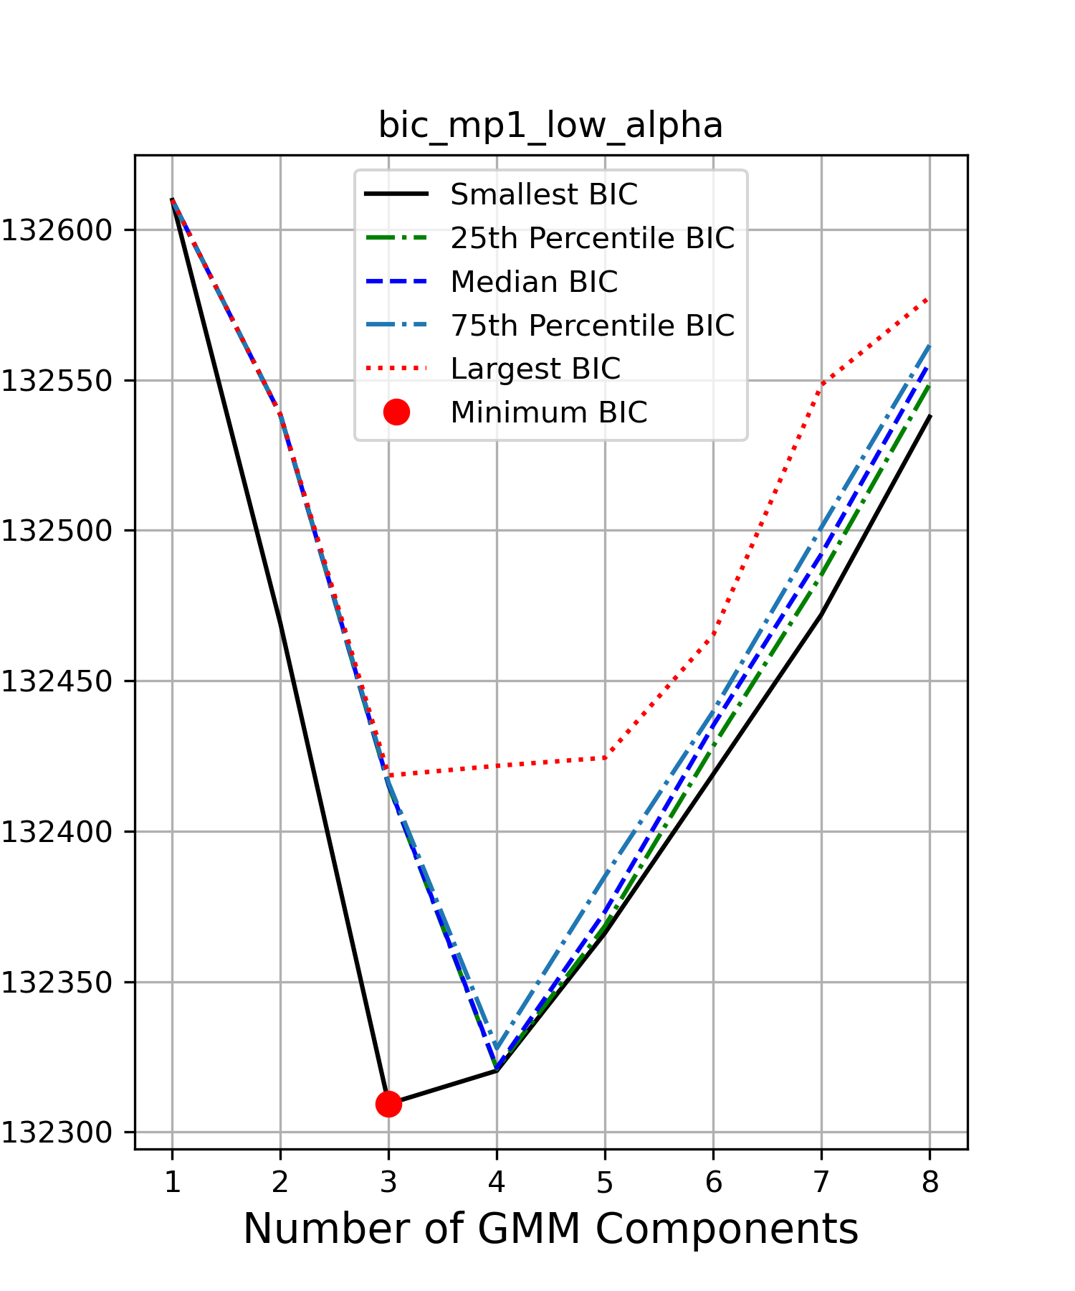
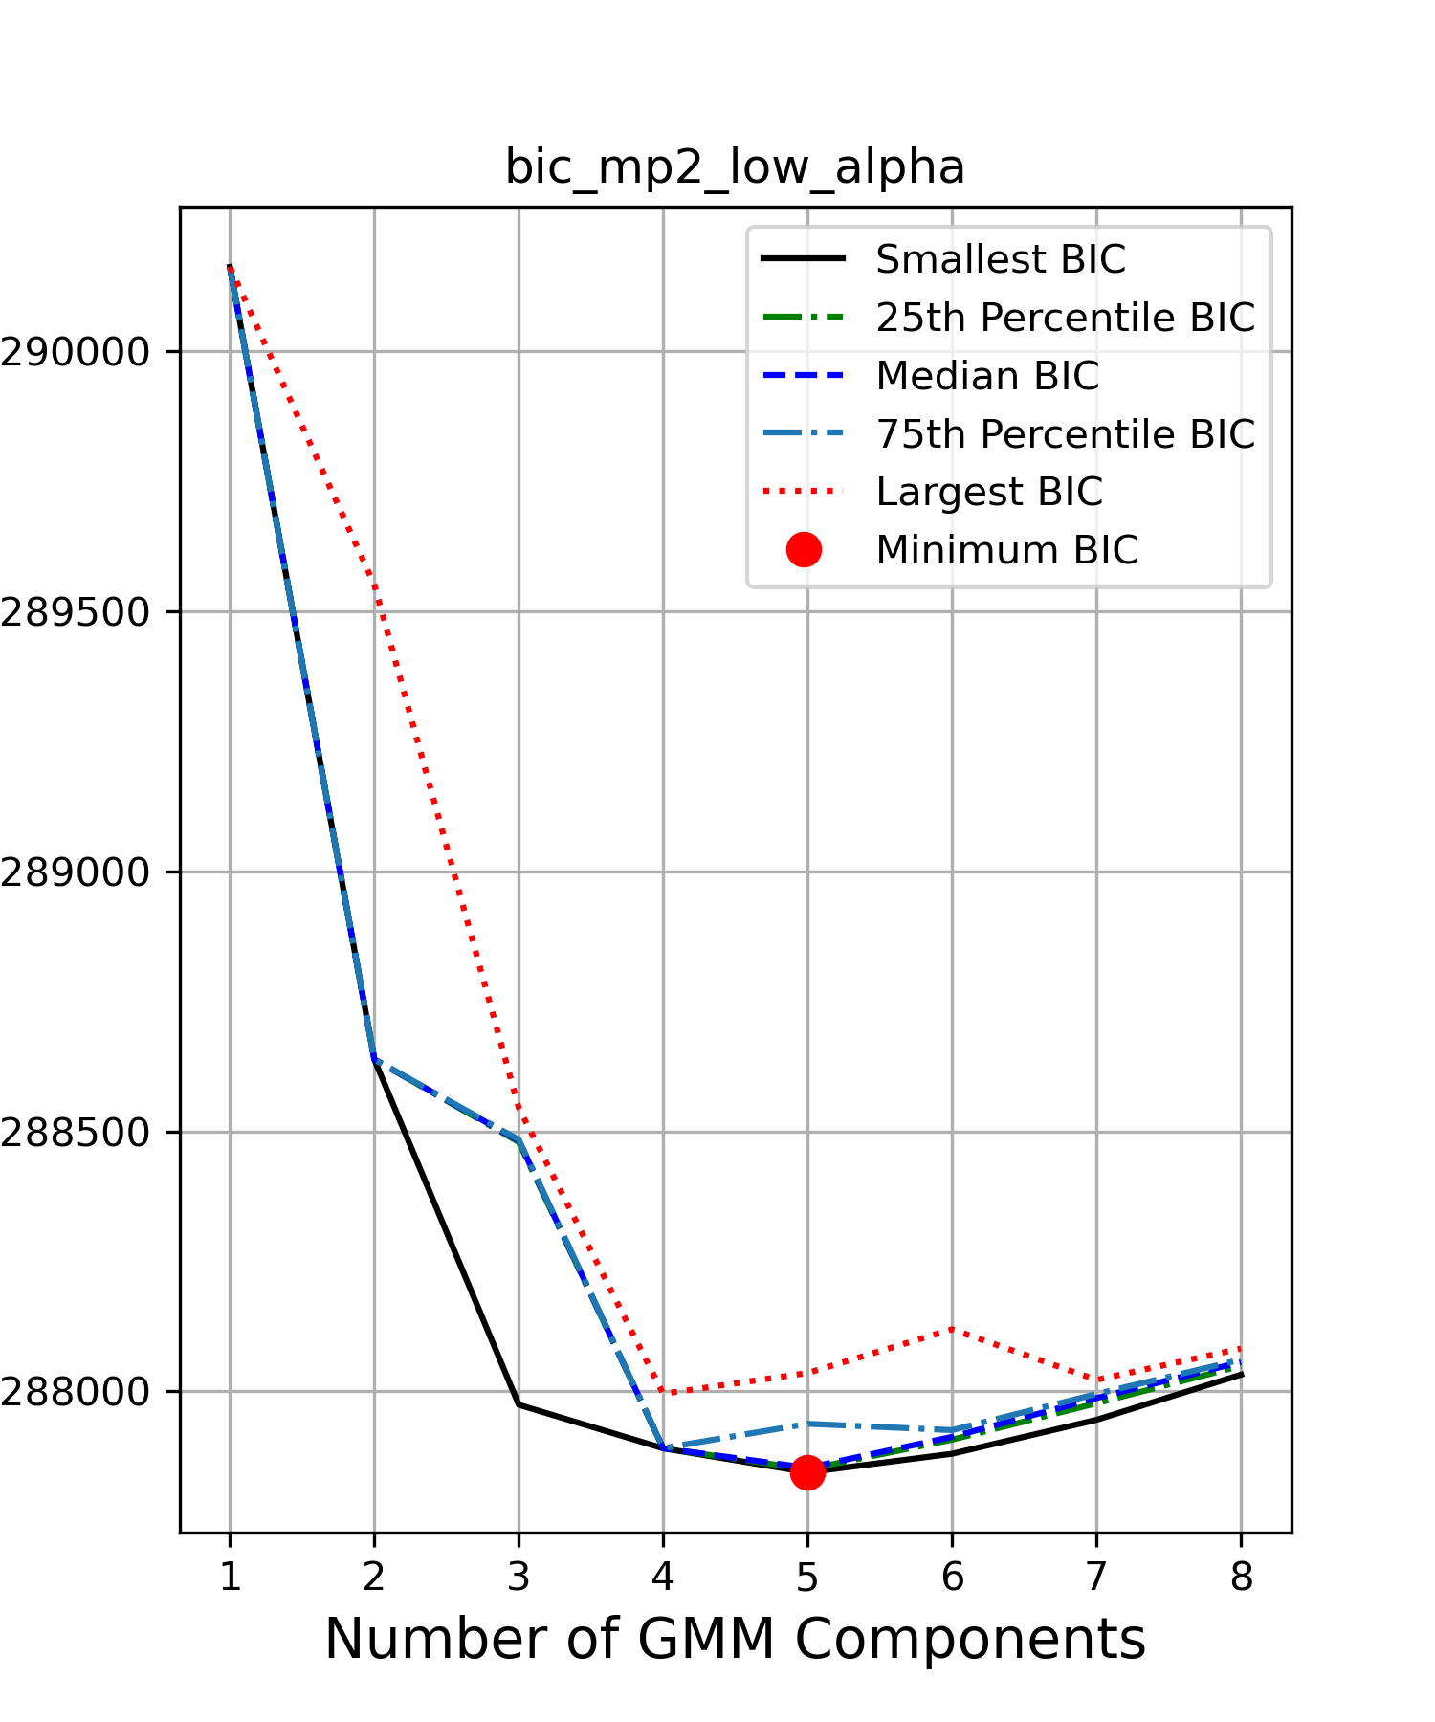
BIC score for high and low alpha
Notes:
We used the same method as before to decide how many gaussian components to fit for each bin in each alpha range

Slide 25
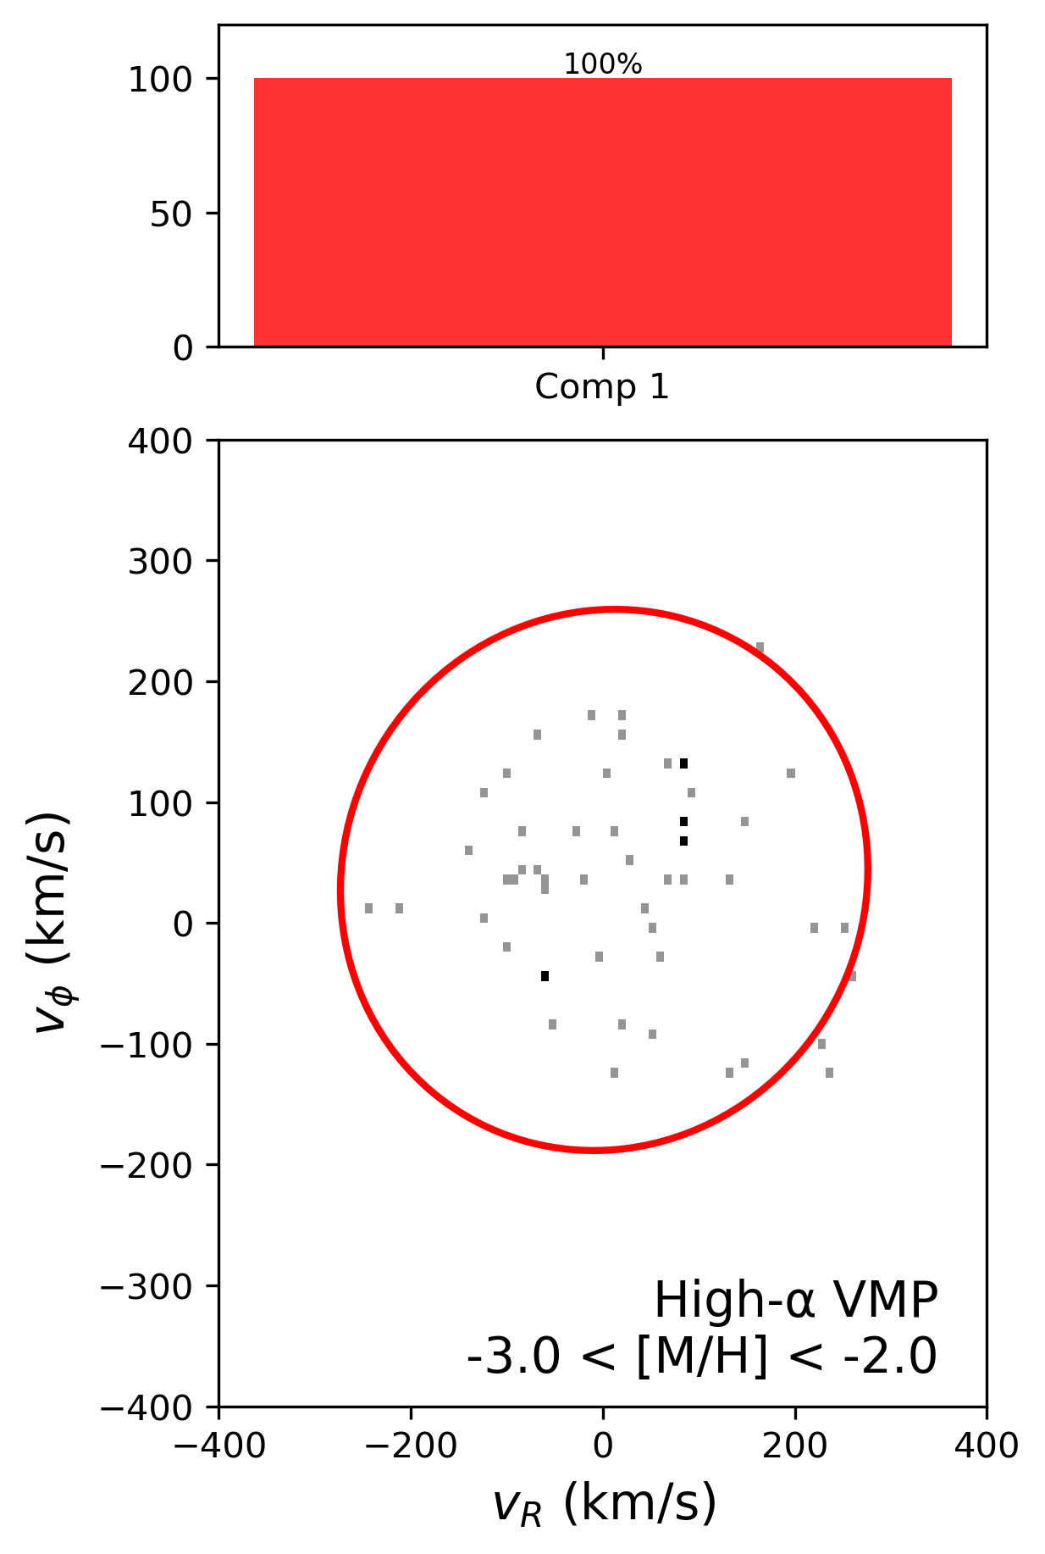
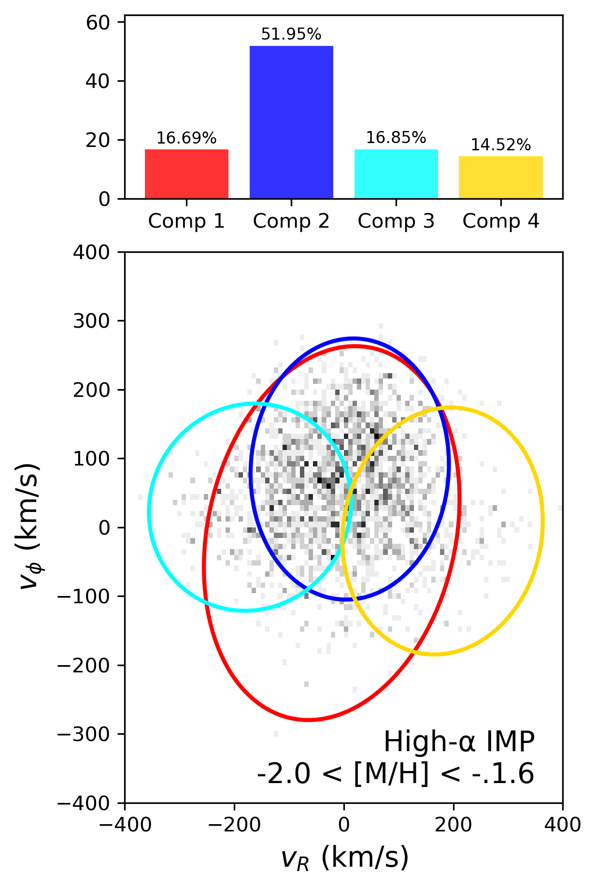
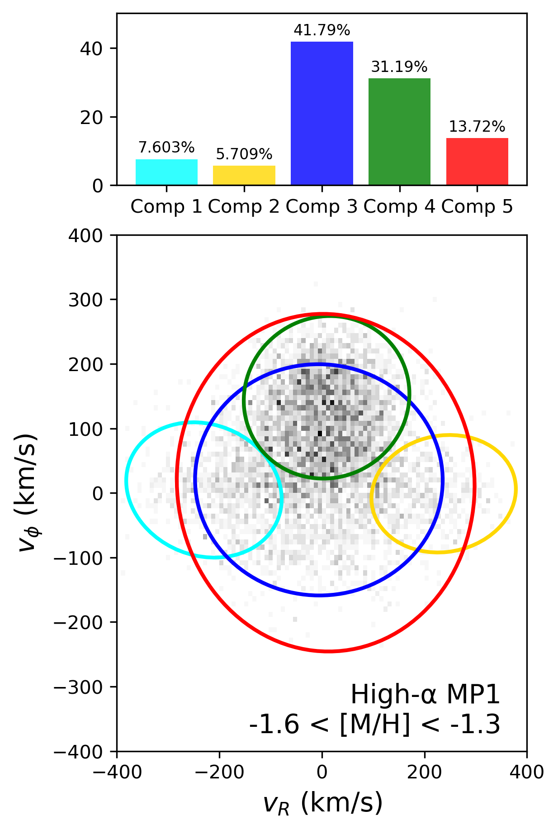
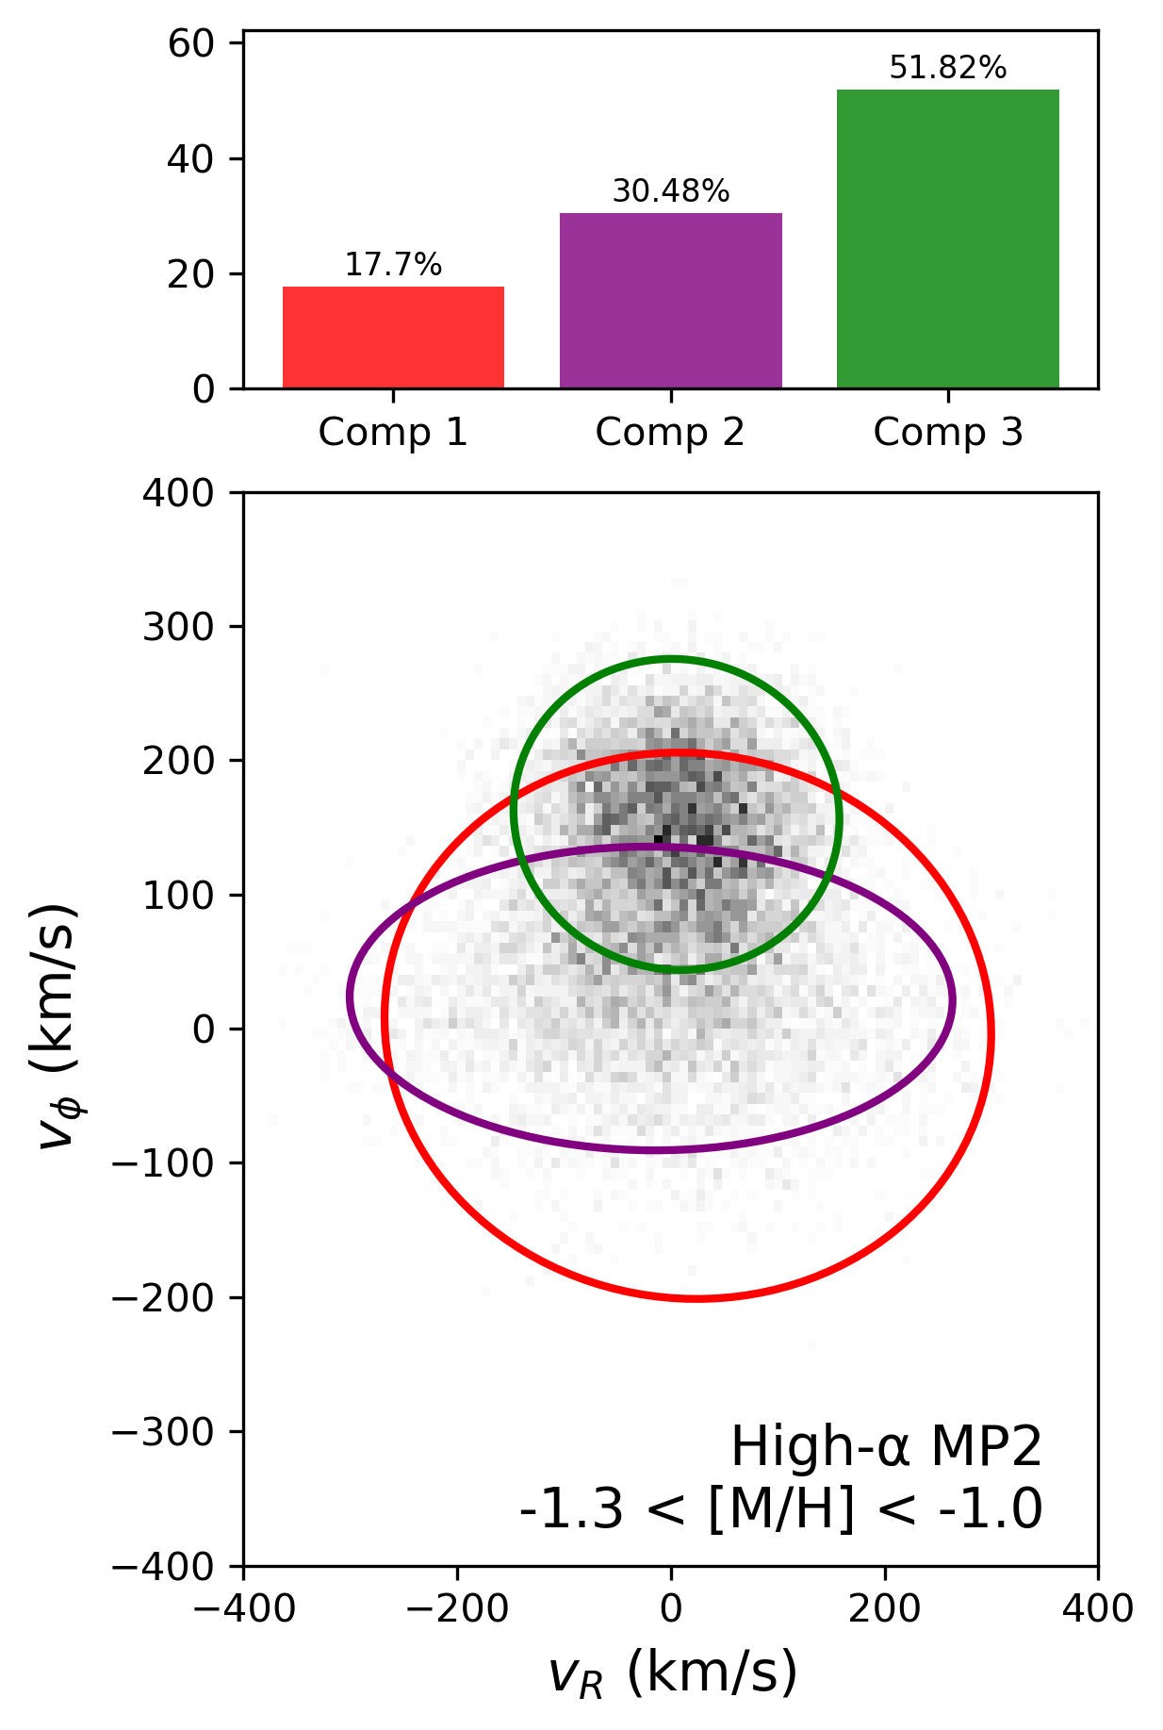
High alpha results
Link
Link
Link
Link
Notes:
- One of the more unexpected outcomes of this analysis is the identification of GS/E components
within the high-α sequence, despite the GS/E progenitor being associated with a slow star
formation history that should result in an α-poor population.
Yet we observe it anyways contrary to theory

Slide 26
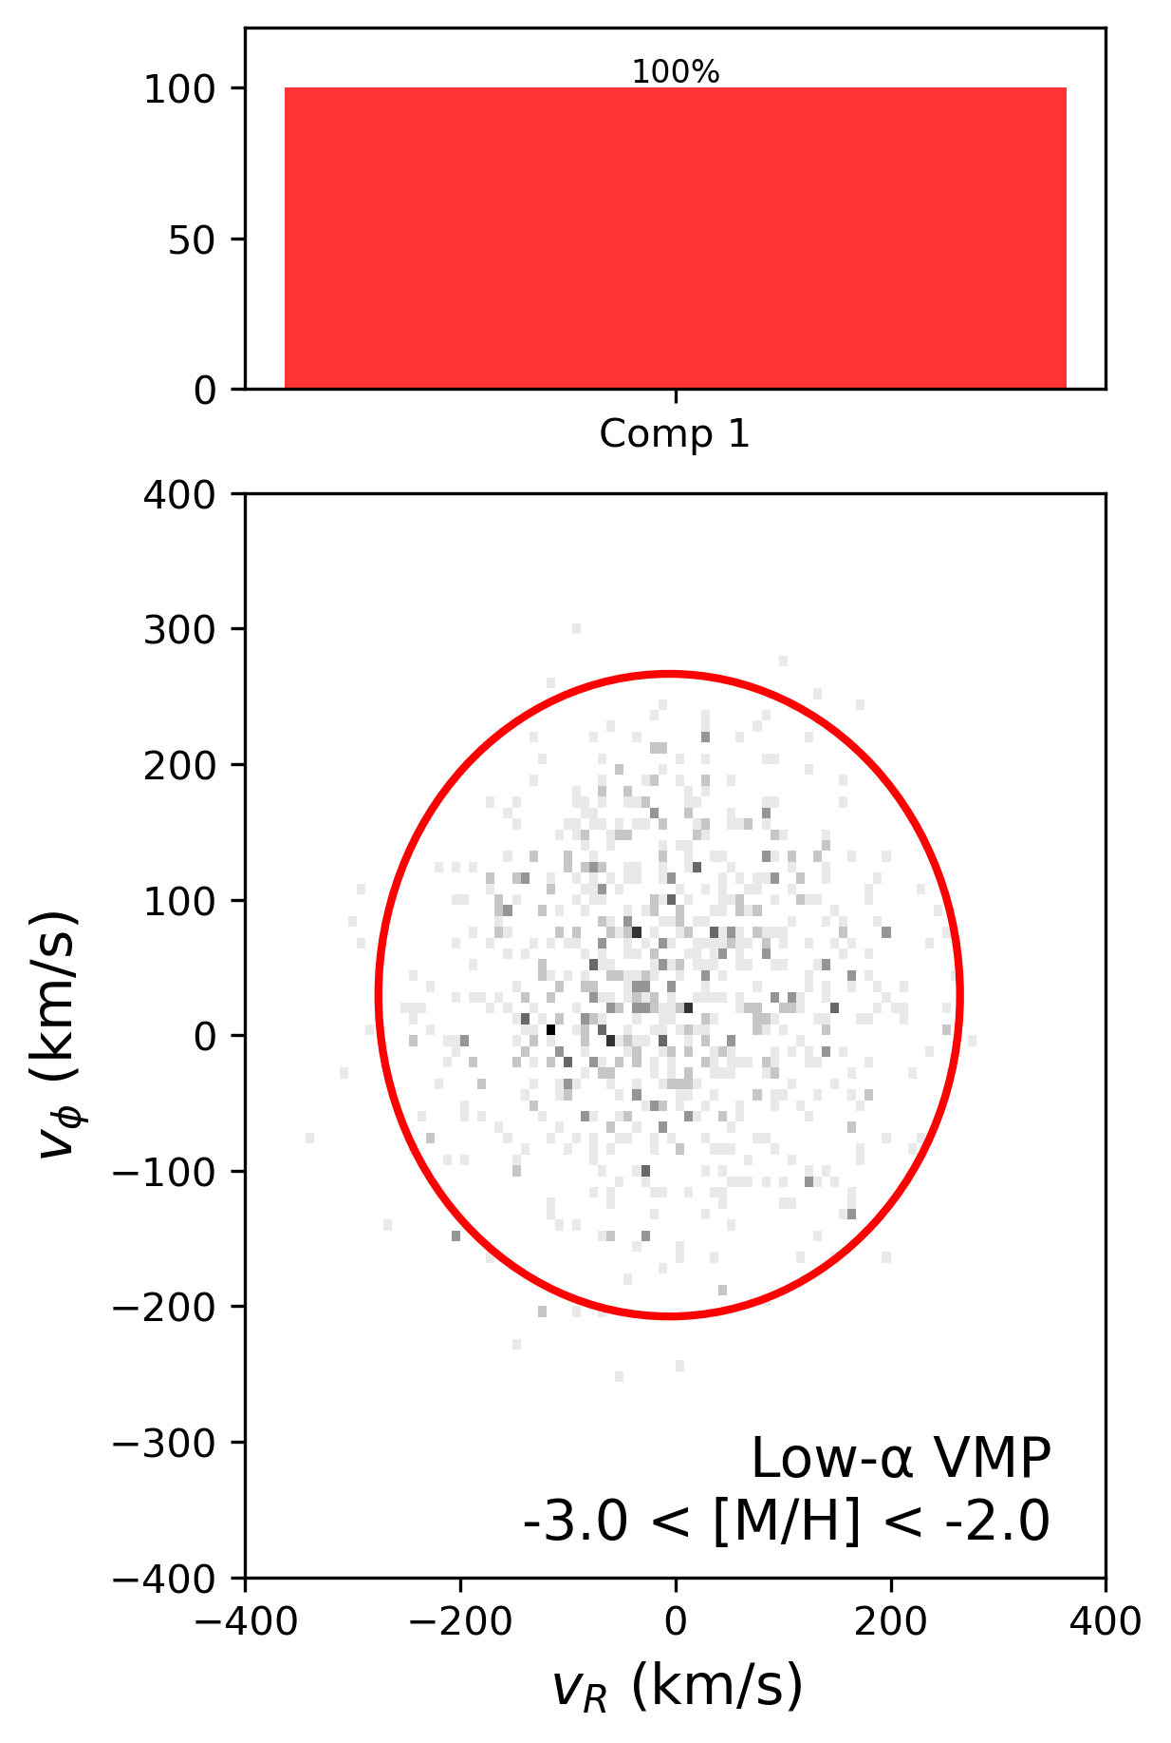
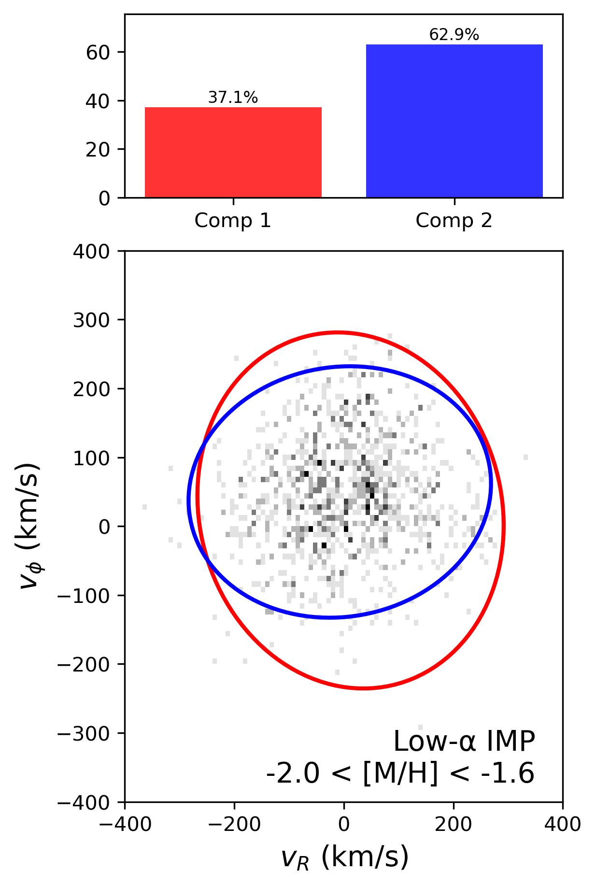
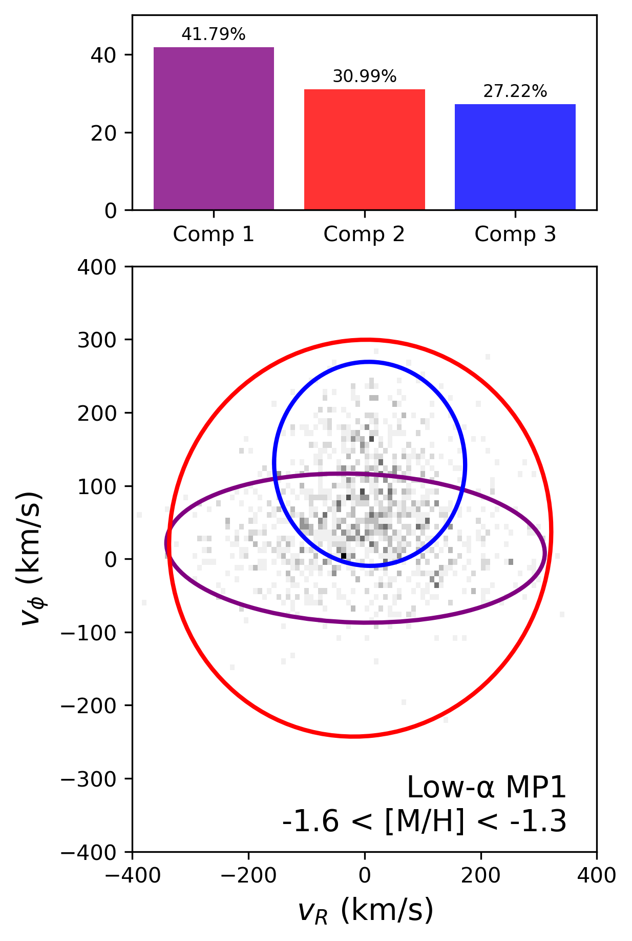
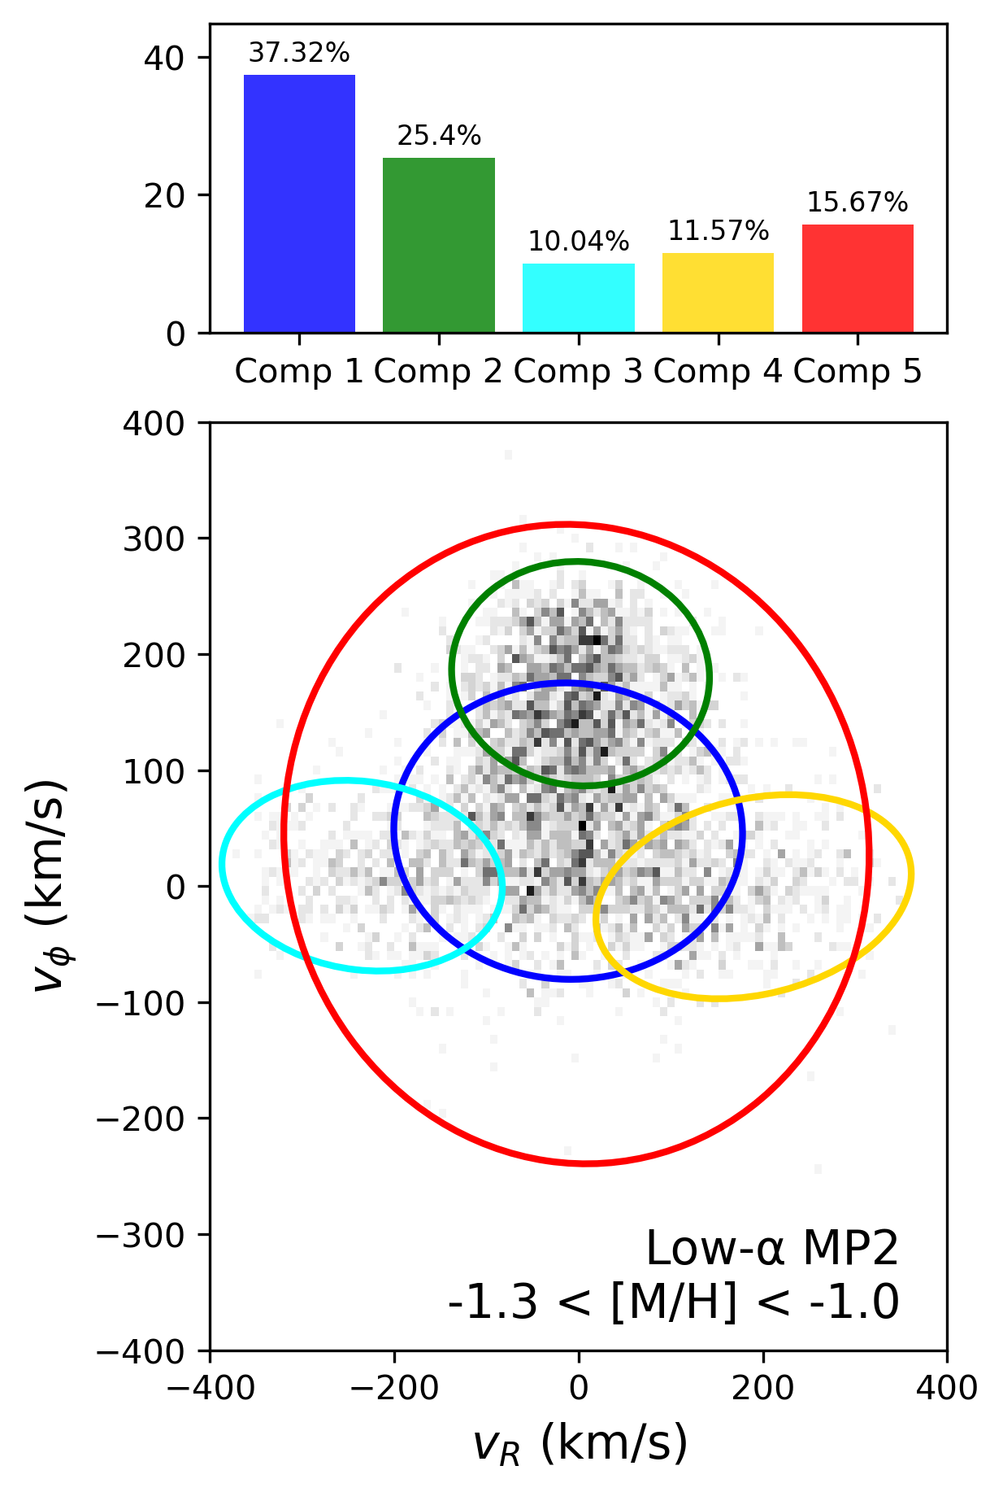
Low alpha results
Link
Link
Link
Link

Slide 27
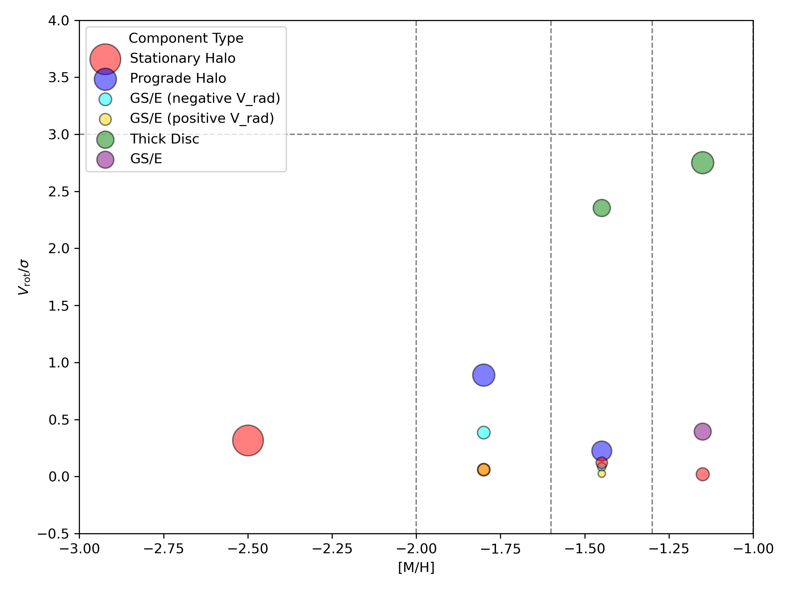
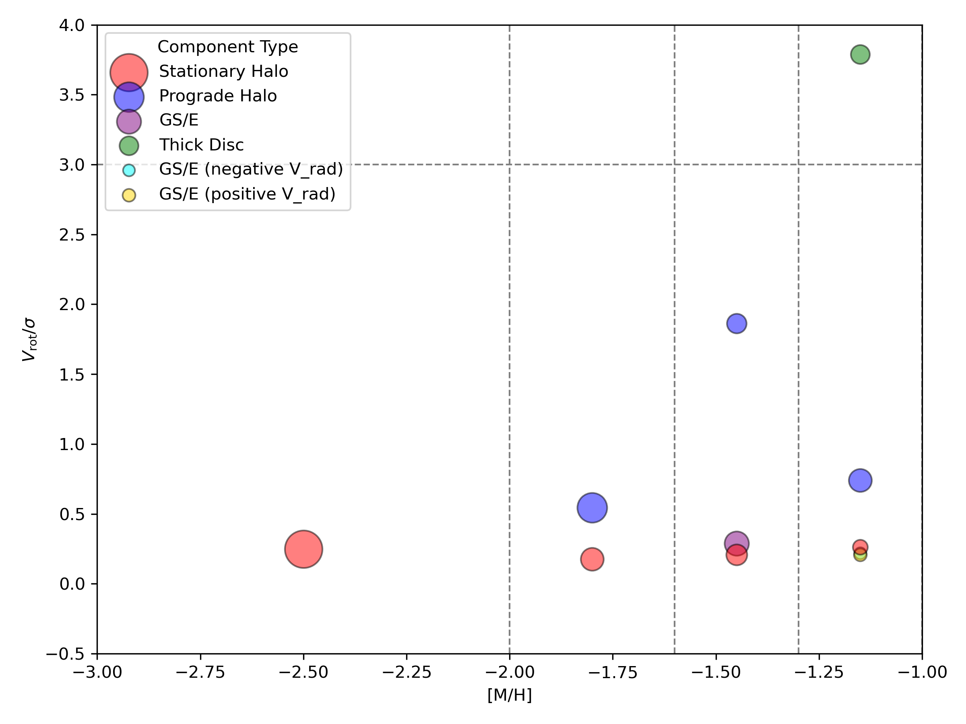
Rotational Support
Notes:
-

Slide 28
High- /Low- Alpha Comparison
Metallicity Bin | High Alpha | Low Alpha
VMP ( < -2 ) | Isotropic, non-rotating halo | Isotropic, non-rotating halo α has little influence on halo here
IMP ( -2 to -1.6) | Two radially biased components Limited rotation (possible misclassified stars) | Distinct prograde + stationary halo components
MP1 ( -1.6 to -1.3) | Emergence of thick disc | GS/E-like halo appears Supports merger-driven structure
MP2 (-1.3 to -1.0) | Hotter, massive disc Gradual disc buildup | high V/σ - Sharp disc onset; dynamically colder.
Notes:
- Starting with the very-metal-poor bin (VMP), where [M/H] < –2:
We see that both the high- and low-alpha populations are dominated by a single, isotropic, non-rotating halo component. This is consistent with a classic stellar halo — broad velocity dispersions and no net rotation.
Now moving into the intermediate metallicity range (IMP; –2.0 < [M/H] < –1.6):
In the low-alpha population, the GMM separates the stars into two components — one stationary and one mildly prograde. This could reflect a true split into a classical halo and an accreted, rotating halo — but it may also be a sign of the model picking up structure where there is none. Meanwhile, in the high-alpha sample, the model fits two radially biased components with very little rotation — again, this may be due to contamination from low-alpha stars or overfitting.
In the MP1 bin (–1.6 < [M/H] < –1.3):
We start to see real structural divergence. A thick disc component clearly emerges in the high-alpha population, with moderate rotational support — suggesting in-situ disc formation is beginning here. At the same time, the low-alpha stars take on a GS/E-like signature, consistent with a population accreted in a massive early merger event, around the same time the high-alpha disc was forming.
Finally, in the most metal-rich bin (MP2; –1.3 < [M/H] < –1.0):
Both sequences show prominent disc components. The high-alpha disc is hotter and more massive — in line with a thick disc. But the low-alpha population shows a sharp rise in pointing to a dynamically colder structure — this is the signature of the thin disc.

Slide 29
Building on Viswanathan et al. 2024
Instead of fixed 2 components (as in Viswanathan et al.), we optimized component number using BIC in each metallicity bin.
Captured complex structures: multiple halo populations, thick disc emergence, and transitions across bins.
GS/E-like kinematics in high-α stars, though GS/E progenitor expected to be α-poor.
Abundance uncertainties at low S/N
Quantify impact of abundance measurement errors on α-sequence classification.
Cross-match with APOGGEE…
Notes:
Instead of assuming a fixed number of two components in each metallicity bin — as Viswanathan and colleagues did — we let the number of Gaussian components vary. We used the Bayesian Information Criterion, or BIC, to select the optimal number of components per bin. This gives us the flexibility to better capture the complexity of the underlying kinematic structure.
we detect multiple halo populations, trace the emergence of the thick disc, and observe smooth transitions across metallicity bins that a two-component model would miss.
I am interested to see a visualisatio of Viswanathan’s GMMs, the claim is that one component is disk like and the other is halo like, but I am not so sure given the other components that are prominent.
Interestingly, we even detect GS/E-like kinematics in the high-alpha population.
This raises the possibility that some high-alpha stars may have been misclassified, particularly at low signal-to-noise where abundance measurements become more uncertain.
Going forward, we’d like to quantify how these abundance errors might influence alpha-sequence classification, and ideally, cross-match with APOGEE to test the robustness of the trends we’re seeing.

Slide 30
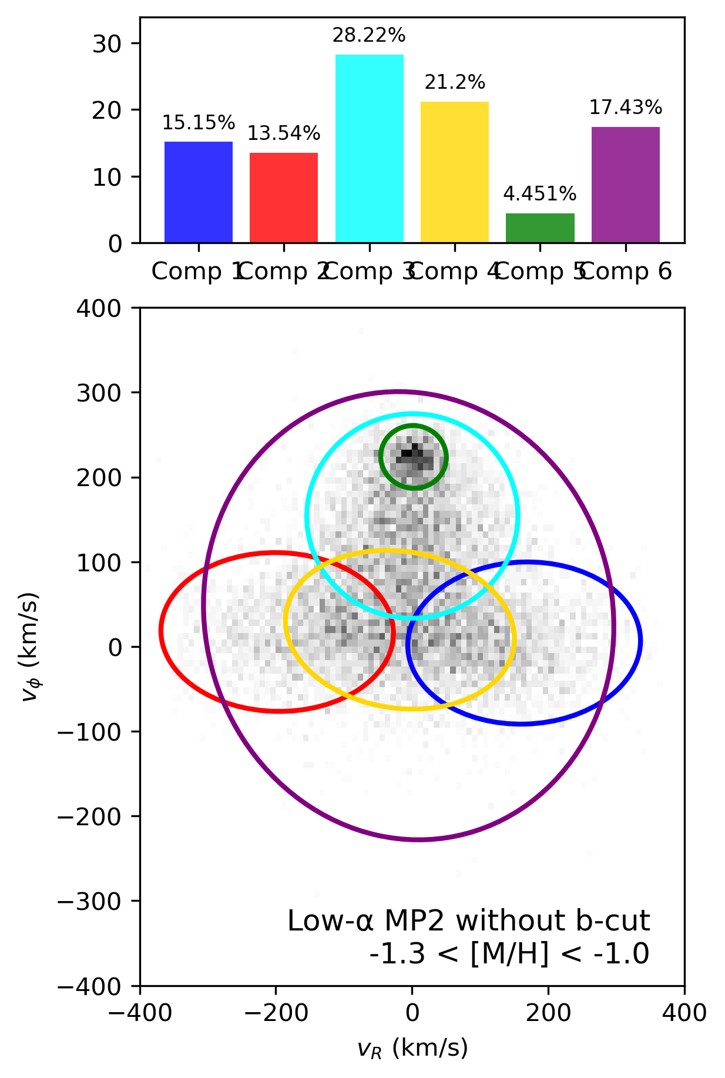
Selection Effects
Galactic latitude cut excludes stars near the disc midplane → suppresses thin disc detection
Low-α cold disc component at high [M/H] appears when this cut is relaxed — excluded from analysis to avoid bias
Focus is on disc onset and halo-disc transition, not on the well-established thin disc
Bias sample towards disc stars
Increase abundance uncertainty (Gaia XP less reliable in high extinction)
Obscure kinematic transitions central to the study
Not representative of the entire Milky Way
Notes:
First, our galactic latitude cut excludes stars close to the disc midplane. This was necessary to reduce extinction and abundance uncertainties, but it does suppress our ability to detect the thin disc — especially the coldest components.
In fact, when we relax this cut, we do see a clear low-alpha cold disc population emerge at high metallicity — as shown on the right.
we’ve chosen to exclude these stars from the main analysis our focus here is on the onset of disc formation and the transition from halo to disc populations.
If we were to relax the latitude cut, we’d bias the sample toward disc stars, increase abundance uncertainties from extinction, and risk obscuring the very transitions that are central to this study.
So while our results provide useful insight into Galaxy formation, we should be clear: this sample is not representative of the Milky Way as a whole.

Slide 31
GMM limitations
GMMs impose symmetric, ellipsoidal velocity structures
Oversimplifies true non-Gaussian Galactic kinematics
For example:
Thin disc: non-Gaussian due to asymmetric drift
GS/E debris: bimodal radial velocity structure
Galactic bar: induces asymmetric resonances
Notes:
GMMs — or Gaussian Mixture Models — assume that each component has a symmetric, ellipsoidal velocity distribution. That’s a strong assumption, and it means GMMs can oversimplify the true kinematic structure of the Galaxy, which is often far from Gaussian.
The thin disc is skewed due to asymmetric drift
And the Galactic bar can induce asymmetric resonances that distort the local velocity field

Slide 32
Next step: Physically Meaningful Models
We need models that are grounded in dynamics and the Galactic Potential
ROADMAPPING/AGAMA
Fits action-based distribution functions to observed data
Can fit for realistic kinematics (asymmetric drift, velocity anisotropy)
Links structure directly to mass and orbit distribution
Fit multi-component DFs (eg. thick + thin disc, halo) using real Gaia kinematics.
May allow us to extract clean population boundaries and their dynamical properties.
Notes:
So the next step is to move toward physically meaningful models — models that are grounded in Galactic dynamics and the gravitational potential.
One promising route is using tools like RoadMapping or AGAMA.
These methods fit action-based distribution functions to the observed kinematics.
That means they can naturally account for important physical effects like asymmetric drift and velocity anisotropy.
More importantly, they directly tie kinematic structure to the mass distribution and orbital properties of stars.
this approach may help us identify clean boundaries between different stellar populations
So the goal now is to go beyond classification — and move towards truly dynamical understanding of the Milky Way.

Slide 33
Next step: Simulations
AURIGA
Cosmological zoom-in simulations of Milky Way-like galaxies
Include realistic disc formation, mergers…
Resolve the build-up of stellar components over time
Fire-2
High resolution simulations
Track individual enrichment events from core-collapse & Type Ia Sne
Provide detailed [M/H] and [α/Fe] evolution
Test alpha sequence boundaries over time
Compare disc formation epochs
Validate major merger signatures
Generate synthetic surveys (use the same selection cuts)
Notes:
To complement the observational work and physically motivated modelling, the next step is to turn to cosmological simulations.
Simulations like Auriga offer detailed zoom-in models of Milky Way-like galaxies. They incorporate realistic physics — including disc formation, mergers, and stellar feedback — and crucially, they let us trace the buildup of different stellar components over time.
We can also look at simulations like FIRE-2, which go one step further in resolution. FIRE tracks individual enrichment events from both core-collapse and Type Ia supernovae. This allows us to follow the chemical evolution in detail, including metallicity and [α/Fe] trends
Do alpha sequence boundaries shift over time in the same way we observe?
When exactly do the discs form, and how do they grow?
Can we validate signatures of major mergers, like GS/E, in the simulated kinematics?
And finally, can we generate synthetic surveys?

Slide 34
Next step: Extra-Galactic surveys
JWST
Can resolve individual red giants in low surface brightness outskirts of galaxies beyond the Local Group.
NIRSpec captures key spectral features (CO, CN, Fe lines) Meaning can derive metallicities and alpha abundances.
LSST Rubin
Will map entire galactic discs over a decade
Can deliver sub-milliarcsecond/year proper motions for bright stars
Combination
JWST for chemical abundance, LSST for phase-space information
Galaxy formation experiment across the nearby universe.
Notes:
To push beyond the Milky Way, we can also look outward — to extra-galactic surveys.
With JWST, we now have the capability to resolve individual red giant stars in the low surface brightness outskirts of galaxies far beyond the Local Group. Using instruments like NIRSpec, we can capture critical spectral features — CO, CN, Fe lines — giving us access to both metallicities and alpha-element abundances in these remote systems.
Then there’s LSST Rubin, which will survey the sky over the next decade and map full galactic discs in exquisite detail. Crucially, it will also deliver proper motions at the sub-milliarcsecond-per-year level for bright stars — opening up proper motion studies of nearby galaxies.
JWST gives us the chemistry; LSST gives us the kinematics.

Slide 35
Conclusion
Successfully Reproduced of Zhang et al. 2024
Built on analysis by Viswanathan et al 2024. by dynamically fitting gaussians to fit physical structure.
Room for extension with new observational tools
Room for simulation-based methods to get more data and to use it as a test platform.
Notes:
I successfully reproduced the results of Zhang et al. (2024), validating their finding of a metal-poor disc component using kinematic decomposition.
I then built on the analysis by Viswanathan et al. (2024) by applying dynamical Gaussian fitting — taking a step closer to mapping statistical components onto physically meaningful Galactic structure.
There's clear room for extension, especially as new observational tools like JWST and LSST come online.
And finally, this framework is well-suited to simulation-based work, both to test predictions and to use as a sandbox for understanding how structures like discs and halos form and evolve.
Thank you

